Slide 1



NUMERICAL INVESTIGATION ON CONVECTIVE HEAT TRANSFER ENHANCEMENT USING VARIOUS NANO FLUIDS AND DIFFERENT DUCT GEOMETRIES
PRESENTED BY:
Sai Praneeth 711956
Srikar 711928
Sai Ganesh 711919
Yuvaraj 711961
SUPERVISOR
Dr. Santhosh kumar
Associate Dean,
Dept. of Mechanical Engineering

Slide 2
Contents
Introduction----------------------------------------------------------------------------
Applications----------------------------------------------------------------------------
Literature Review--------------------------------------------------------------------
Gap Analysis------------------------------------------------------------------------
Objectives-----------------------------------------------------------------------------
Problem Description-----------------------------------------------------------------
Methodology--------------------------------------------------------------------------
Numerical Methodology (Governing Equations)---------------------------------
Geometric Descriptions--------------------------------------------------------------
Boundary Conditions-----------------------------------------------------------------
Meshing---------------------------------------------------------------------------------
Grid Independent Analysis-----------------------------------------------------------
Validation-------------------------------------------------------------------------------
Data Reduction-------------------------------------------------------------------------

Slide 3
Contents
Material Properties of Particles -----------------------------------------------
Correlations Formulas varying by ----------------------------------------------- volumetric concentrations
Thermo-Physical properties of Nano Fluids -----------------------------------
Results and Discussion--------------------------------------------------------------
Conclusions---------------------------------------------------------------------------
Future Work--------------------------------------------------------------------------
Nomenclature------------------------------------------------------------------------
References---------------------------------------------------------------------------

Slide 4
Introduction
Fossil fuels are non-renewable sources of energy extracted from dead plants and animals.
They cause environmental pollution, contribute to climate change, and have finite reserves and major contributors to air and water pollution.
Extraction and transportation can cause environmental disasters, and dependence on them can cause economic vulnerability.
Burning fossil fuels emits greenhouse gases and contributes to global warming.
Solar water heaters use sunlight to heat water for domestic or industrial use.
They are cost-effective, environmentally friendly, and reduce dependence on fossil fuels.
Solar water heaters use sunlight to heat water for domestic or industrial use.

Slide 5
Introduction
They are cost-effective, environmentally friendly, and reduce dependence on fossil fuels.
Solar water heaters require minimal maintenance and emit no greenhouse gases.
They can be installed in homes, hotels, hospitals, and other buildings to provide hot water.
Infusing pure water with nano particles can significantly improve the convective heat transfer efficiency of solar water heaters.
This technique involves adding tiny metal or metal oxide particles to the water to enhance its thermal conductivity, allowing it to absorb and transfer heat more efficiently.
In our project we are analysing the effect of using SiO₂ TiO₂ and Al₂O₃ based nano fluids in improving the convective heat transfer of solar water heater.

Slide 6
Applications:
Heat Exchangers.( Heat exchangers are used more often to dissipate heat )
Laser cooling
Cooling techniques
Thermal reservoirs
Usage of Boilers

Slide 7
Literature Review:
Authors | Flow passage | Type of Nanofluid | Outcomes
Ferrouillat, S., Bontemps, A., Ribeiro, J. P., Gruss, J. A., & Soriano, O. (2011) | circular tube | CuO/water nanofluid | Both theoretical and experimental results indicate that heat-transfer coefficients increase with nanoparticle concentration as well as the Peclet number.
Mohammed, H. A., Om, N. I., Shuaib, N. H., Hussein, A. K., & Saidur, R. (2011). | Equilateral triangular duct | Au , SiO2/water nanofluid | . It is found that SiO 2 nanofluid has the highest Nusselt number while Au nanofluid has the lowest Nusselt number among other nanofluids. The apex angle of the triangular duct has remarkable influence on the Nusselt number. An increasing of the duct apex angle decreases the Nusselt number value.
Hanks, R. W., & Cope, R. C. (1970). | isosceles triangular cross section | water | for the case of steady, isothermal, fully developed flow of Newtonian fluids in straight ducts of constant isosceles triangular cross section., the simultaneous existence of macroscopically large stable regions of laminar and turbulent flow are predicted to occur during the transition phenomenon.

Slide 8
Literature Review:
Authors | Flow passage | Working fluid | Outcomes
Aggarwala, B. D., & Gangal, M. K. (1975) | equilateral and right isosceles triangles | CuO/water nanofluid | solving an integro-differential eigenvalue problem arising in the discussion of laminar flow development in ducts. Application is made to equilateral and right isosceles triangles..
Ali, M. E., & Al-Ansary, H. (2009, January) | vertical triangular cross section | air | Axial (perimeter averaged) heat transfer coefficients along the side of each duct are obtained for laminar and transition to turbulent regimes of natural convection heat transfer. Axial (perimeter averaged) Nusselt numbers are evaluated and correlated using the modified Rayleigh numbers for laminar
Xuan, Y., & Li, Q. (2000). | Circular tube | Transformer oil + Cu nanoparticles suspenion Water+Cu nanoparticles | he hot-wire method has been used tomeasure the thermal conductivity of nanoØuids..

Slide 9
Literature Review:
Authors | Flow passage | Working fluid | Outcomes
Alawi, O. A., Sidik, N. A. C., Mohammed, H. A., & Syahrullail, S. (2014) | - | Al203, Au and SiO2 based nano fluids | The exercise’s main objective was to compare thermal conductivity data obtained by different organizations for the same samples. Four sets of test nanofluids were procured
Khanafer, K., & Vafai, K. (2011) | vertical triangular cross section | Al₂O₃/water nanofluid | . Correlations for effective thermal conductivity and viscosity are synthesized and developed in this study in terms of pertinent physical parameters based on the reported experimental data.
Zhou, S. Q., & Ni, R. (2008). | Circular tube | Al₂O₃/water nanofluid | presented an experimental investigation of the specific heat c of the water-based Al2O3 nanofluid with DSC measurement. It has been found that the specific heat of nanofluid decreases with increasing nanoparticle volume fraction and their relationship is in with the prediction of the thermal equilibrium model [

Slide 10
Literature Review:
Authors | Flow passage | Working fluid | Outcomes
Aggarwala, B. D., & Gangal, M. K. (1975) | equilateral and right isosceles triangles | CuO/water nanofluid | solving an integro-differential eigenvalue problem arising in the discussion of laminar flow development in ducts. Application is made to equilateral and right isosceles triangles..
Ali, M. E., & Al-Ansary, H. (2009, January) | vertical triangular cross section | air | Axial (perimeter averaged) heat transfer coefficients along the side of each duct are obtained for laminar and transition to turbulent regimes of natural convection heat transfer. Axial (perimeter averaged) Nusselt numbers are evaluated and correlated using the modified Rayleigh numbers for laminar
Xuan, Y., & Li, Q. (2000). | Circular tube | Al₂O₃/water nanofluid | he hot-wire method has been used tomeasure the thermal conductivity of nanofuids..

Slide 11
Literature Review:
Authors | Flow passage | Type of Nanofluid | Outcomes
Heris, S. Z., Esfahany, M. N., & Etemad, G. (2006). | circular tube | CuO/water nanofluid | Both theoretical and experimental results indicate that heat-transfer coefficients increase with nanoparticle concentration as well as the Peclet number.
Edalati, Z., Zeinali Heris, S., & Noie, S. H. (2012) | Equilateral triangular duct | CuO/water nanofluid | The heat transfer increases with the nanofluid volume concentration as well as the Peclet number, a 41% enhancement in the convective heat transfer coefficient for a 0.8% CuO/water nanofluid can be seen when compared to pure water.
Manca, O., Nardini, S., Ricci, D., & Tamburrino, S. (2012) | Equilateral triangular duct | Al₂O₃/water nanofluid | There is a increase of average convective heat transfer coefficient and Nusselt number for increasing values of Richardson number and particle concentration, also wall shear stress and required pumping power profiles grow significantly.

Slide 12
Literature Review:
Authors | Flow passage | Type of Nanofluid | Outcomes
Mansour, R. B., Galanis, N., & Nguyen, C. T. (2011). | Inclined copper tube | Al₂O₃/water nanofluid | They developed correlations to calculate the Nusselt number in fully developed region for horizontal and vertical tubes. a higher particle volume concentration induces a decrease of the Nusselt number for the horizontal inclination. On the other hand, for the vertical one, the Nusselt number remains nearly constant with an increase of particle volume concentration from 0 to 4%.
Heris, S. Z., Edalati, Z., Noie, S. H., & Mahian, O. (2014). | Equilateral triangular duct | Al₂O₃/water nanofluid | The heat transfer enhancement increases with increases in the nanofluid volume concentration and Peclet number.

Slide 13
Gap Analysis

Slide 14
Objectives
Observing how thermo-physical and thermal properties of nanofluids are varying with volume concentrations.
Comparing different nano fluids for enhanced heat transfer.
Inferencing the convective heat transfer at different locations within the duct from the fluid stream lines.
Evaluating maximum heat transfer properties for different duct geometries.

Slide 15
Problem Description
In our present work , a comparision is done for different nano fluids (SiO₂ TiO₂ and Al₂O₃ ) to understand their convective heat transfer performance for volume concentrations varying from 0% – 4% and at Richardson’s numbers = { 0.1 , 0.5 , 1 , 2 , 3 , 5}
We considered an equilateral triangular duct with side length of 17mm and duct length 2 metre.
A Uniform Heat flux is applied to all three rectangular sides of the triangular cross sectioned duct.
We also consider six other geometries with one rectangular duct , 4 isosceles trapezoidal ducts with base angles of 50 deg, 60 deg, 70 deg & 80 deg and isosceles triangle of 45 deg.

Slide 16
Methodology:
The study has been done on steady state and fully developed regime flow.
The numerical analysis on three dimensional triangular duct model is solved by computational fluid dynamic(CFC) code “Ansys Fluent 18.1” for varying volume concentrations, varying Richardson numbers and for different nanofluids.
The flow is steady state, incompressible, laminar flow with constant temperature and we assumed Boussinesq approximation.
The single-phase model approach is employed for nanofluids. A second-order upward scheme is employed for energy and momentum equations.

Slide 18
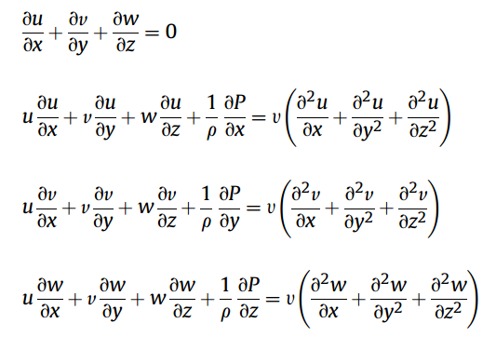
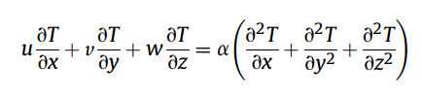
Numerical Methodology:
The governing equations of continuity, momentum and energy equations in 3-D form were solved by means of FLUENT code.
Continuity Equation
Momentum Equation
Energy Equation

Slide 20
Boundary Conditions:
The assigned boundary conditions are the following:
inlet section: uniform velocity and temperature profile;
outlet section: outflow condition with velocity components and temperature derivatives equal to zero;
duct surfaces: velocity components equal to zero(no slip condition) and assigned uniform heat flux.

Slide 21
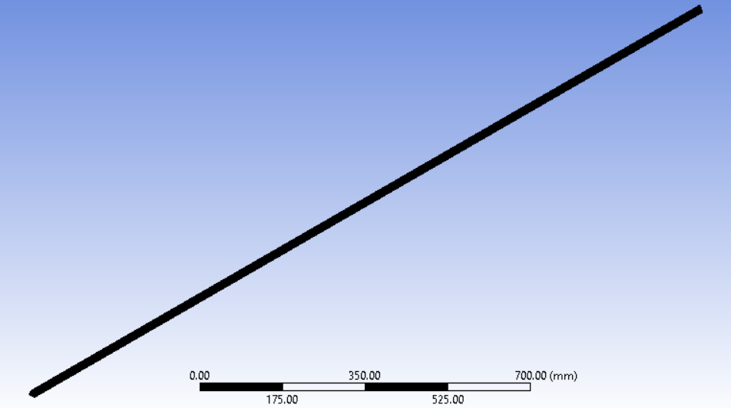

Meshing
Meshing is one of the most important steps in performing an accurate simulation using FEA. A mesh is made up of elements which contain nodes (coordinate locations in space that can vary by element type) that represent the shape of the geometry.
Any continuous object has infinite degrees of freedom (DOF) which makes it impossible to solve using hand calculations. So in FEM, we create a mesh which splits the domain into a discrete number of elements for which the solution can be calculated.

Slide 22
Grid Independent Analysis:
The grid independence test is a process used to find the optimal grid condition that has the smallest number of grids without generating a difference in the numerical results based on the evaluation of various grid conditions.
We had used 31840, 60000, 111300, 341829, 757614, 1024458, 2296574 nodes for 22260, 44955, 87384, 287712, 662000, 903279, 2088000 number of elements, respectively to accomplish grid-sensitivity test.
The respective Nusselt numbers and mesh size is mentioned in table-1.
To accomplish a optimal solution we used 1521856 elements and 1716900 nodes with a mesh size of 0.45 mm.

Slide 23
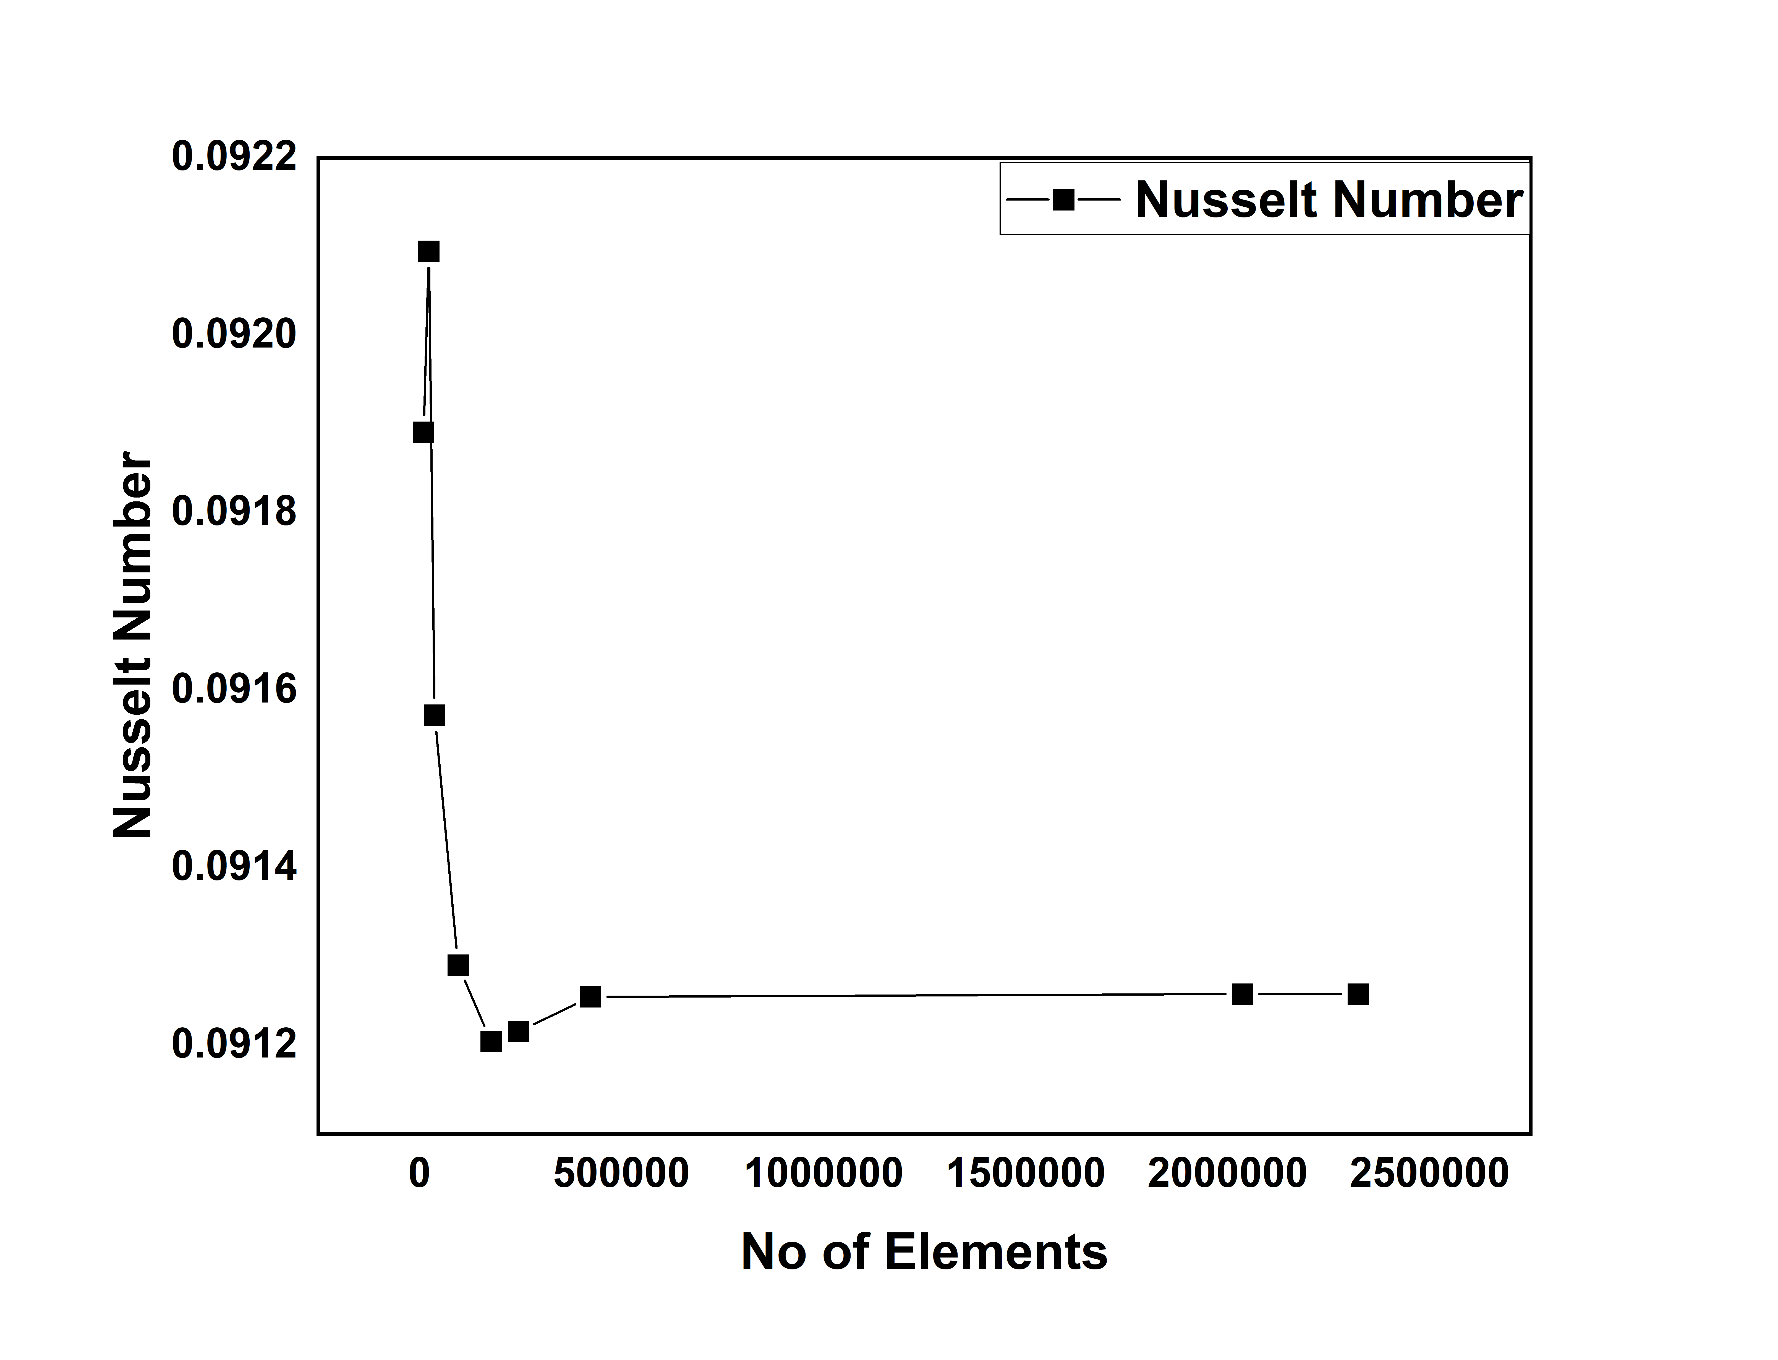
Grid Independent Analysis:
S.NO | Number of Elements | Nusselt Number
1 | 10697 | 0.091891039
2 | 23744 | 0.09209474
3 | 37925 | 0.091572295
4 | 95944 | 0.091290553
5 | 177413 | 0.091204188
6 | 245735 | 0.091215578
7 | 424072 | 0.09125459
8 | 2036320 | 0.091257739
9 | 2323456 | 0.091257801
Table-1: Nusselt Numbers for different Mesh size taken at 0% volume concentration and Richardson number equal to 0.1
Graph-1: Nusselt number vs No of Elements

Slide 24
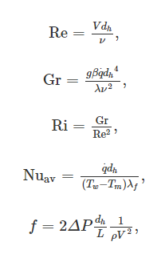
Data Reduction:
The dimensionless parameters of Reynolds number, Grashof number, Richardson number, Nusselt number and friction factor are considered for the data reduction and they are expressed by the following relations:
Where V is average inlet velocity, q is heat flux, Tw and Tm represents the average surface temperature and bulk fluid temperature, respectively

Slide 25
Material Properties of Particles:
Here we are using three nanoparticles infused in base fluid water, those are Aluminum oxide, titanium oxide and silicon oxide. There respective material properties are shown below:
 | Density[kg/m3] | Specific Heat[J/Kg.K] | Volumetric Expansion Coefficient[1/K] | Dynamic Viscosity[Pa.s] | Thermal conductivity[W/m.K]
Al₂O₃ | 3880 | 773 | // | // | 36
Water | 998.2 | 4182 | 2.10e-4 | 993e-6 | Material0.597
Table-2: Aluminum oxide Material properties at T=293 K.

Slide 26
Material Properties of Particles:
Material | Density[kg/m3] | Specific Heat[J/Kg.K] | Volumetric Expansion Coefficient[1/K] | Dynamic Viscosity[Pa.s] | Thermal conductivity[W/m.K]
TiO₂ | 4250 | 686.2 | 2.6e-8 | // | 8.9
Water | 998.2 | 4182 | 2.10e-4 | 993e-6 | 0.597
Table-3: Titanium oxide Material properties at T=293 K.
Material | Density[kg/m3] | Specific Heat[J/Kg.K] | Volumetric Expansion Coefficient[1/K] | Dynamic Viscosity[Pa.s] | Thermal conductivity[W/m.K]
SiO₂ | 2220 | 745 | 4e-6 | // | 10.4
Water | 998.2 | 4182 | 2.10e-4 | 993e-6 | 0.597
Table-4: Silicon oxide Material properties at T=293 K.

Slide 27
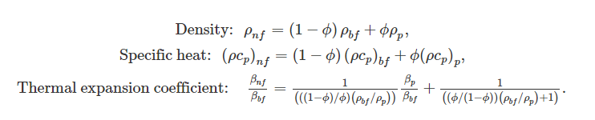
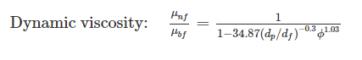
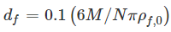
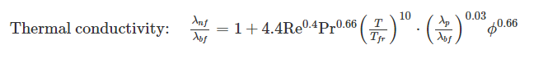
Correlations formulas varying by volumetric concentrations:
With in which M is the molecular weight of the base fluid, N is the Avogadro number, and ρ_{f,0} is the mass density of the base fluid calculated at T = 293 K

Slide 28
Thermo-Physical Properties of Nanofluids:
Here we are using water based Aluminum oxide, Titanium oxide and Silicon oxide nanofluids. There respective Thermo-Physical properties are shown below:
Volume concentration | Density[kg/m3] | Specific Heat[J/Kg.K] | Volumetric Expansion Coefficient[1/K] | Dynamic Viscosity[Pa.s] | Thermal conductivity[W/m.K]
0% | 998.2 | 4182 | 2.1e-4 | 993e-6 | 0.597
1% | 1027 | 4053 | 2.098e-4 | 1082e-6 | 0.622
2% | 1056 | 3931 | 2.095e-4 | 1193e-6 | 0.636
4% | 1113 | 3707 | 2.09e-4 | 1511e-6 | 0.658
Table-5: Water based Aluminum oxide Nanofluid Thermo-physical properties at T=293 K.

Slide 29
Volume concentration | Density[kg/m3] | Specific Heat[J/Kg.K] | Volumetric Expansion Coefficient[1/K] | Dynamic Viscosity[Pa.s] | Thermal conductivity[W/m.K]
0% | 998.2 | 4182 | 2.1e-4 | 993e-6 | 0.597
1% | 1030.718 | 4037.85631 | 2.095e-4 | 1035.68e-6 | 0.59847
2% | 1063.236 | 3902.5296 | 2.09e-4 | 1084.24e-6 | 0.59932
4% | 1128.272 | 3655.2772 | 2.0798e-4 | 1199.06e-6 | 0.60067
Table-6: Water based Titanium oxide Nanofluid Thermo-physical properties at T=293 K.
Volume concentration | Density[kg/m3] | Specific Heat[J/Kg.K] | Volumetric Expansion Coefficient[1/K] | Dynamic Viscosity[Pa.s] | Thermal conductivity[W/m.K]
0% | 998.2 | 4182 | 2.1e-4 | 993e-6 | 0.597
1% | 1010.418 | 4106.48532 | 2.0914e-4 | 1018.47e-6 | 0.600717
2% | 1022.636 | 4032.77505 | 2.0827e-4 | 1045.23e-6 | 0.60287
4% | 1047.072 | 3890.51517 | 2.0650e-4 | 1102.62e-6 | 0.60628
Table-7: Water based Silicon oxide Nanofluid Thermo-physical properties at T=293 K.

Slide 30
Results and Discussion:
Results are obtained for 3 different nanofluids and we considered Reynolds number as constant value 100, Richardson number varying as 0.1, 0.5, 1, 2, 3, 5, and 0%, 1%, 2%, 4% volume concentrations.
Results are reported in terms of average convective heat transfer coefficient, average Nusselt number, wall shear stress and required pumping power profiles.
The above result profiles are considered for varying volume concentrations and for 3 different nanofluids.

Slide 31
Various profiles for Water based Aluminum-oxide Nanofluid

Slide 32
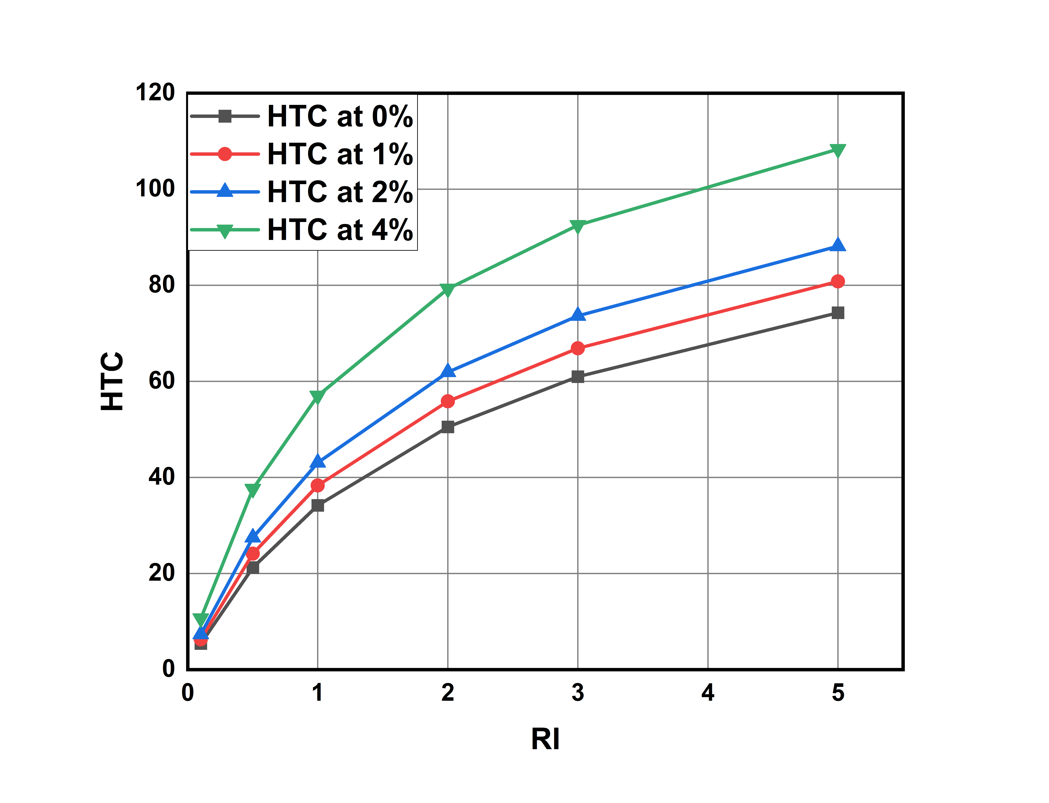
Heat Transfer Coefficient for different Richardson numbers and different volume concentration values:
HTC increases with increase in volume concentration of nano particles.
HTC for different Richardson’s number ranges from 5.448133 to 108.3699.
The percentage increase of HTC at 1%,2%,4% with respective to the HTC at 0% is calculated by:
% Change = (HTC at x% - HTC at 0% ) / HTC at 0%
For Richardson number 0.1:
% change for 1% = 2.37% for 2% = 5.50% for 4% = 14.96%
For Richardson number 2:
% change for 1%= 1.51% for 2% = 3.59% for 4%: 9.63%
For Richardson number 5:
% change for 1% = 1.21 for 2% = 2.84% for 4%: 7.79%
As Richardson number is increasing HTC increases and after a certain Richardson number it is becoming constant.
Graph-2: Richardson number vs average heat transfer coefficient values for different volume concentrations.

Slide 33
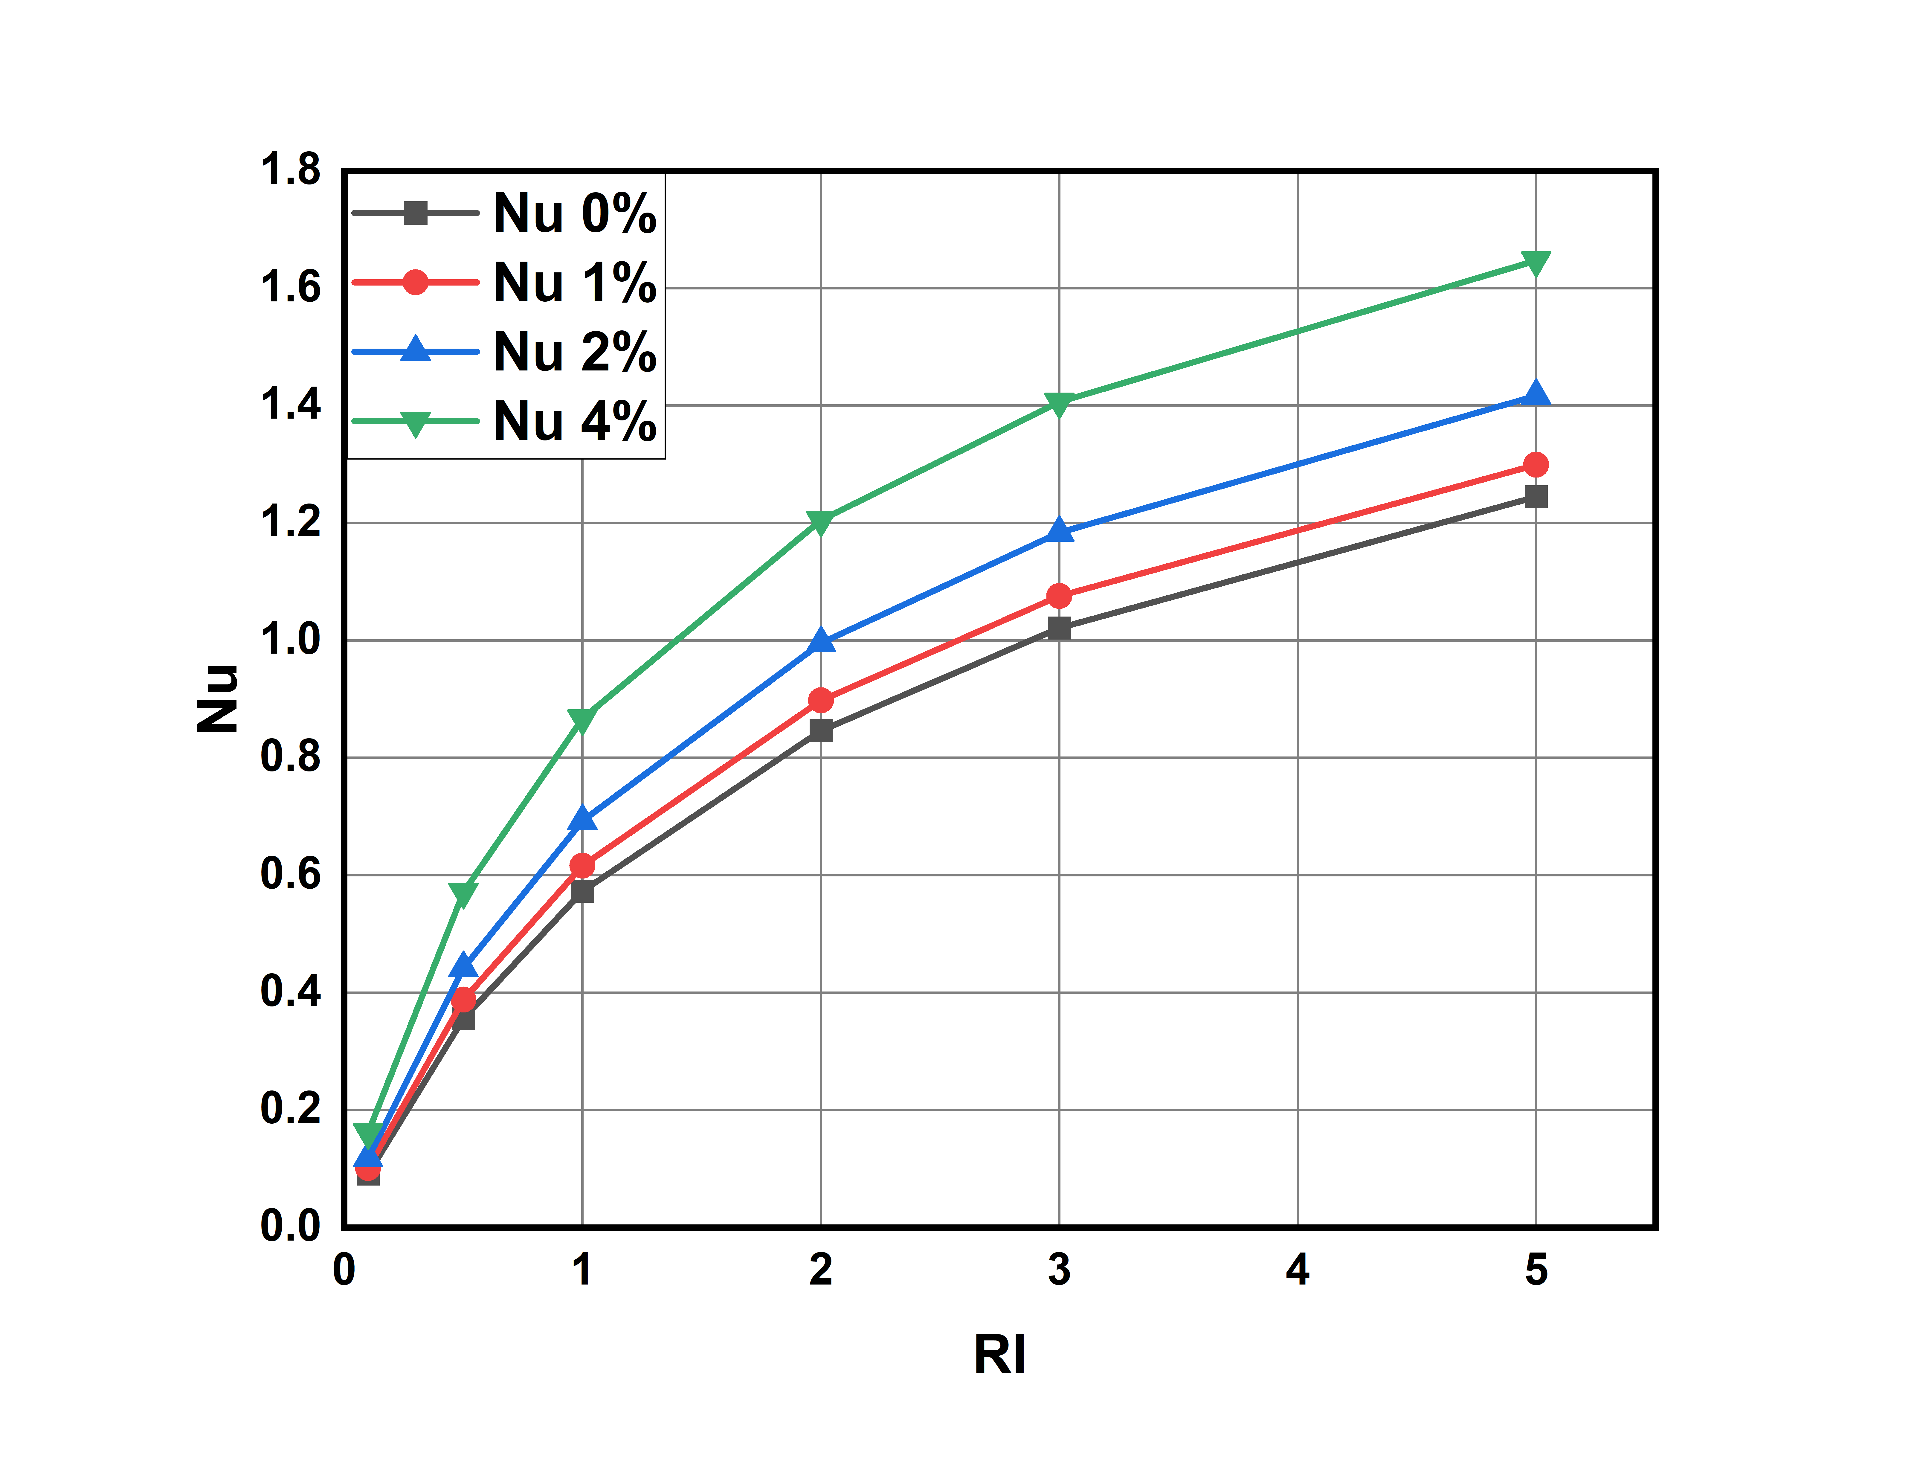
Nusselt Numbers for different Richardson numbers and different volume concentration values:
Nusselt number increases with increase in volume concentration.
Nu value for different Richardson’s number ranges from 0.09126
to 1.64696
The percentage increase of Nusselt number at 1%,2%,4% with
respective to the Nusselt number at 0% is calculated by
% Change = (Nu at x% - Nu at 0% ) / Nu at 0%
For Richardson number = 0.1:
% Change at 1% = 11.22% % , 2% = 29.54% , 4% = 77.68%
For Richardson number = 2:
% Change at 1% = 6.11% , 2% = 17.65% , 4% = 42.25%
For Richardson number = 5:
% Change at 1% = 4.39% , 2% = 13.86% , 4% = 32.25%
However the percentage of increase in Nusselt number decreases and becomes constant due to law of diminishing returns.
This Implies increasing the concentration linearly doesn't increase the Nusselt number linearly.
Graph-3: Richardson Number vs Nusselt Number values for different volume concentrations.

Slide 34
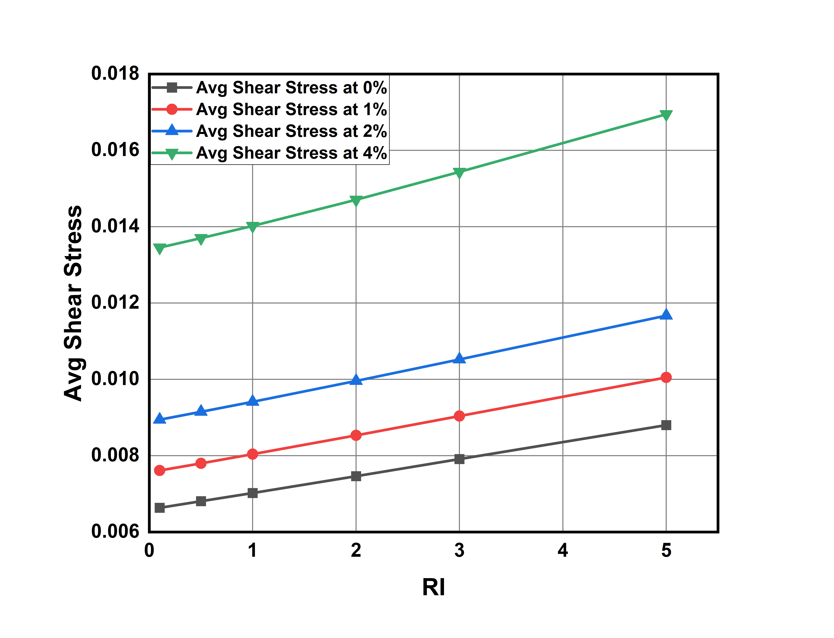
Average Shear stresses for different Richardson numbers and different volume concentration values:
As Nusselt number is increasing average shear stress on walls also increasing.
Average shear stress for different Richardson’s number ranging from 0.0066354363 to 0.01694618
The percentage change in avg shear stress compared with 0% concentration as reference are as follows
% Change = (value at x% - value at 0% ) / value at 0%
Richardson number 0.1:
% change for 1%: 15.221% for 2%: 34.783% for 4%: 102.25%
Richardson number 2:
% change for 1%: 18.346% for 2%: 32.202% for 4%: 94.158%
Richardson number 5:
% change for 1%: 25.296% for 2%: 32.576% for 4%: 92.777%
Here as concentration of nanoparticles is increasing stress are becoming 1.2 times of stress seen in pure water.
Graph-4: Richardson Number vs average Shear Stress values for different volume concentrations.

Slide 35
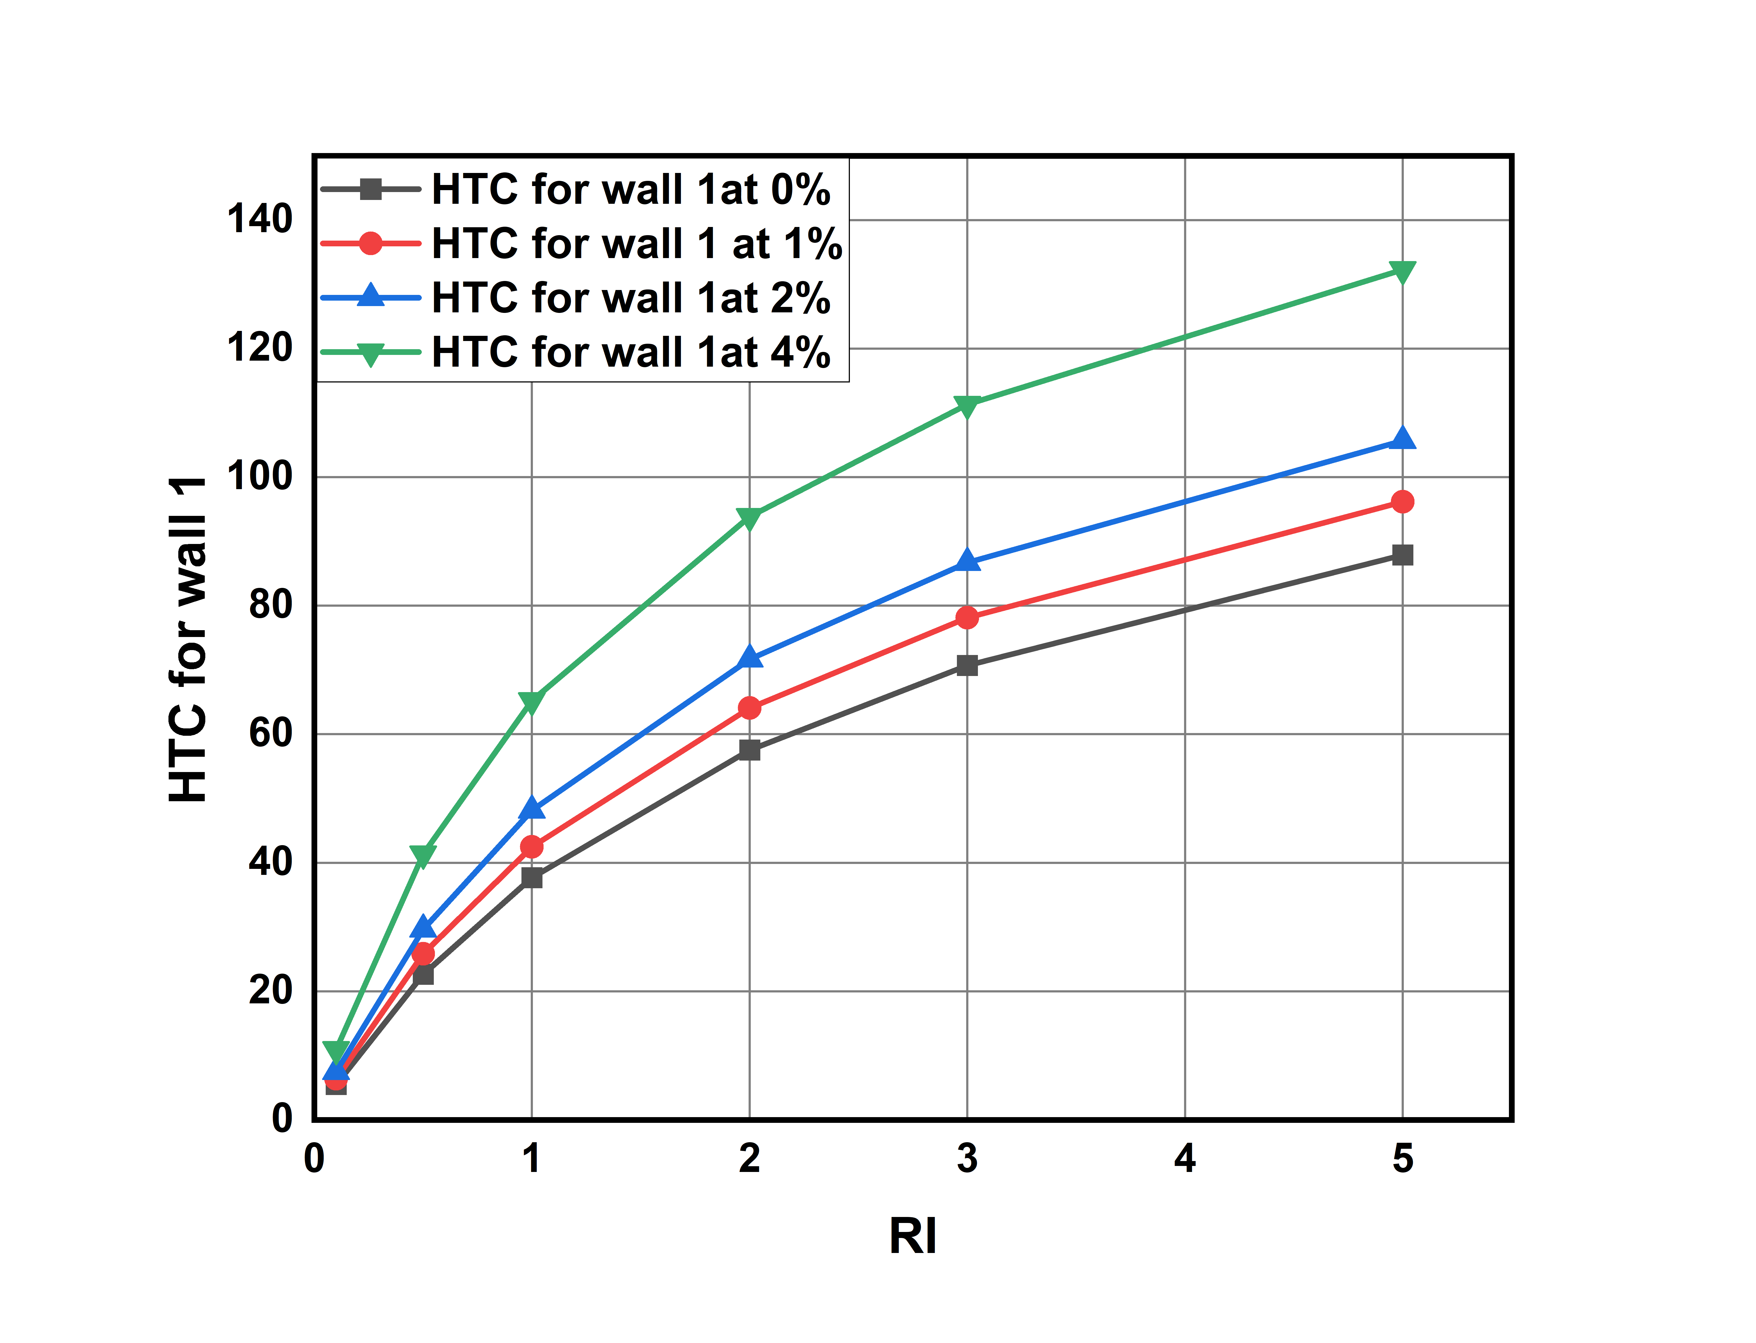
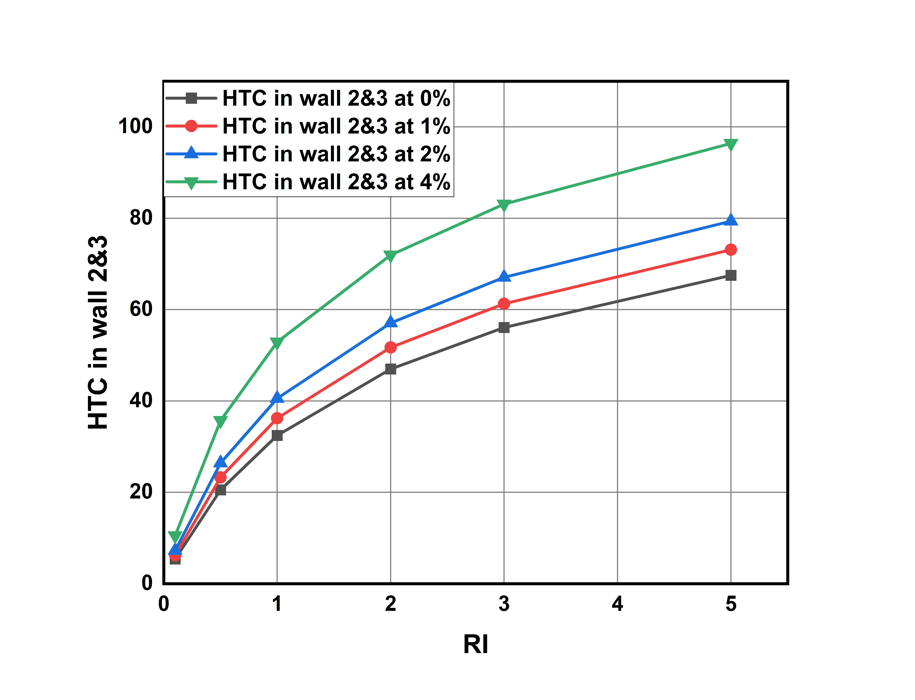
Heat Transfer Coefficient in wall-2 & wall-3 for different Richardson numbers and different volume concentration values:
Here for wall 1 it slightly higher heat transfer coefficient values compared to that wall-2 and wall-3. This is because of gravity and weight of fluid is acting on wall-1. For wall-2 and wall-3 we are observing a same HTC values.
Graph-5: Richardson Number vs Heat transfer coefficient values in wall-1 avg for different volume concentrations.
Graph-6: Richardson Number vs Heat transfer coefficient values in wall-2 ,3 avg for different volume concentrations.

Slide 36
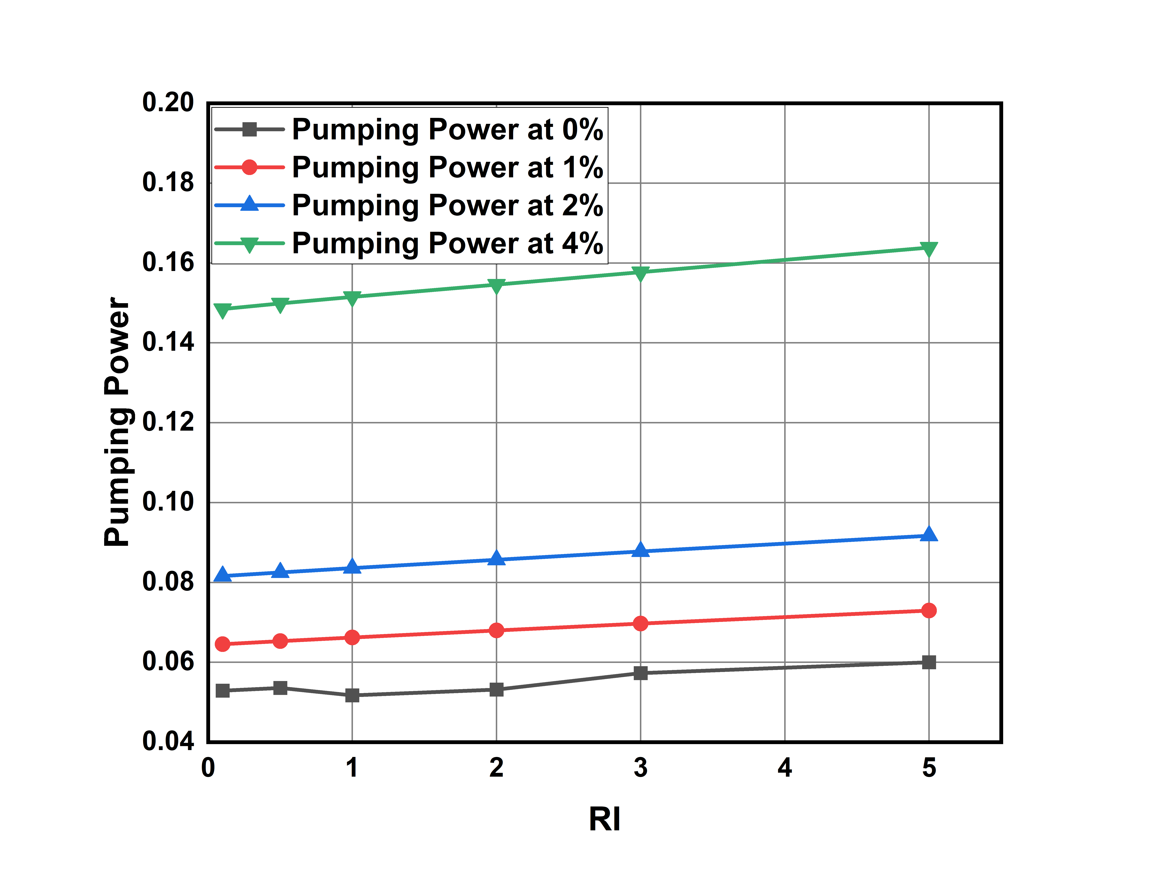
Pumping Power for different Richardson numbers and different volume concentration values:
Here as Heat transfer is increasing power required to pump the fluid into duct also increasing.
Pumping power is increasing linearly with respective to Richardson’s number.
We calculate the percentage change with 0 % as reference
% Change = (value at x% - value at 0% ) / value at 0%
For Richardson Number = 0.1:
% change at 1% = 21.92% at 2% = 54.176% 4% = 180.57%
For Richardson Number = 2:
% change at 1% = 27.87% at 2% = 61.16% at 4% = 192.81%
For Richardson Number = 5:
% change at 1% = 21.60% at 2% = 52.80% at 4% = 173.04%
At higher concentrations and at higher Richardson’s number pumping power required is becoming more.
Graph-7: Richardson Number vs Pumping Power for different volume concentrations.

Slide 37
Various profiles for Water based Titanium-oxide Nanofluid

Slide 38
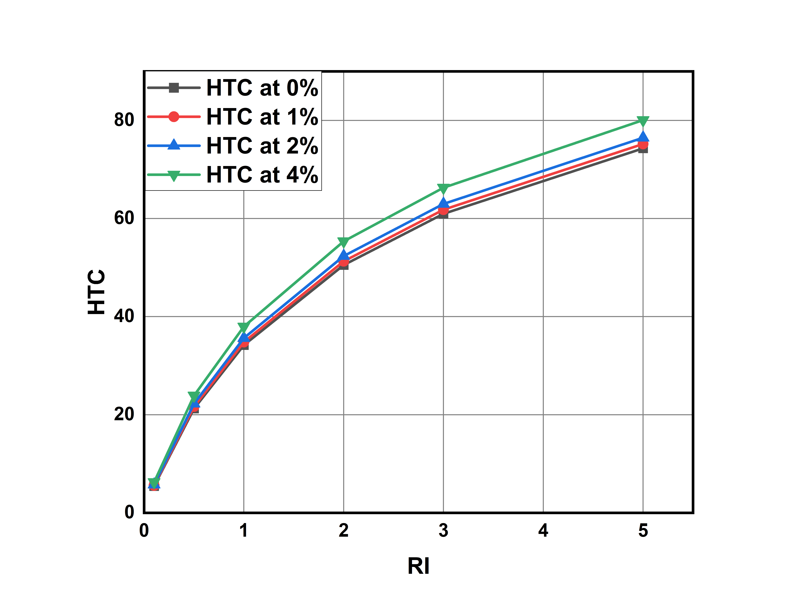
Heat Transfer Coefficient for different Richardson numbers and different volume concentration values:
HTC increases with increase in volume concentration of nano particles.
HTC for different Richardson’s number ranges from
5.448133 to 80.05796
The percentage increase of HTC at 1%,2%,4% with respective to the HTC at 0% is calculated by
% Change = (HTC at x% - HTC at 0% ) / HTC at 0%
For Richard number 0.1:
% change for 1% = 2.37% for 2% = 5.61% for 4% = 14.85%
For Richard number 2:
% change for 1%= 1.51% for 2% = 3.61% for 4%: 9.56%
For Richard number 5:
% change for 1% = 1.27 for 2% = 2.9% for 4%: 7.73%
As Richardson number is increasing HTC increases and after a certain Richardson number it is becoming constant.
Graph-8: Richardson number vs average heat transfer coefficient values for different volume concentrations.

Slide 39
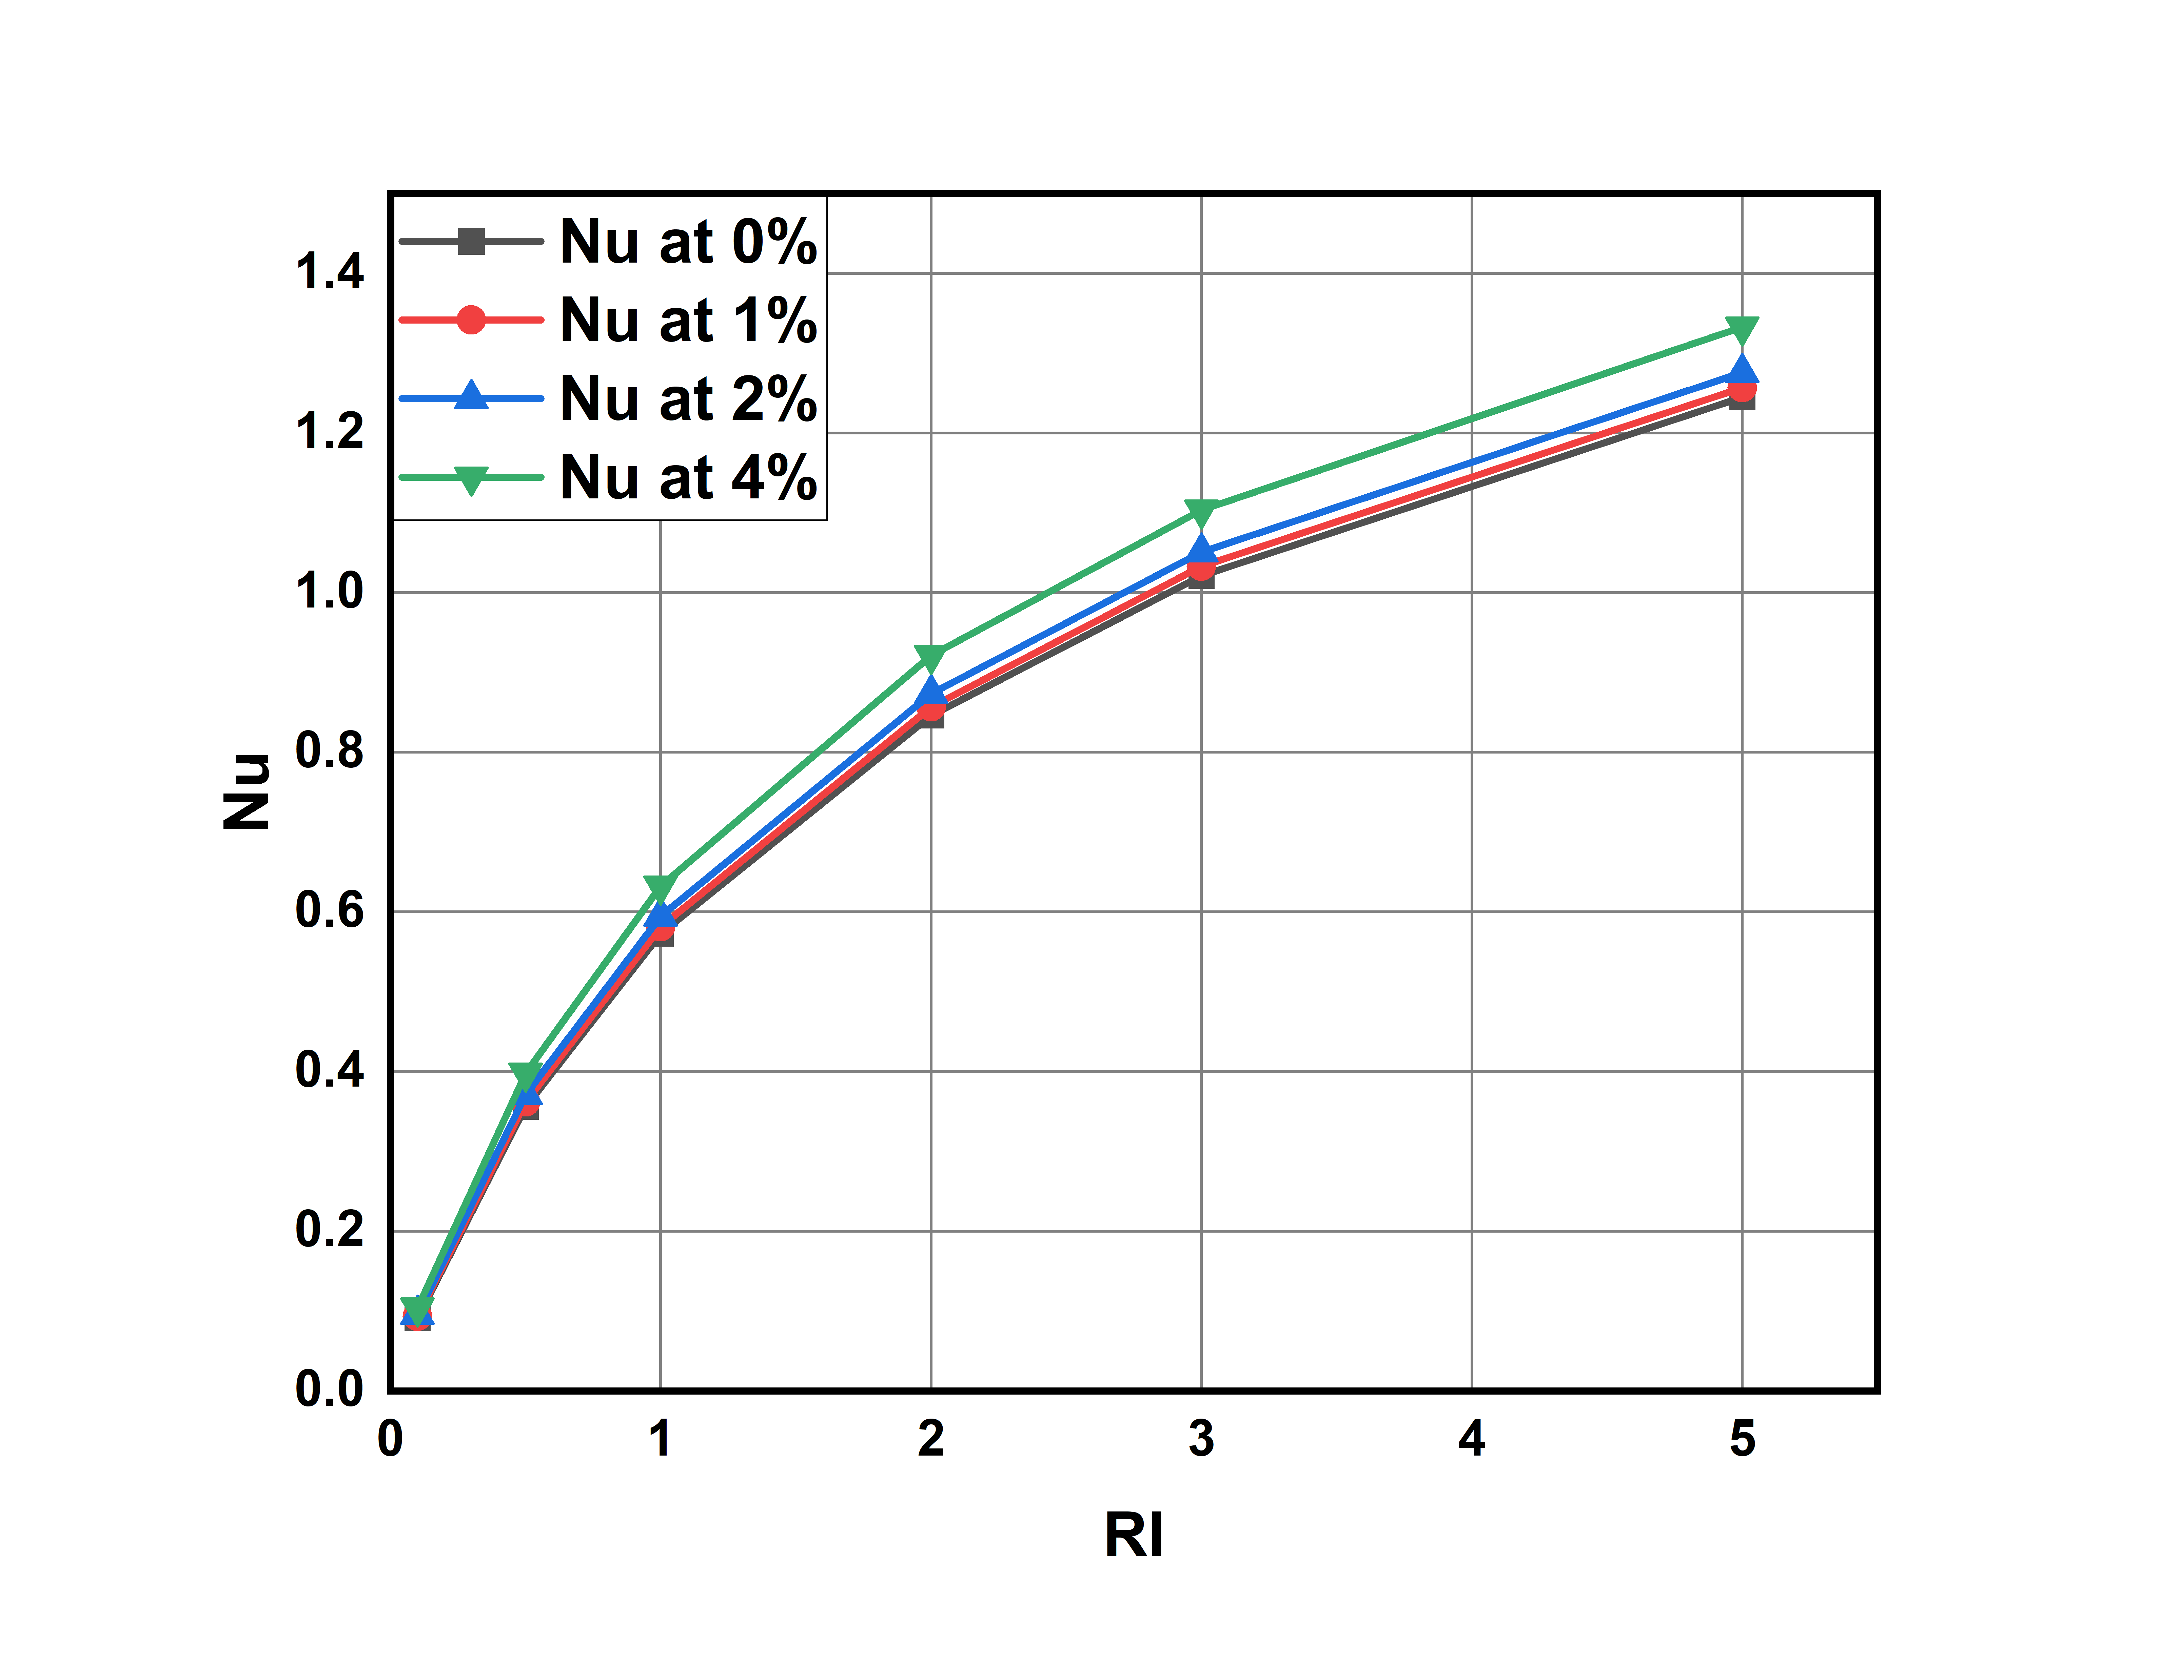
Nusselt Numbers for different Richardson numbers and different volume concentration values:
Nusselt number increases with increase in volume concentration.
Nu value for different Richardson’s number ranges from 0.09126 to 1.64696
The percentage increase of Nusselt number at 1%,2%,4% with respective to the Nusselt number at 0% is calculated by
% Change = (Nu at x% - Nu at 0% ) / Nu at 0%
For Richardson number = 0.1:
% Change at 1% = 2.119% % , 2% = 5.205% , 4% = 14.149%
For Richardson number = 2:
% Change at 1% = 1.2639% , 2% = 3.21% , 4% = 8.827%
For Richardson number = 5:
% Change at 1% = 0.9585% , 2% = 2.511% , 4% = 7.0794%
However the percentage of increase in Nusselt number decreases and becomes constant due to law of diminishing returns.
This Implies increasing the concentration linearly doesn't increase the Nusselt number linearly.
Graph-9: Richardson Number vs Nusselt Number values for different volume concentrations.

Slide 40
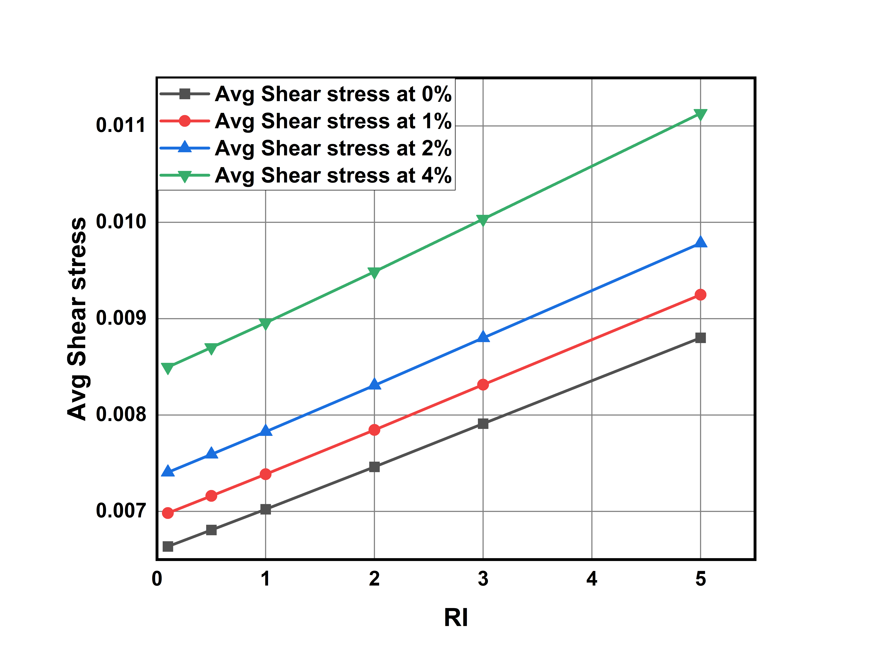
Average Shear stresses for different Richardson numbers and different volume concentration values:
As Nusselt number is increasing average shear stress on walls also increasing.
Average shear stress for different Richardson’s number ranges from 0.0066354363 to 0.01694618
The percentage change in Avg shear stress compared with 0% concentration as reference are as follows
The percentage increase of Avg shear stress at 1%,2%,4% with
respective to the value at 0% is calculated by
% Change = (value at x% - value at 0% ) / value at 0%
Richardson number 0.1:
% change for 1%: 5.2301% for 2%: 11.604% for 4%: 28.059%
Richardson number 2:
% change for 1%: 5.139% for 2%: 11.336% for 4%: 27.148%
Richardson number 5:
% change for 1%: 5.0911% for 2%: 11.16% for 4%: 26.482%
Graph-10: Richardson Number vs average Shear Stress values for different volume concentrations.

Slide 41
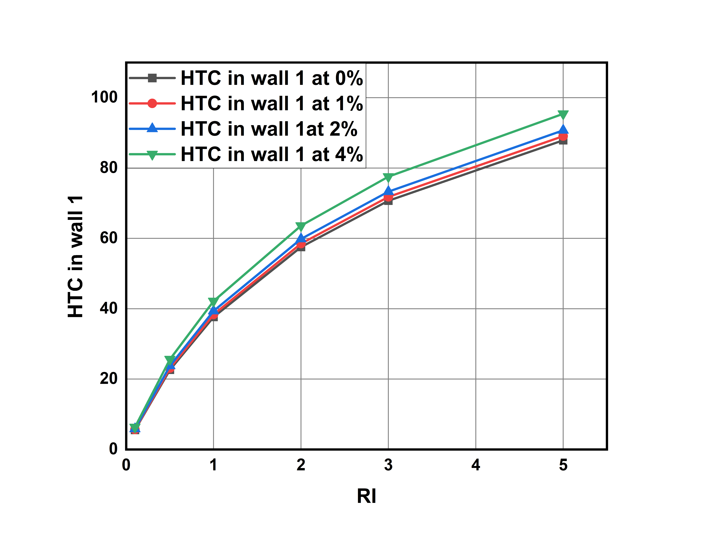
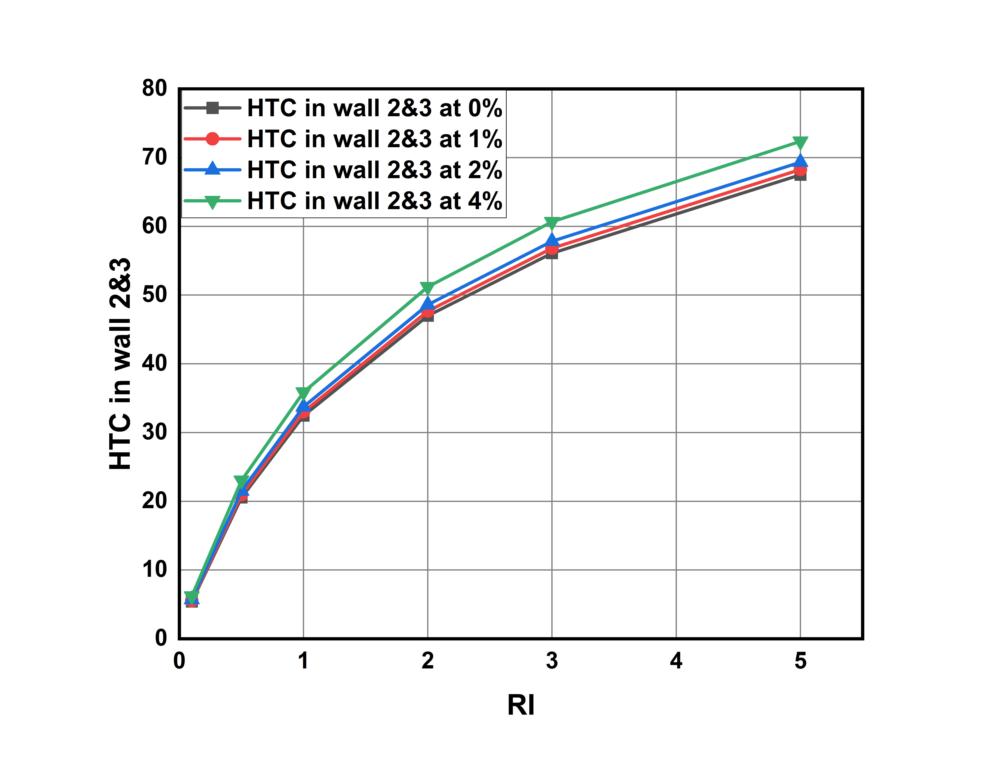
Heat Transfer Coefficient in wall-1 and wall 2&3Avg for different Richardson numbers and different volume concentration values:
Here for wall 1 it slightly higher heat transfer coefficient values compared to that wall-2 and wall-3. This is because of gravity and weight of fluid is acting on wall-1. For wall-2 and wall-3 we are observing a same HTC values.
Graph-11: Richardson Number vs Heat transfer coefficient values in wall-1 for different volume concentrations.
Graph-12: Richardson Number vs Heat transfer coefficient values in wall-1 for different volume concentrations.

Slide 42
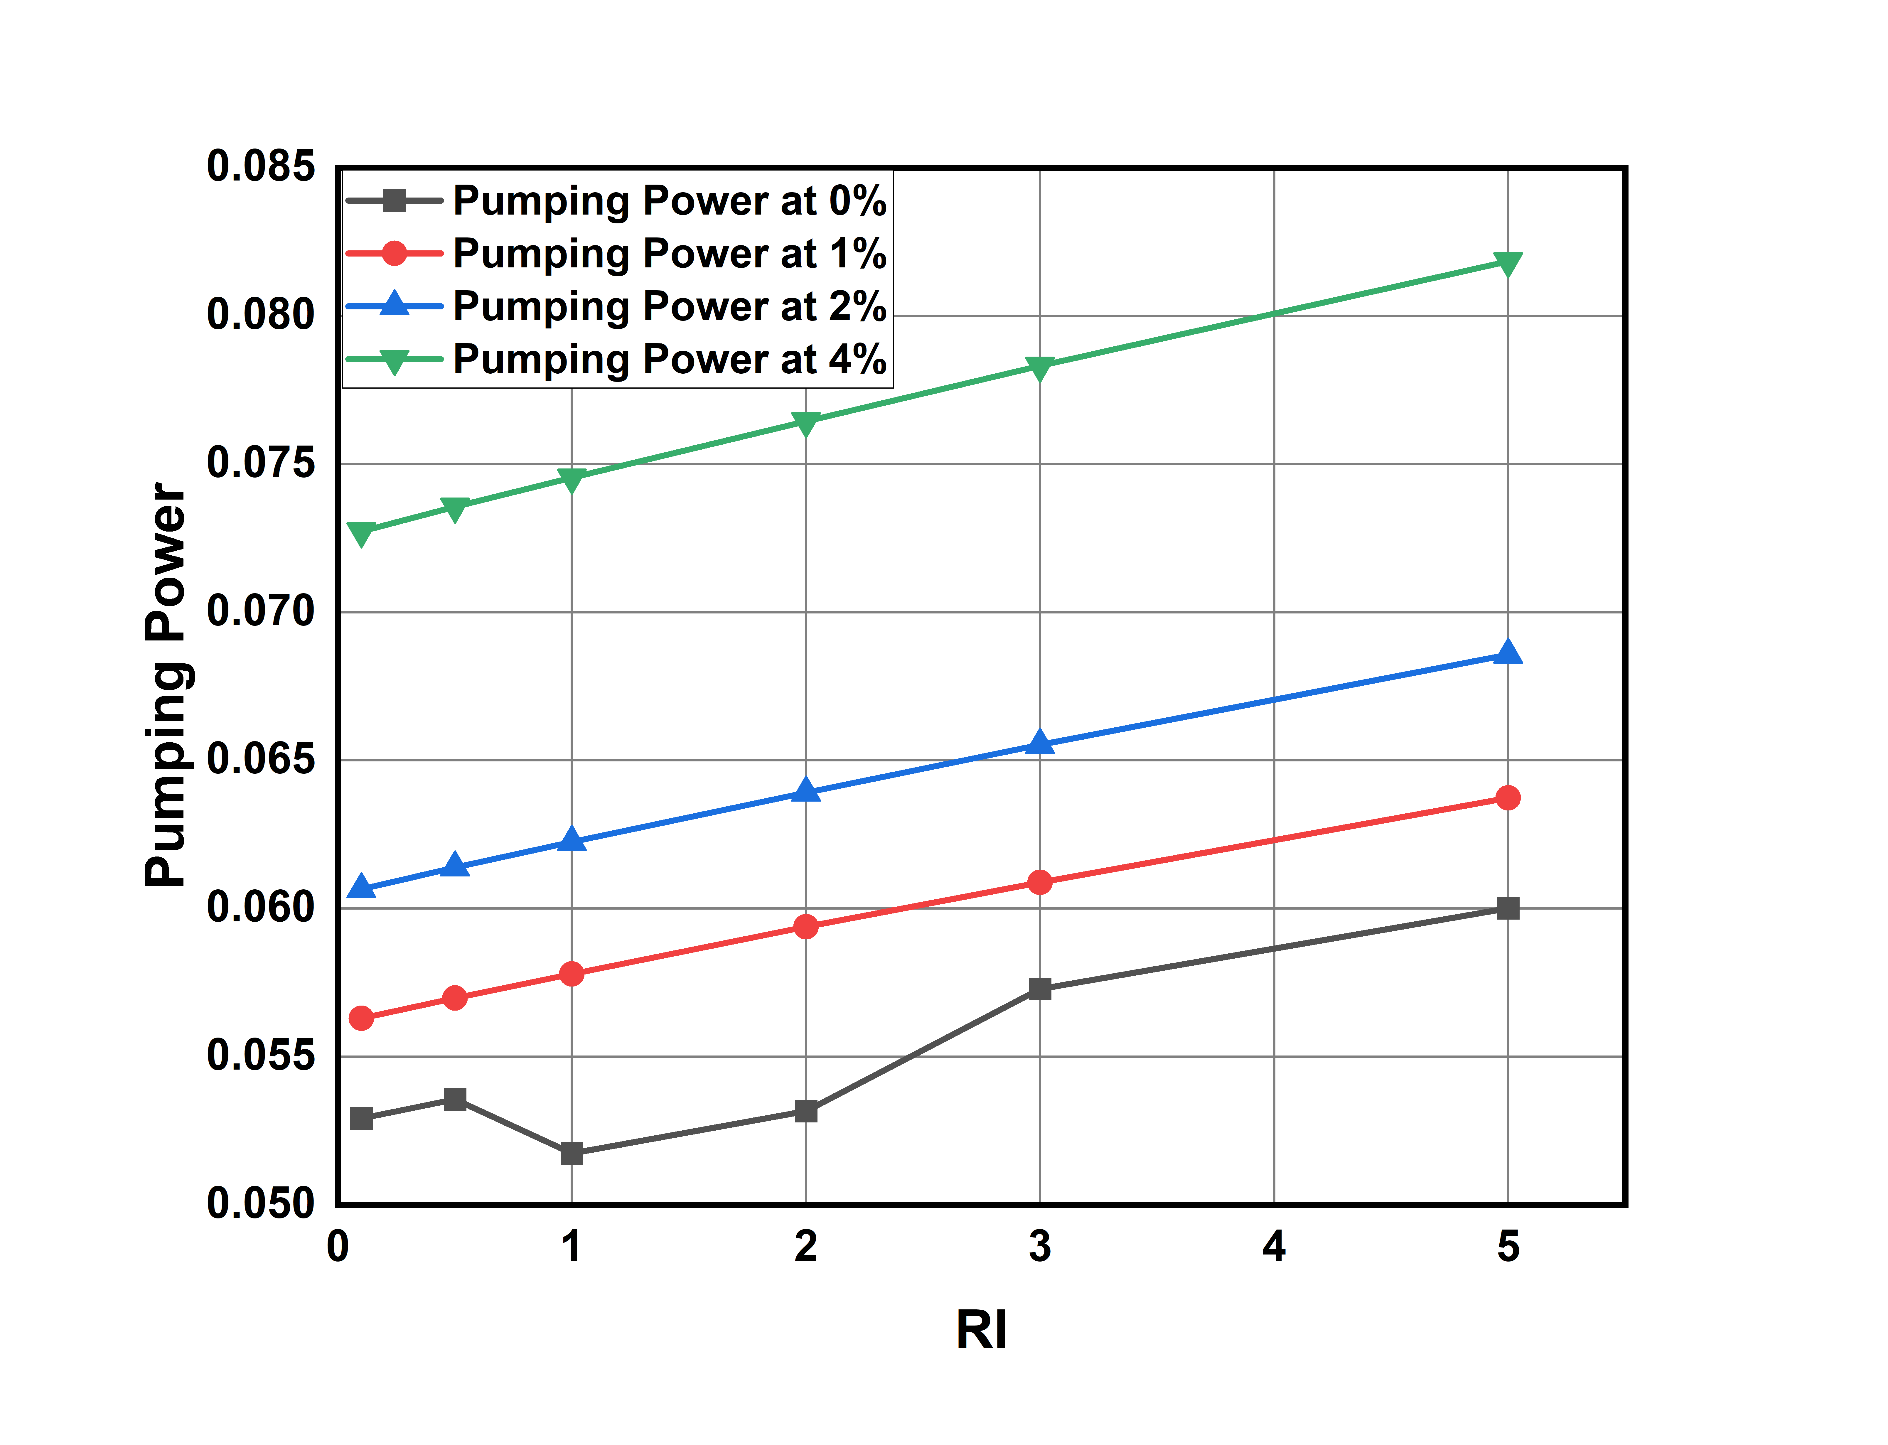
Pumping Power for different Richardson numbers and different volume concentration values:
Here as Heat transfer is increasing power required to pump the fluid into duct also increasing.
Pumping power is increasing linearly with respective to Richardson’s number.
We calculate the percentage change with 0 % as reference
% Change = (value at x% - value at 0% ) / value at 0%
For Richardson Number = 0.1:
% change at 1% = 22.05% at 2% = 54.31% 4% =180.32%
For Richardson Number = 2:
% change at 1% = 27.85% at 2% = 61.23% at 4% =191.95%
For Richardson Number = 5:
% change at 1% = 21.55% at 2% = 52.77% at 4% = 173.03%
At higher concentrations and at higher Richardson’s number pumping power required is becoming more.
Graph-13: Richardson Number vs Pumping Power for different volume concentrations.

Slide 43
Various profiles for Water based Silicon-oxide Nanofluid

Slide 44
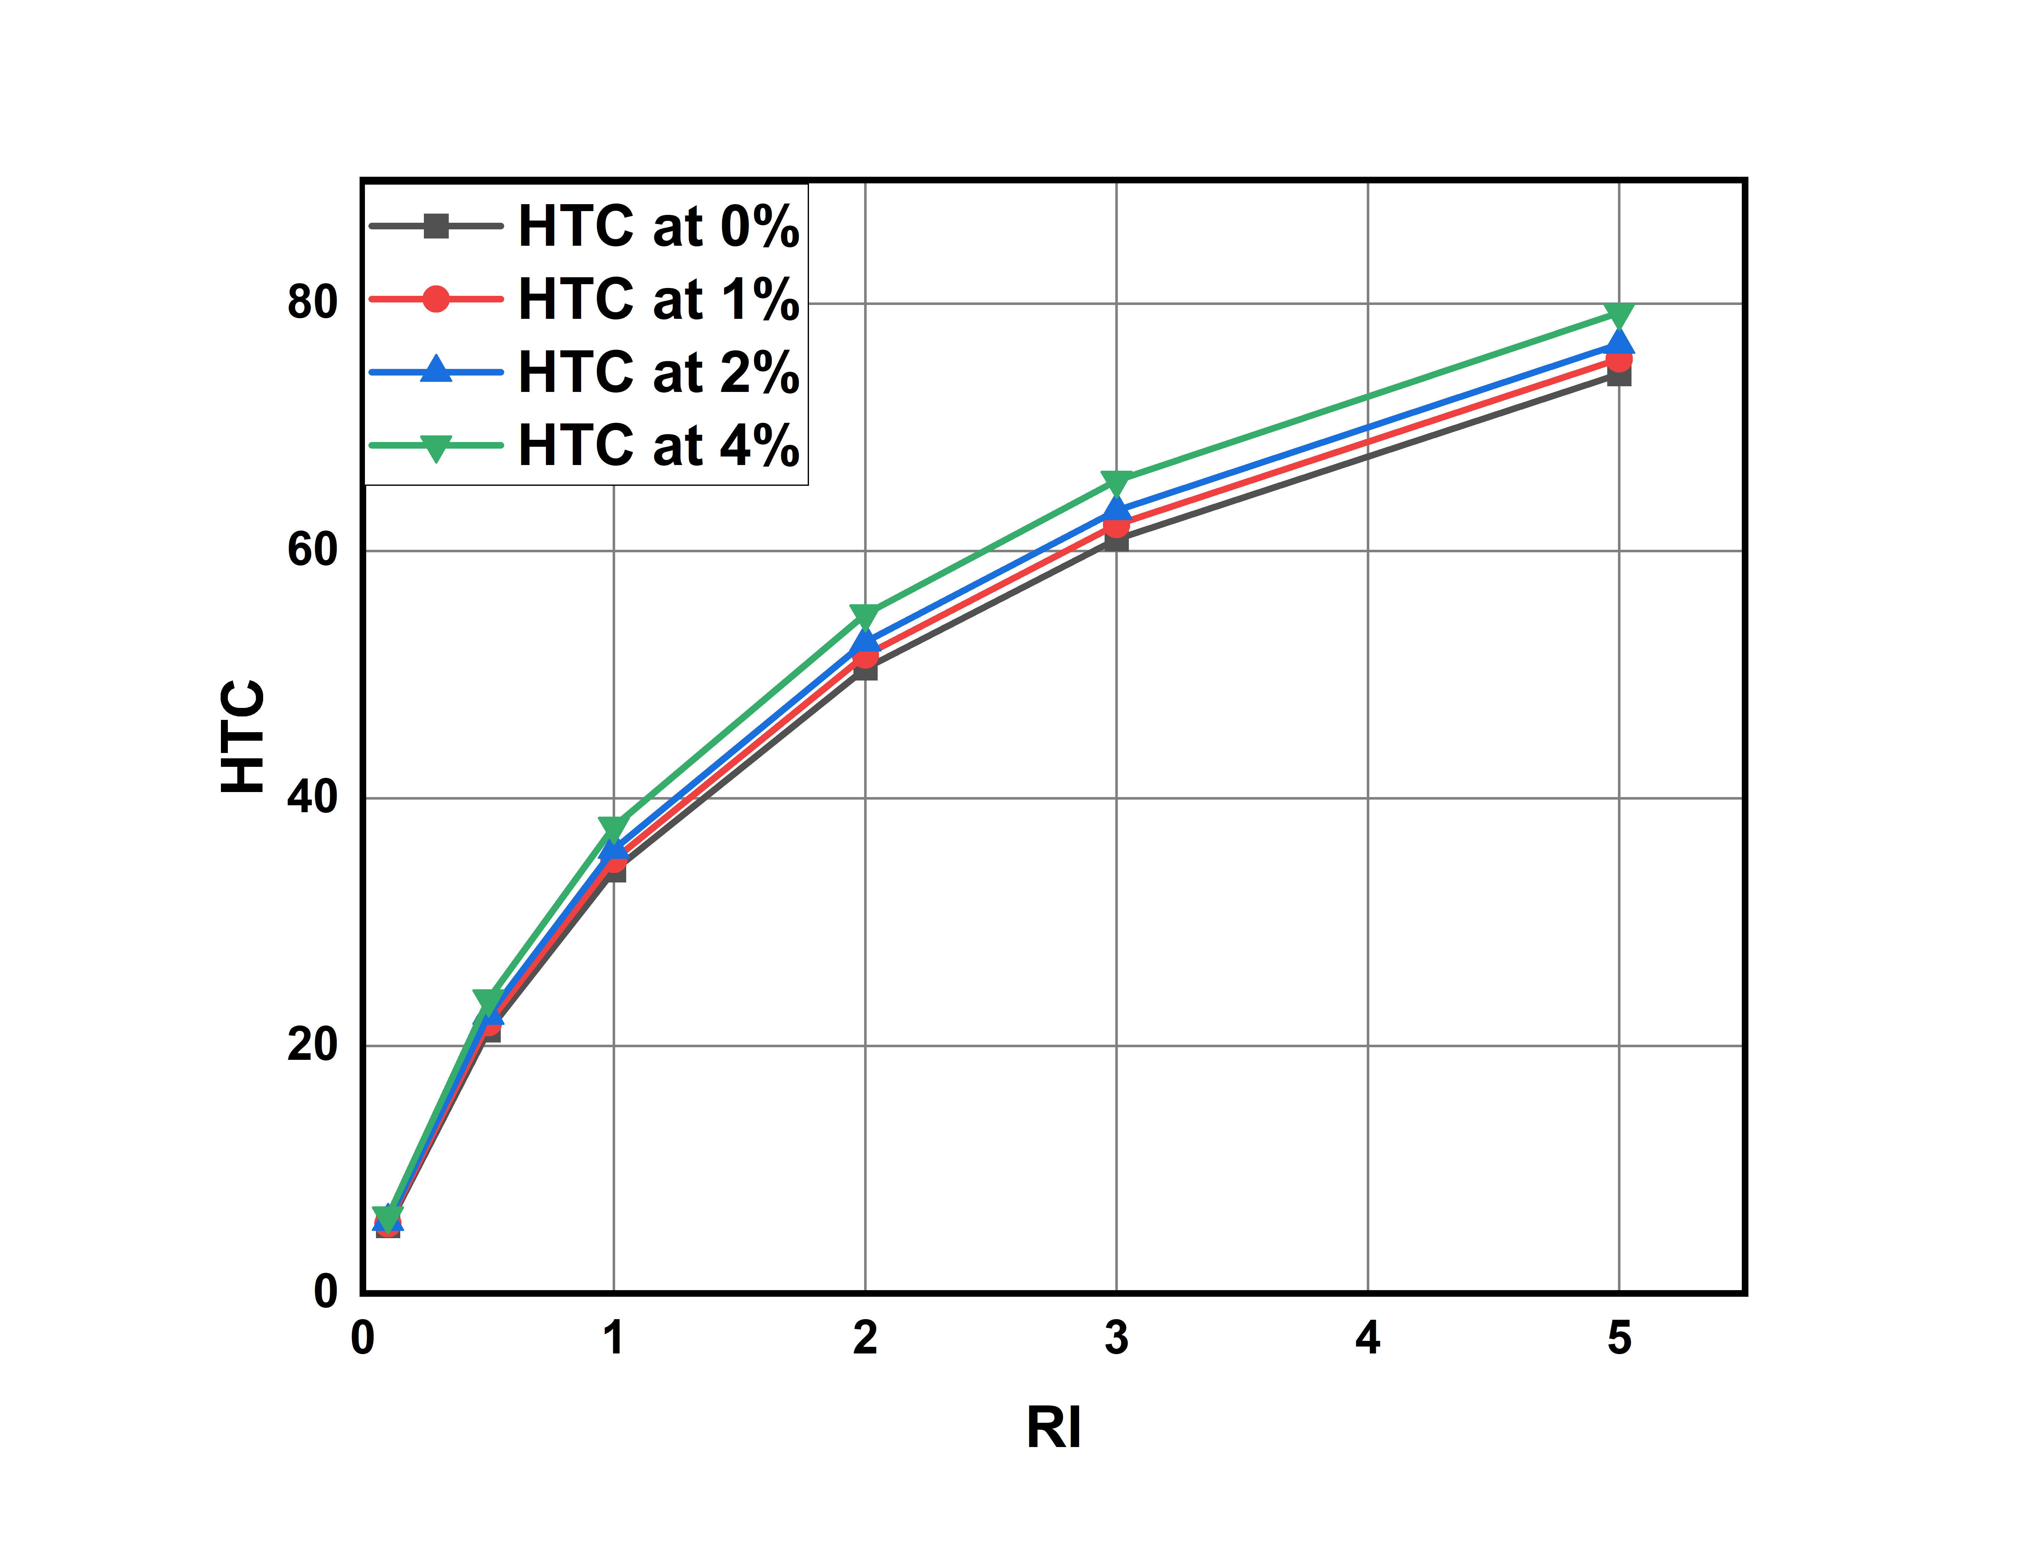
Heat Transfer Coefficient for different Richardson numbers and different volume concentration values:
HTC increases with increase in volume concentration of nano particles.
HTC for different Richardson’s number ranges from 6.239 to 79.270
The percentage increase of HTC at 1%,2%,4% with
respective to the HTC at 0% is calculated by:
% Change = (HTC at x% - HTC at 0% ) / HTC at 0%
For Richard number 0.1:
% change for 1% = 3.484 % for 2% =6.96% for 4% =14.53%
For Richard number 2:
% change for 1%= 2.1295% for 2% = 4.217% for 4%: 8.66%
For Richard number 5:
% change for 1% = 1.6531 for 2% = 3.27% for 4%: 6.67%
As Richardson number is increasing HTC increases and after a certain Richardson number it is becoming constant.
Graph-14: Richardson number vs average heat transfer coefficient values for different volume concentrations.

Slide 45
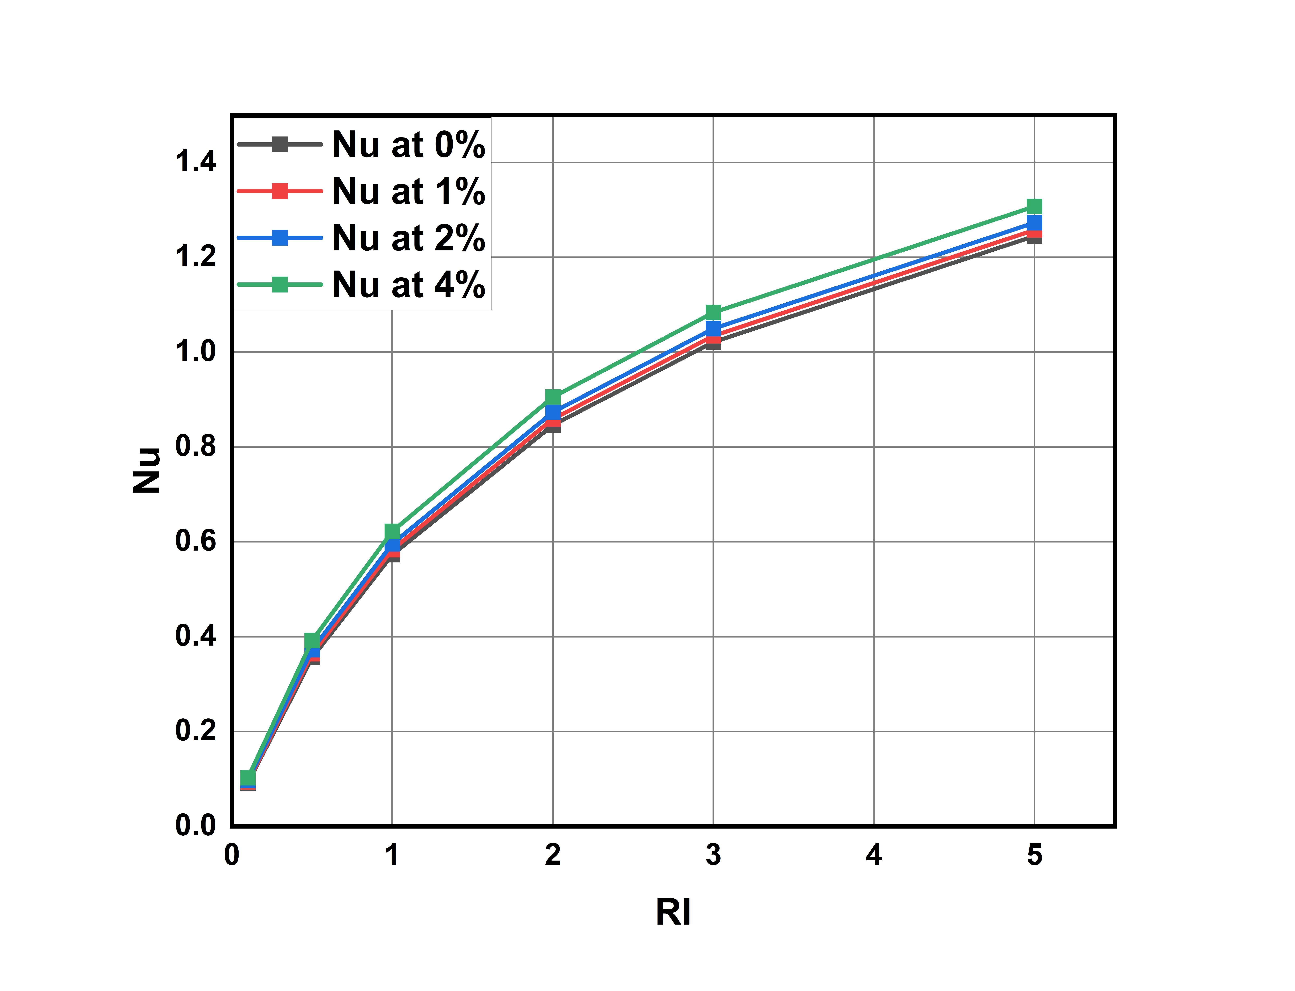
Nusselt Numbers for different Richardson numbers and different volume concentration values:
Nusselt number increases with increase in concentration.
Nu value for different Richardson’s number ranges from 0.1029
to 1.307
The percentage increase of Nusselt number at 1%,2%,4% with respective to the Nusselt number at 0% is calculated by
% Change = (Nu at x% - Nu at 0% ) / Nu at 0%
For Richardson number = 0.1:
% Change at 1% = 2.84% % , 2% = 5.918% , 4% = 12.77%
For Richardson number = 2:
% Change at 1% = 1.4976% , 2% =3.2019% , 4% = 6.9961%
For Richardson number = 5:
% Change at 1% =1.1241% , 2% =2.2645% , 4% = 5.0454%
However the percentage of increase in Nusselt number decreases and becomes constant due to law of diminishing returns.
This Implies increasing the concentration linearly doesn't increase the Nusselt number linearly
Graph-15: Richardson Number vs Nusselt Number values for different volume concentrations.

Slide 46
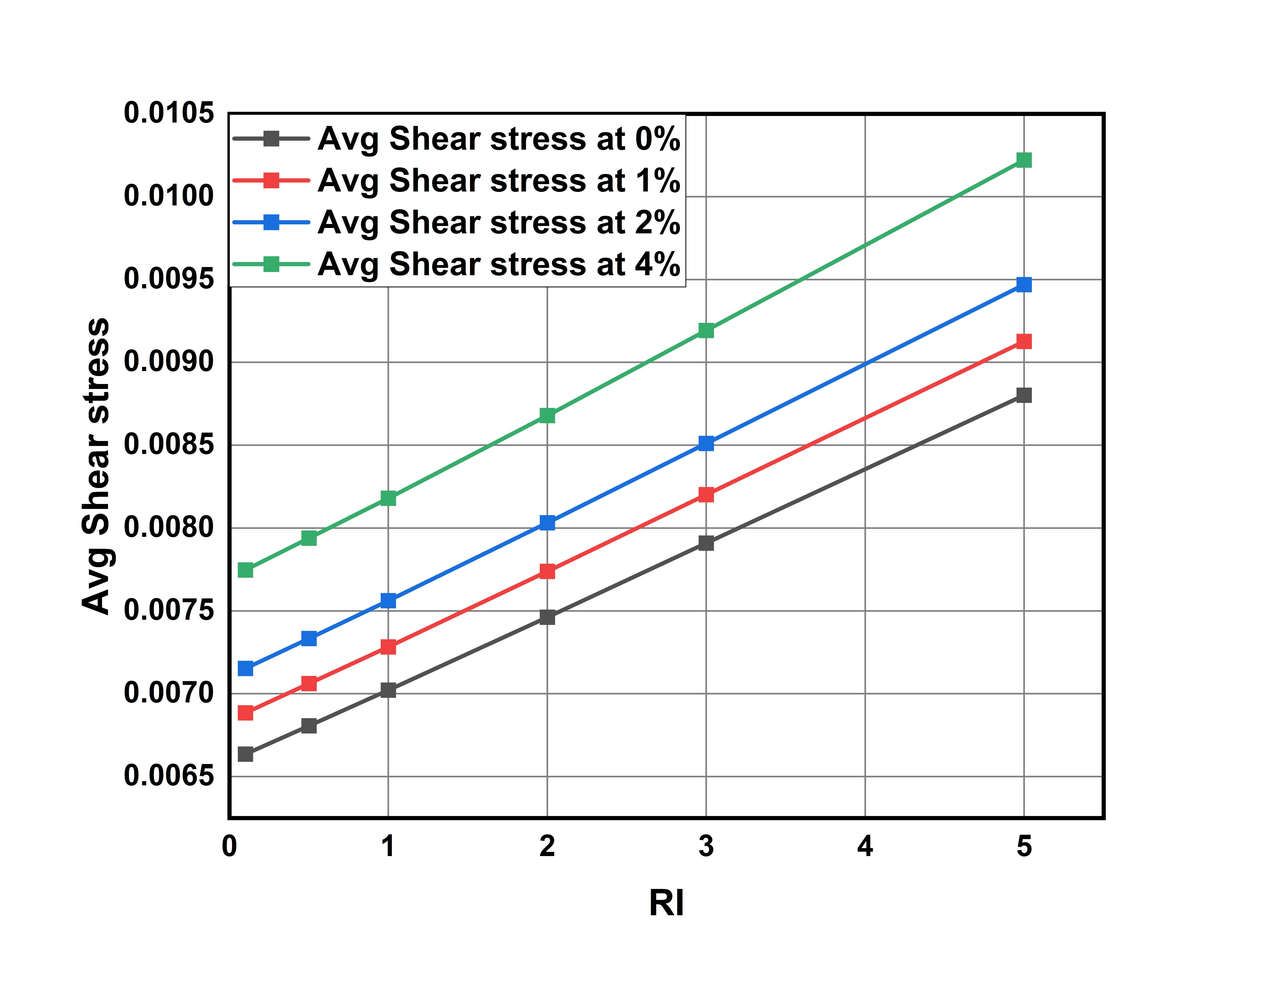
Average Shear stresses for different Richardson numbers and different volume concentration values:
As Nusselt number is increasing average shear stress on walls also increasing.
Average shear stress for different richardson’s number ranges from 0.0066354363 to 0.01022
The percentage change in avg shear stress compared with 0% concentration as reference are as follows
% Change = (value at x% - value at 0% ) / value at 0%
For Richard number 0.1:
% change for 1% = 3.7535% for 2% = 7.794% for 4% = 16.72%
For Richard number 2:
% change for 1%= 3.6982% for 2% = 3.59% for 4%: 16.312%
For Richard number 5:
% change for 1% = 3.6979 for 2% = 7.5857% for 4%: 16.182%
Graph-16: Richardson Number vs average Shear Stress values for different volume concentrations.

Slide 47
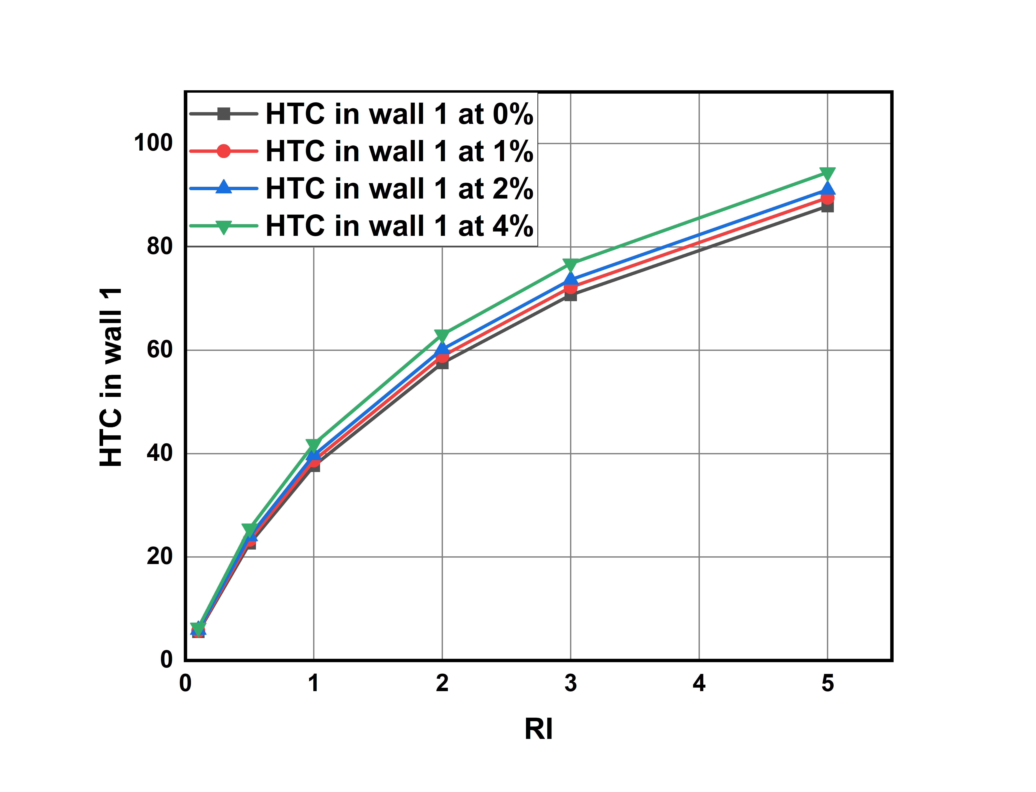
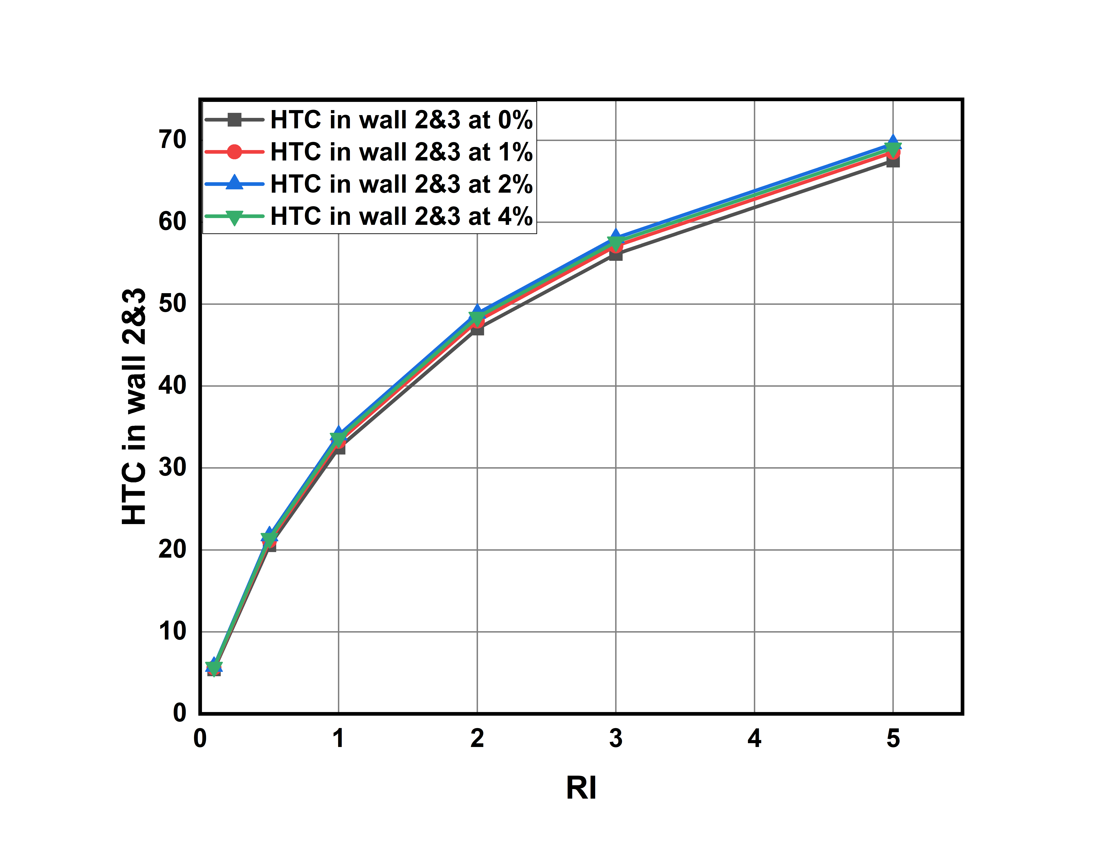
Heat Transfer Coefficient in wall-1 and wall-2&3 for different Richardson numbers and different volume concentration values:
Here for wall 1 it slightly higher heat transfer coefficient values compared to that wall-2 and wall-3. This is because of gravity and weight of fluid is acting on wall-1. For wall-2 and wall-3 we are observing a same HTC values.
Graph-17: Richardson Number vs Heat transfer coefficient values in wall-1 for different volume concentrations.
Graph-18: Richardson Number vs Heat transfer coefficient values in wall-1 for different volume concentrations.

Slide 48
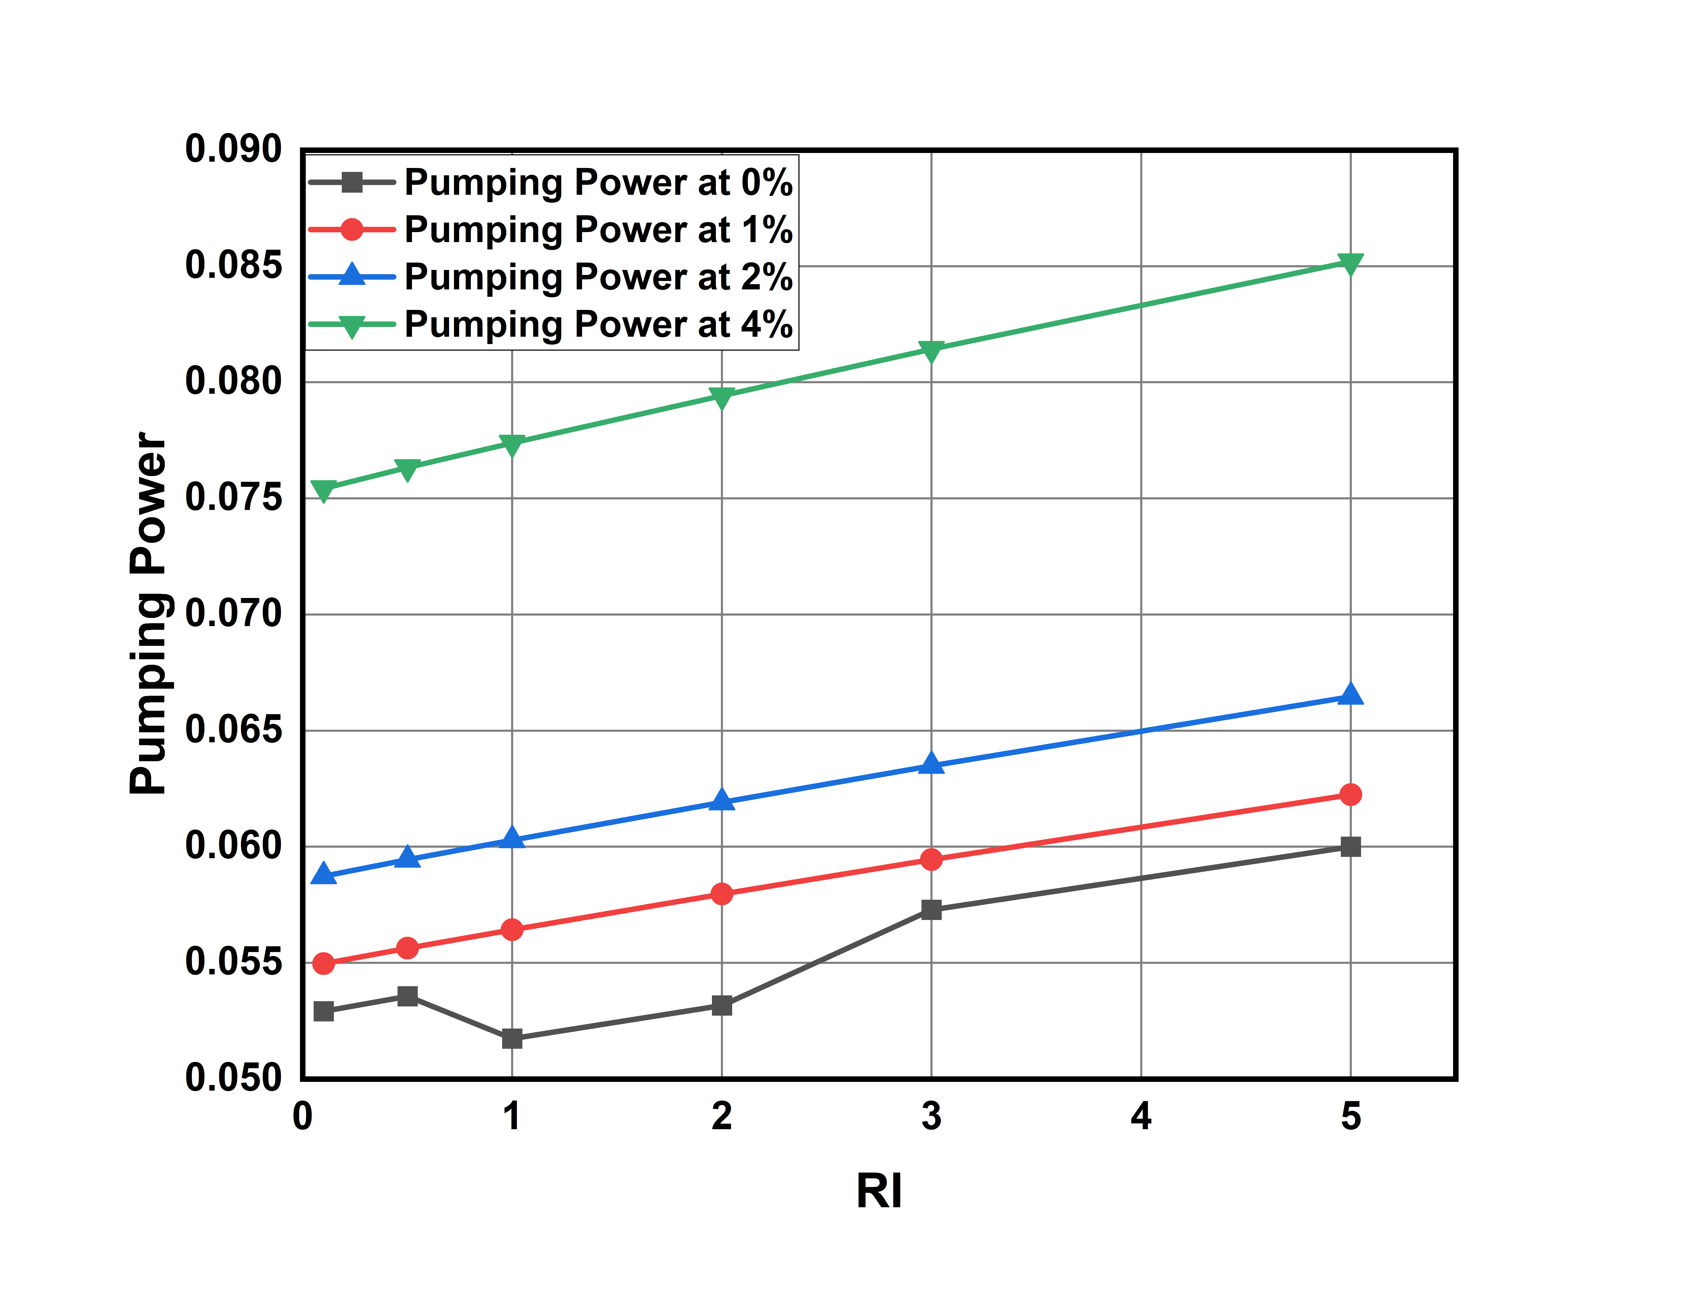
Pumping Power for different Richardson numbers and different volume concentration values:
Here as Heat transfer is increasing power required to pump the fluid into duct also increasing.
Pumping power is increasing linearly with respective to Richardson’s number.
The range of pumping power is 0.0592 and 0.0852
The percentage change with 0% concentration as reference are as follow
% Change = (value at x% - value at 0% ) / value at 0%
For Richardson Number = 0.1:
% change at 1% = 3.87% at 2% = 11% 4% = 42%
For Richardson Number = 2:
% change at 1% = 9.025% at 2% = 16.44% at 4% = 49.392%
For Richardson Number = 5:
% change at 1% = 3.728% at 2% = 10.76% at 4% = 41.984%
At higher concentrations and at higher Richardson’s number pumping power required is becoming more.
Graph-19: Richardson Number vs Pumping Power for different volume concentrations.

Slide 49
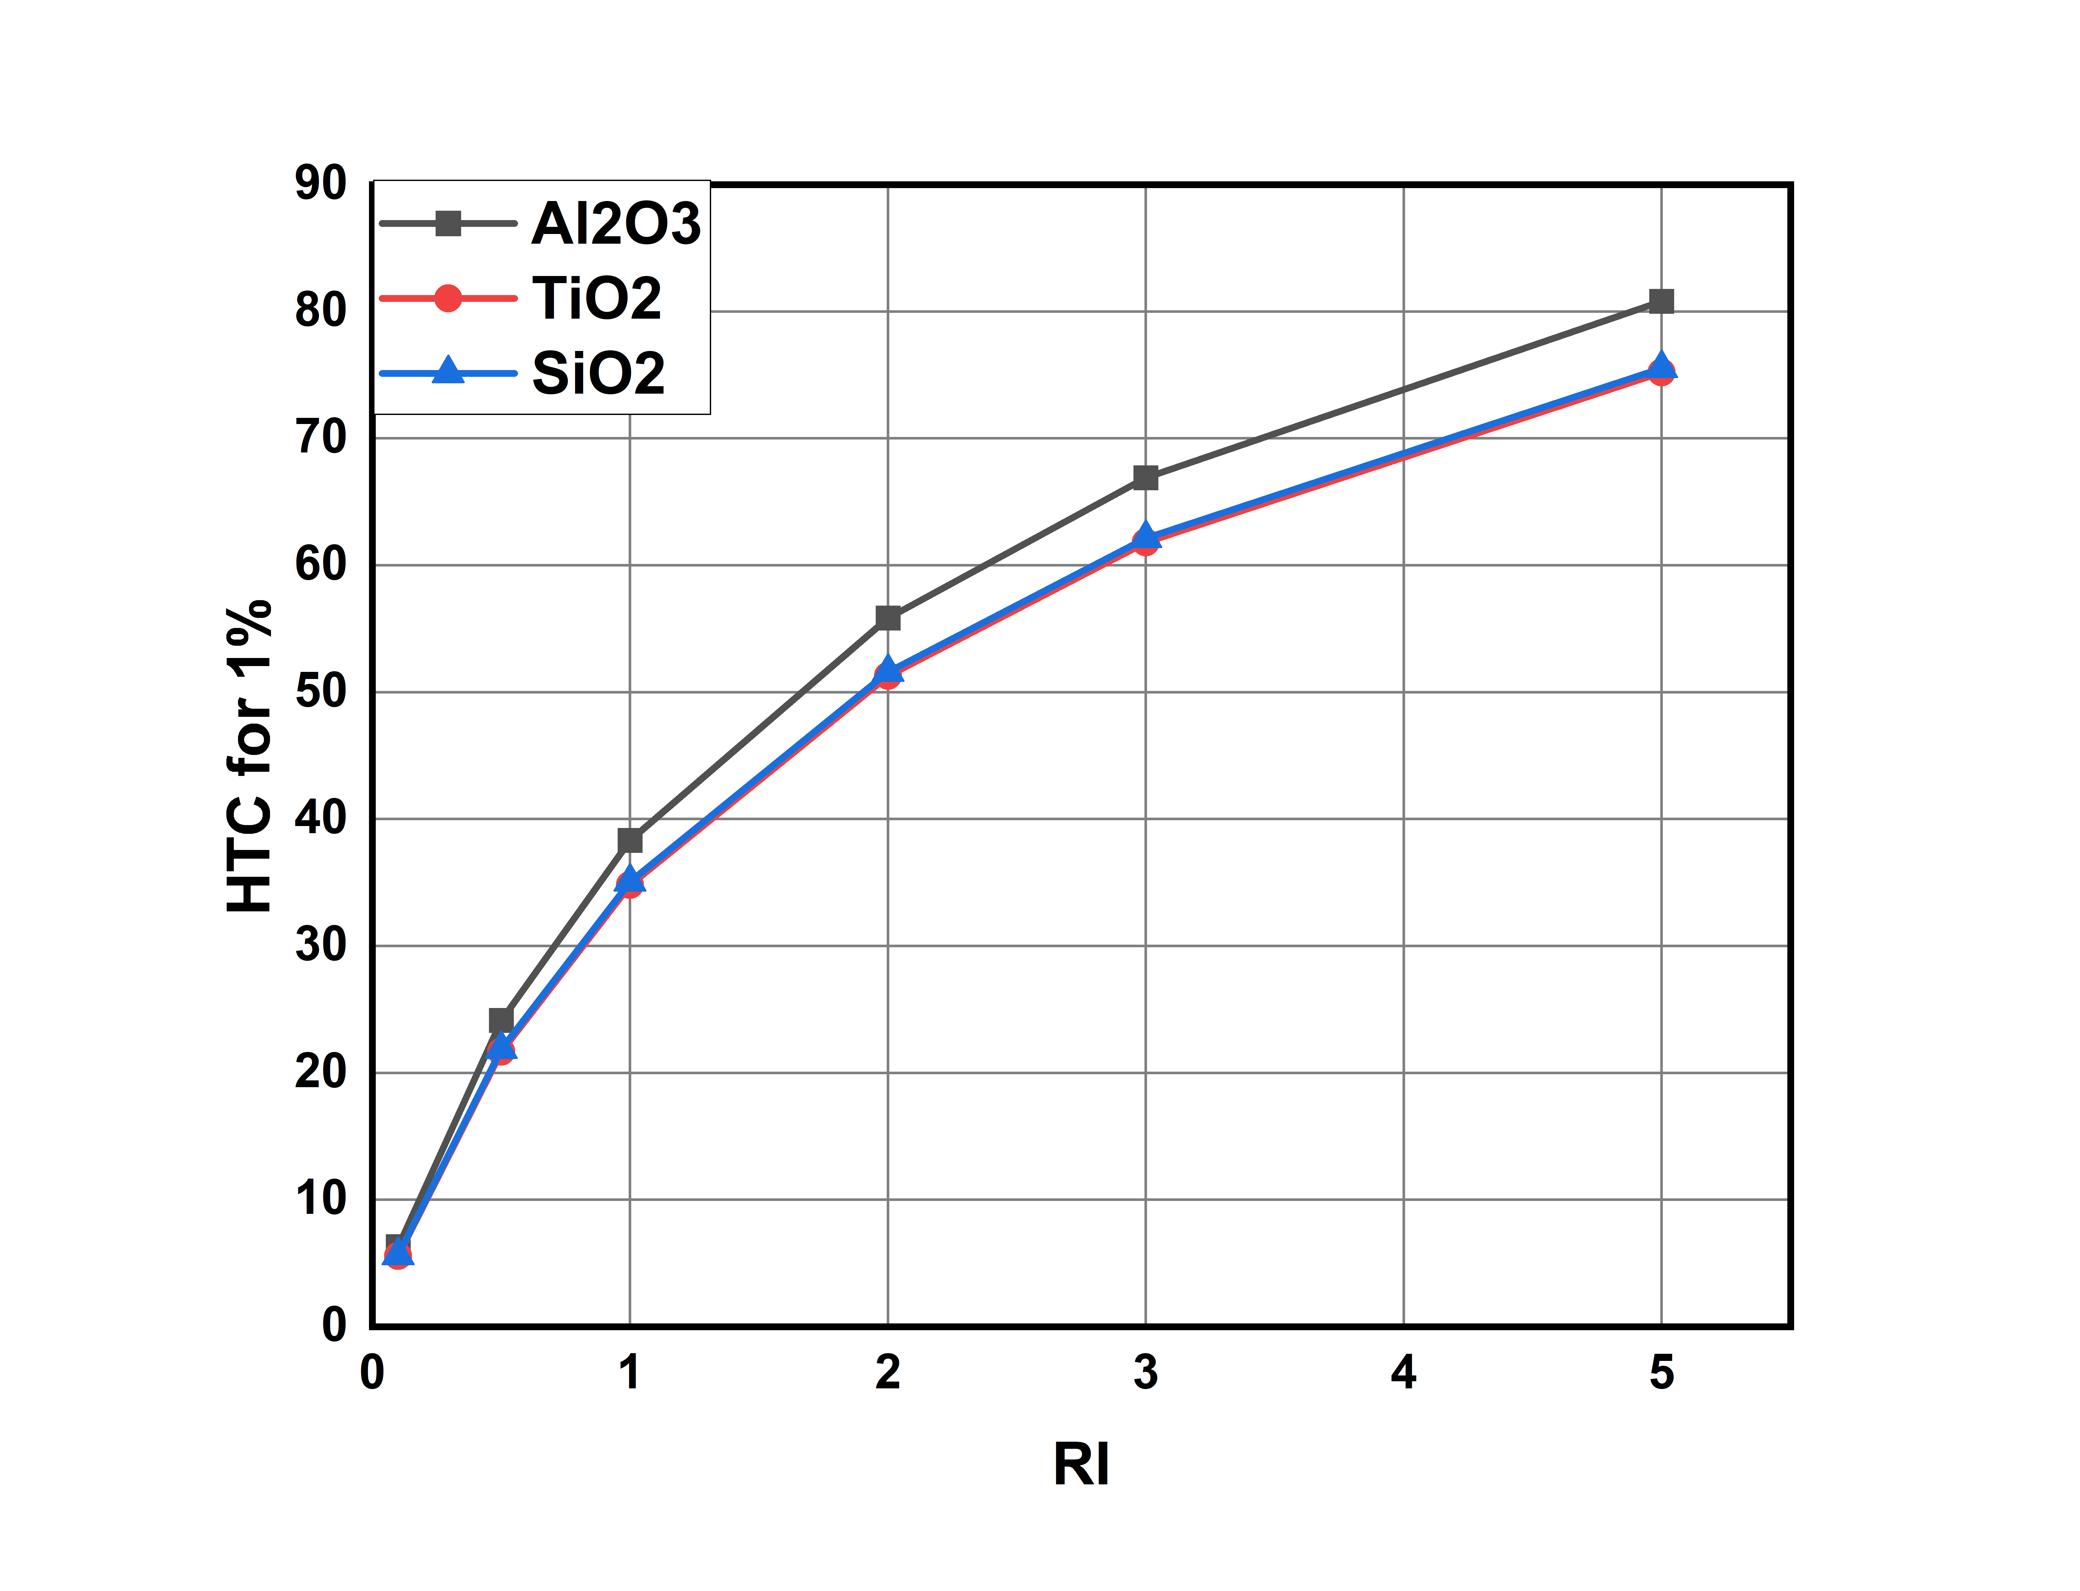
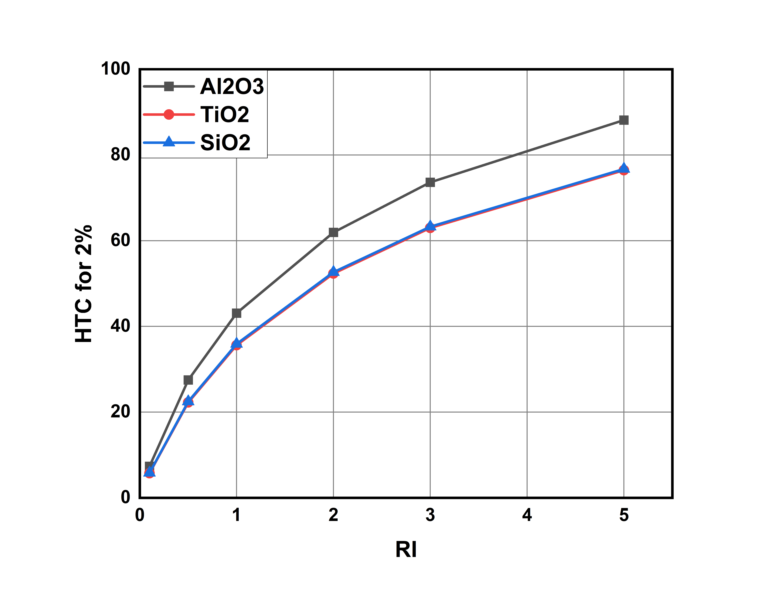
Comparing results between Nanofluids:
Graph-20: Heat transfer coefficient for various nanofluids at 1% volume concentration
Graph-21: Heat transfer coefficient for various nanofluids at 2% volume concentration

Slide 50
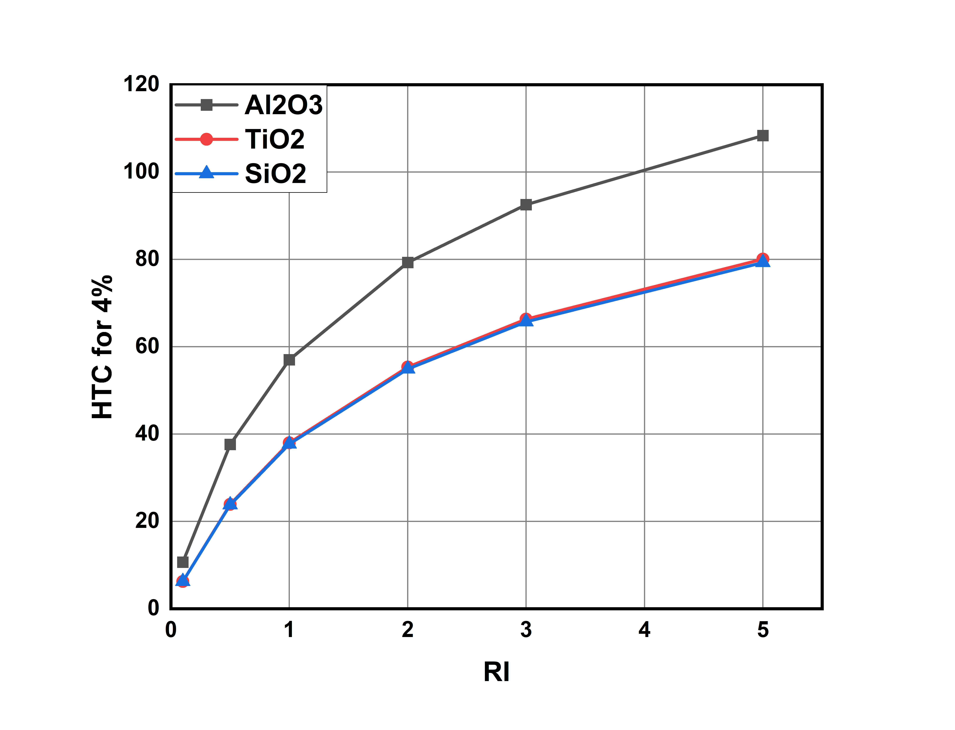
Comparing results between Nanofluids:
Here Aluminium oxide nanofluid has greater heat transfer coefficient than silicon oxide or titanium oxide of around 108.36 vs 79.270
Water based Silicon oxide and Titanium oxide nanofluids has almost very same thermo-physical properties difference between those values is very less Nearly around 79.270
As volume concentration increases gap between Aluminium-oxide nanofluids and silicon oxide nanofluid increasing, showing that as volume concentration is increasing, Aluminium oxide is showing greater sensitivity and providing higher heat transfer coefficient.
Graph-22: Heat transfer coefficient for various nanofluids at 4% volume concentration

Slide 51
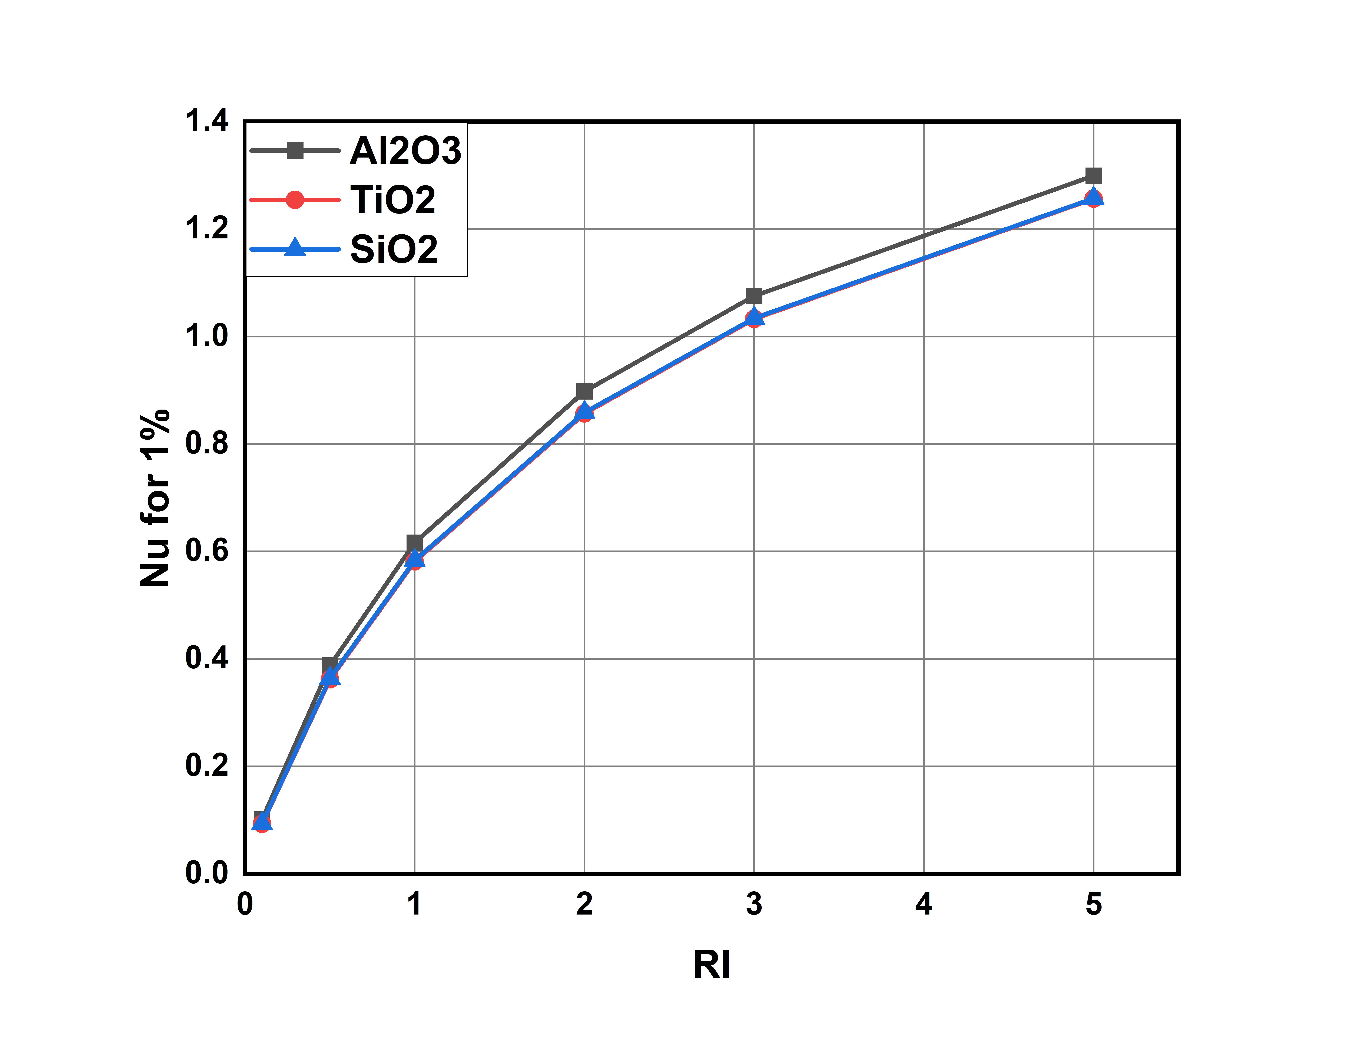
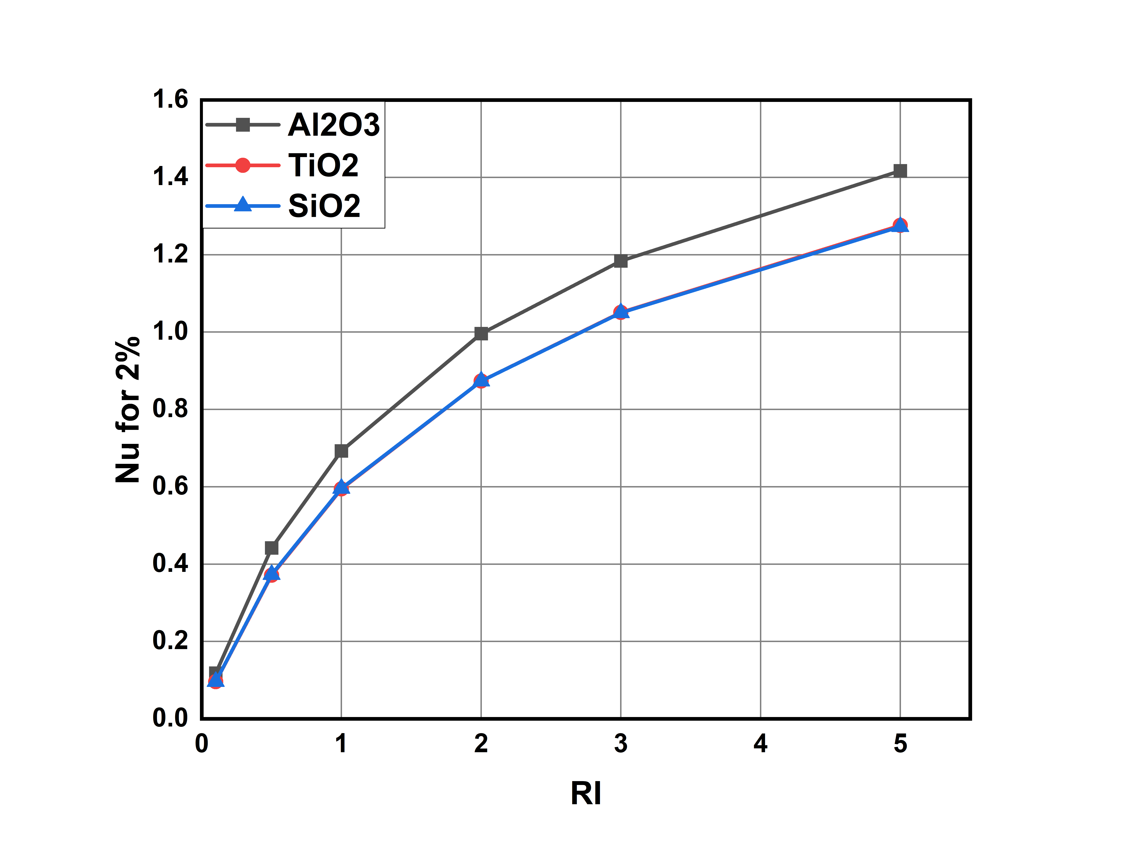
Comparing results between Nanofluids:
Graph-23: Nusselt Number for various nanofluids at 1% volume concentration
Graph-24: Nusselt Number for various nanofluids at 2% volume concentration

Slide 52
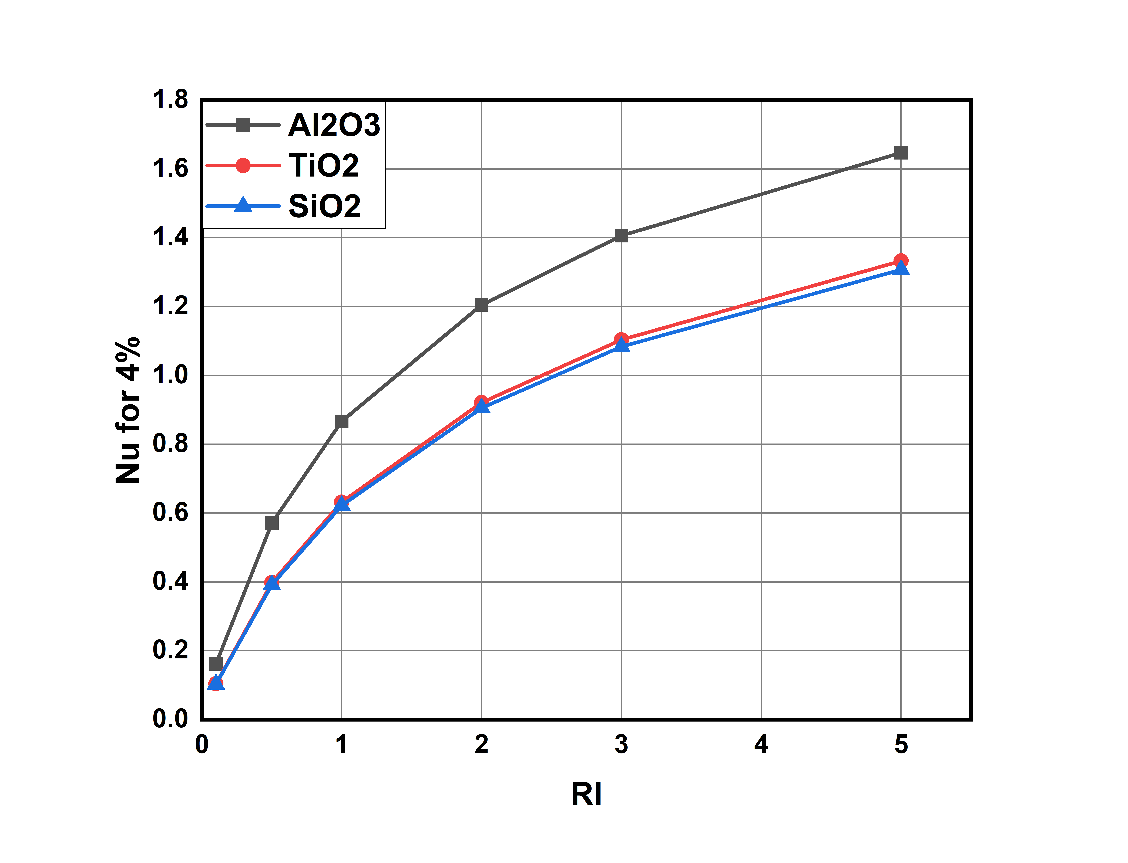
Comparing results between Nanofluids:
Here water + aluminium oxide based has higher Nusselt number among the other two nanofluids.
For Aluminium oxide nanofluid at 1% volume concentration , Nusselt number is varying from 0 to 1.4, at 2% volume concentration Nusselt number is varying from 0 to 1.6 and at 4% volume concentration Nusselt number is varying from 0 to 1.8.
Where as for titanium and silicon oxide nanofluids has it is varying from 0 to 1.4 at all concentrations and values for both nanofluids are very close to each other.
Comparatively Silicon oxide-water based nanofluid has lower Nusselt number.
Graph-25: Nusselt Number for various nanofluids at 4% volume concentration

Slide 53
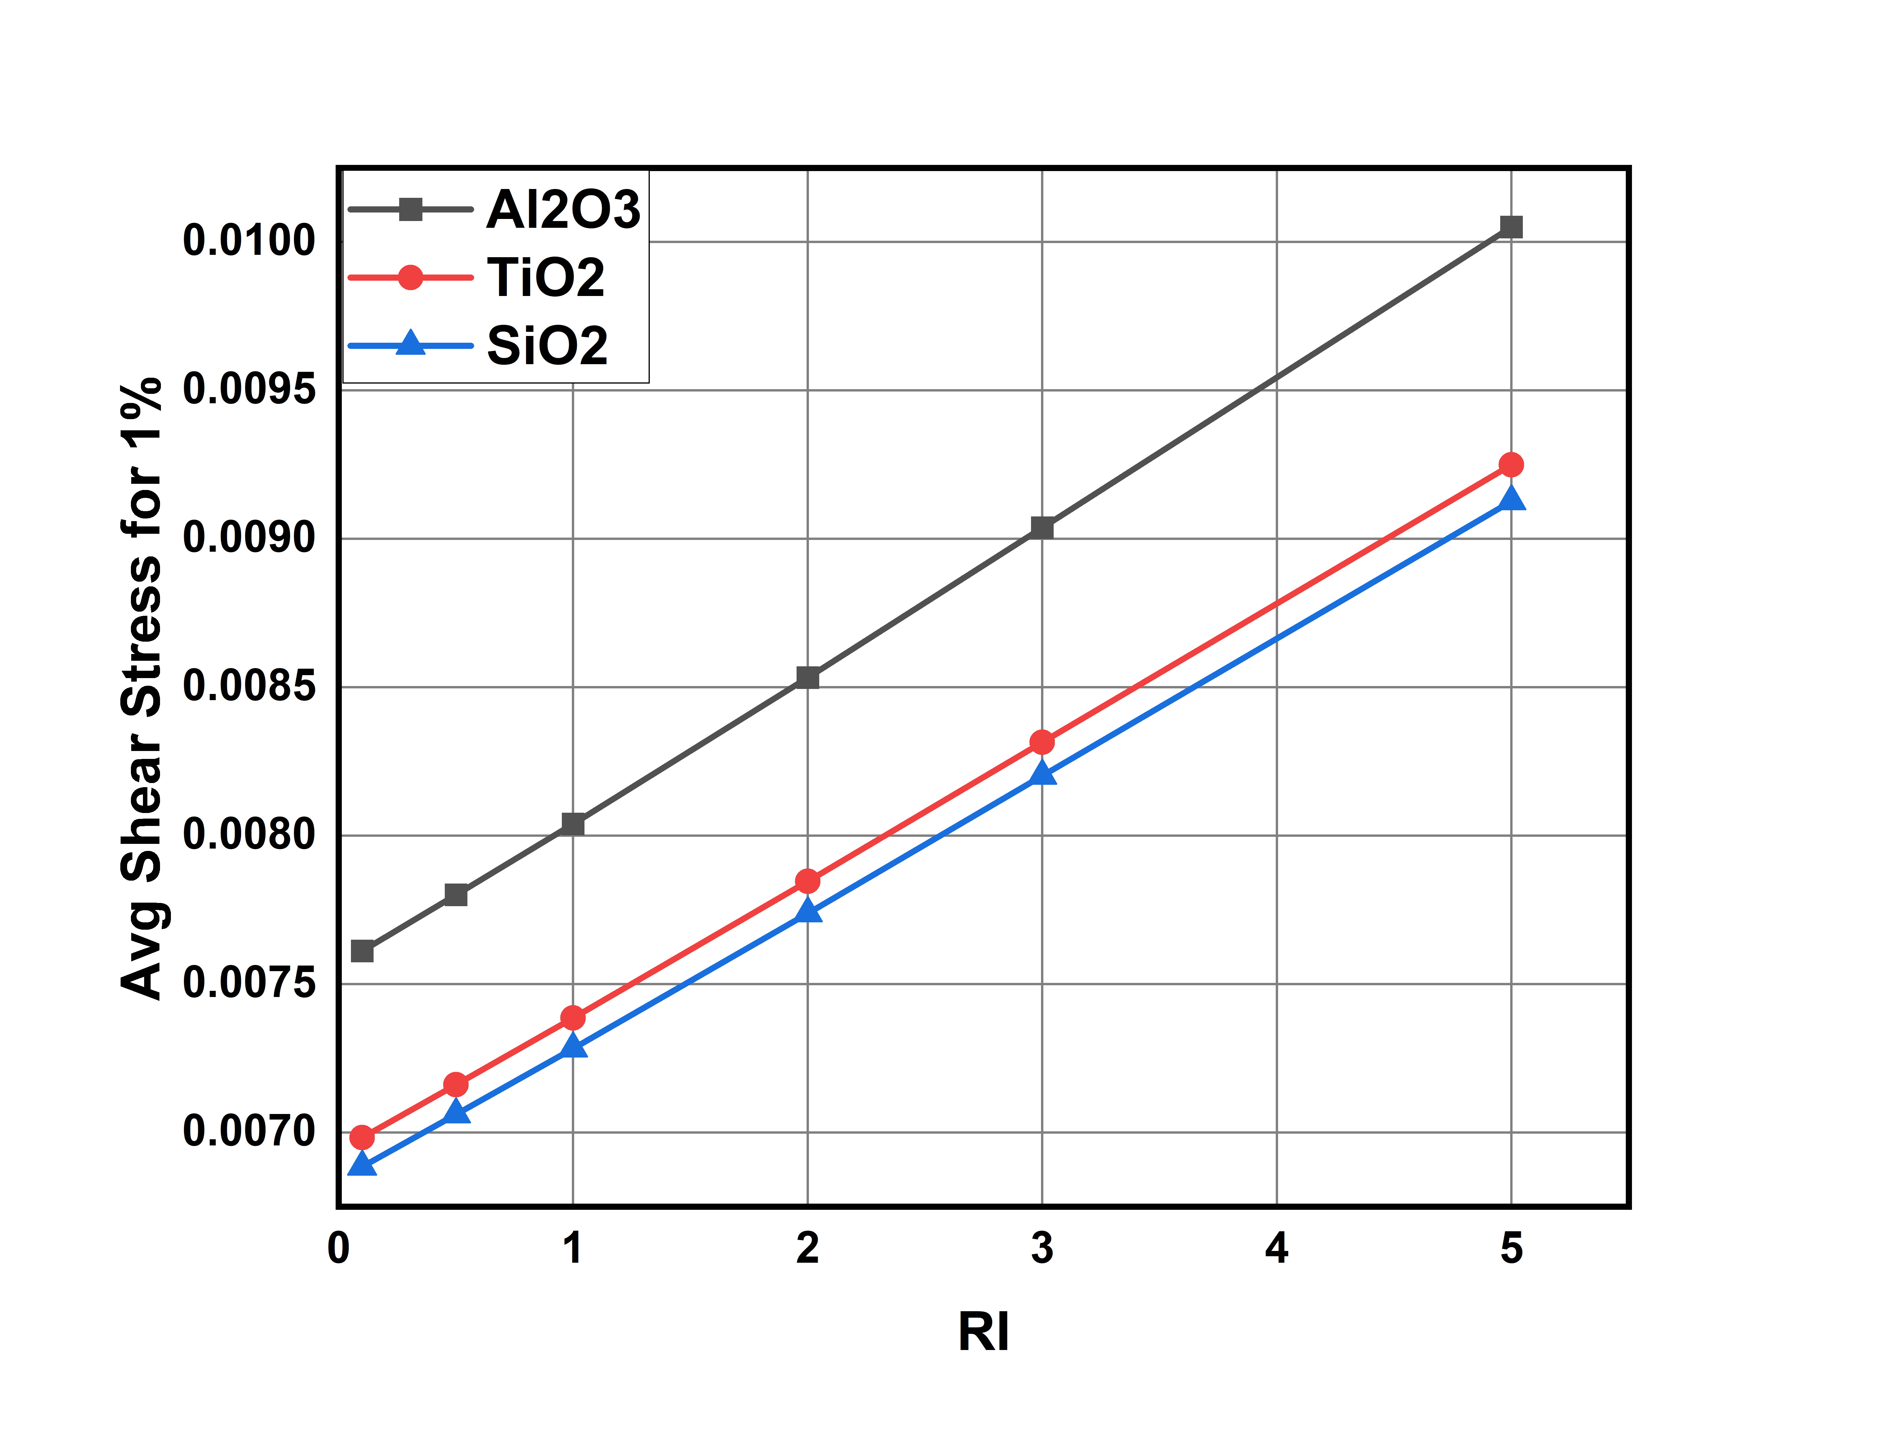
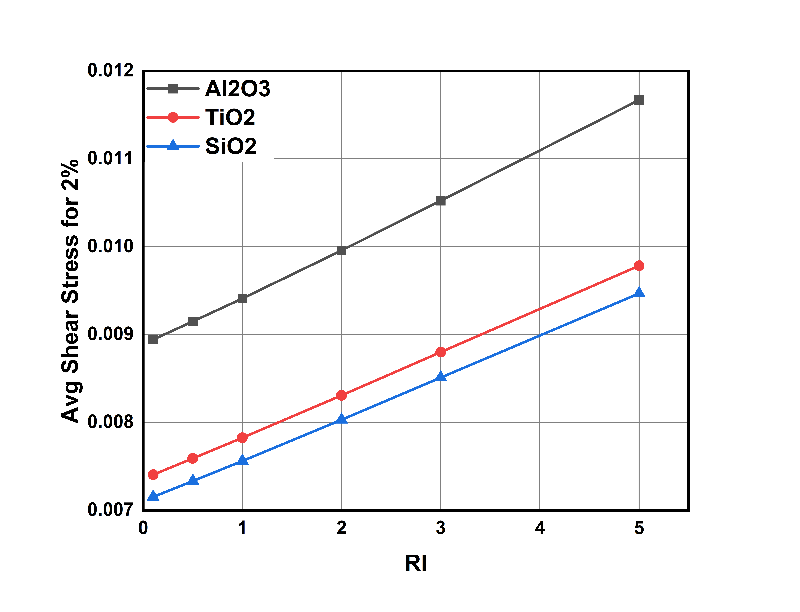
Comparing results between Nanofluids:
Graph-26: Average shear stress for various nanofluids at 1% volume concentration
Graph-27: Average shear stress for various nanofluids at 2% volume concentration

Slide 54
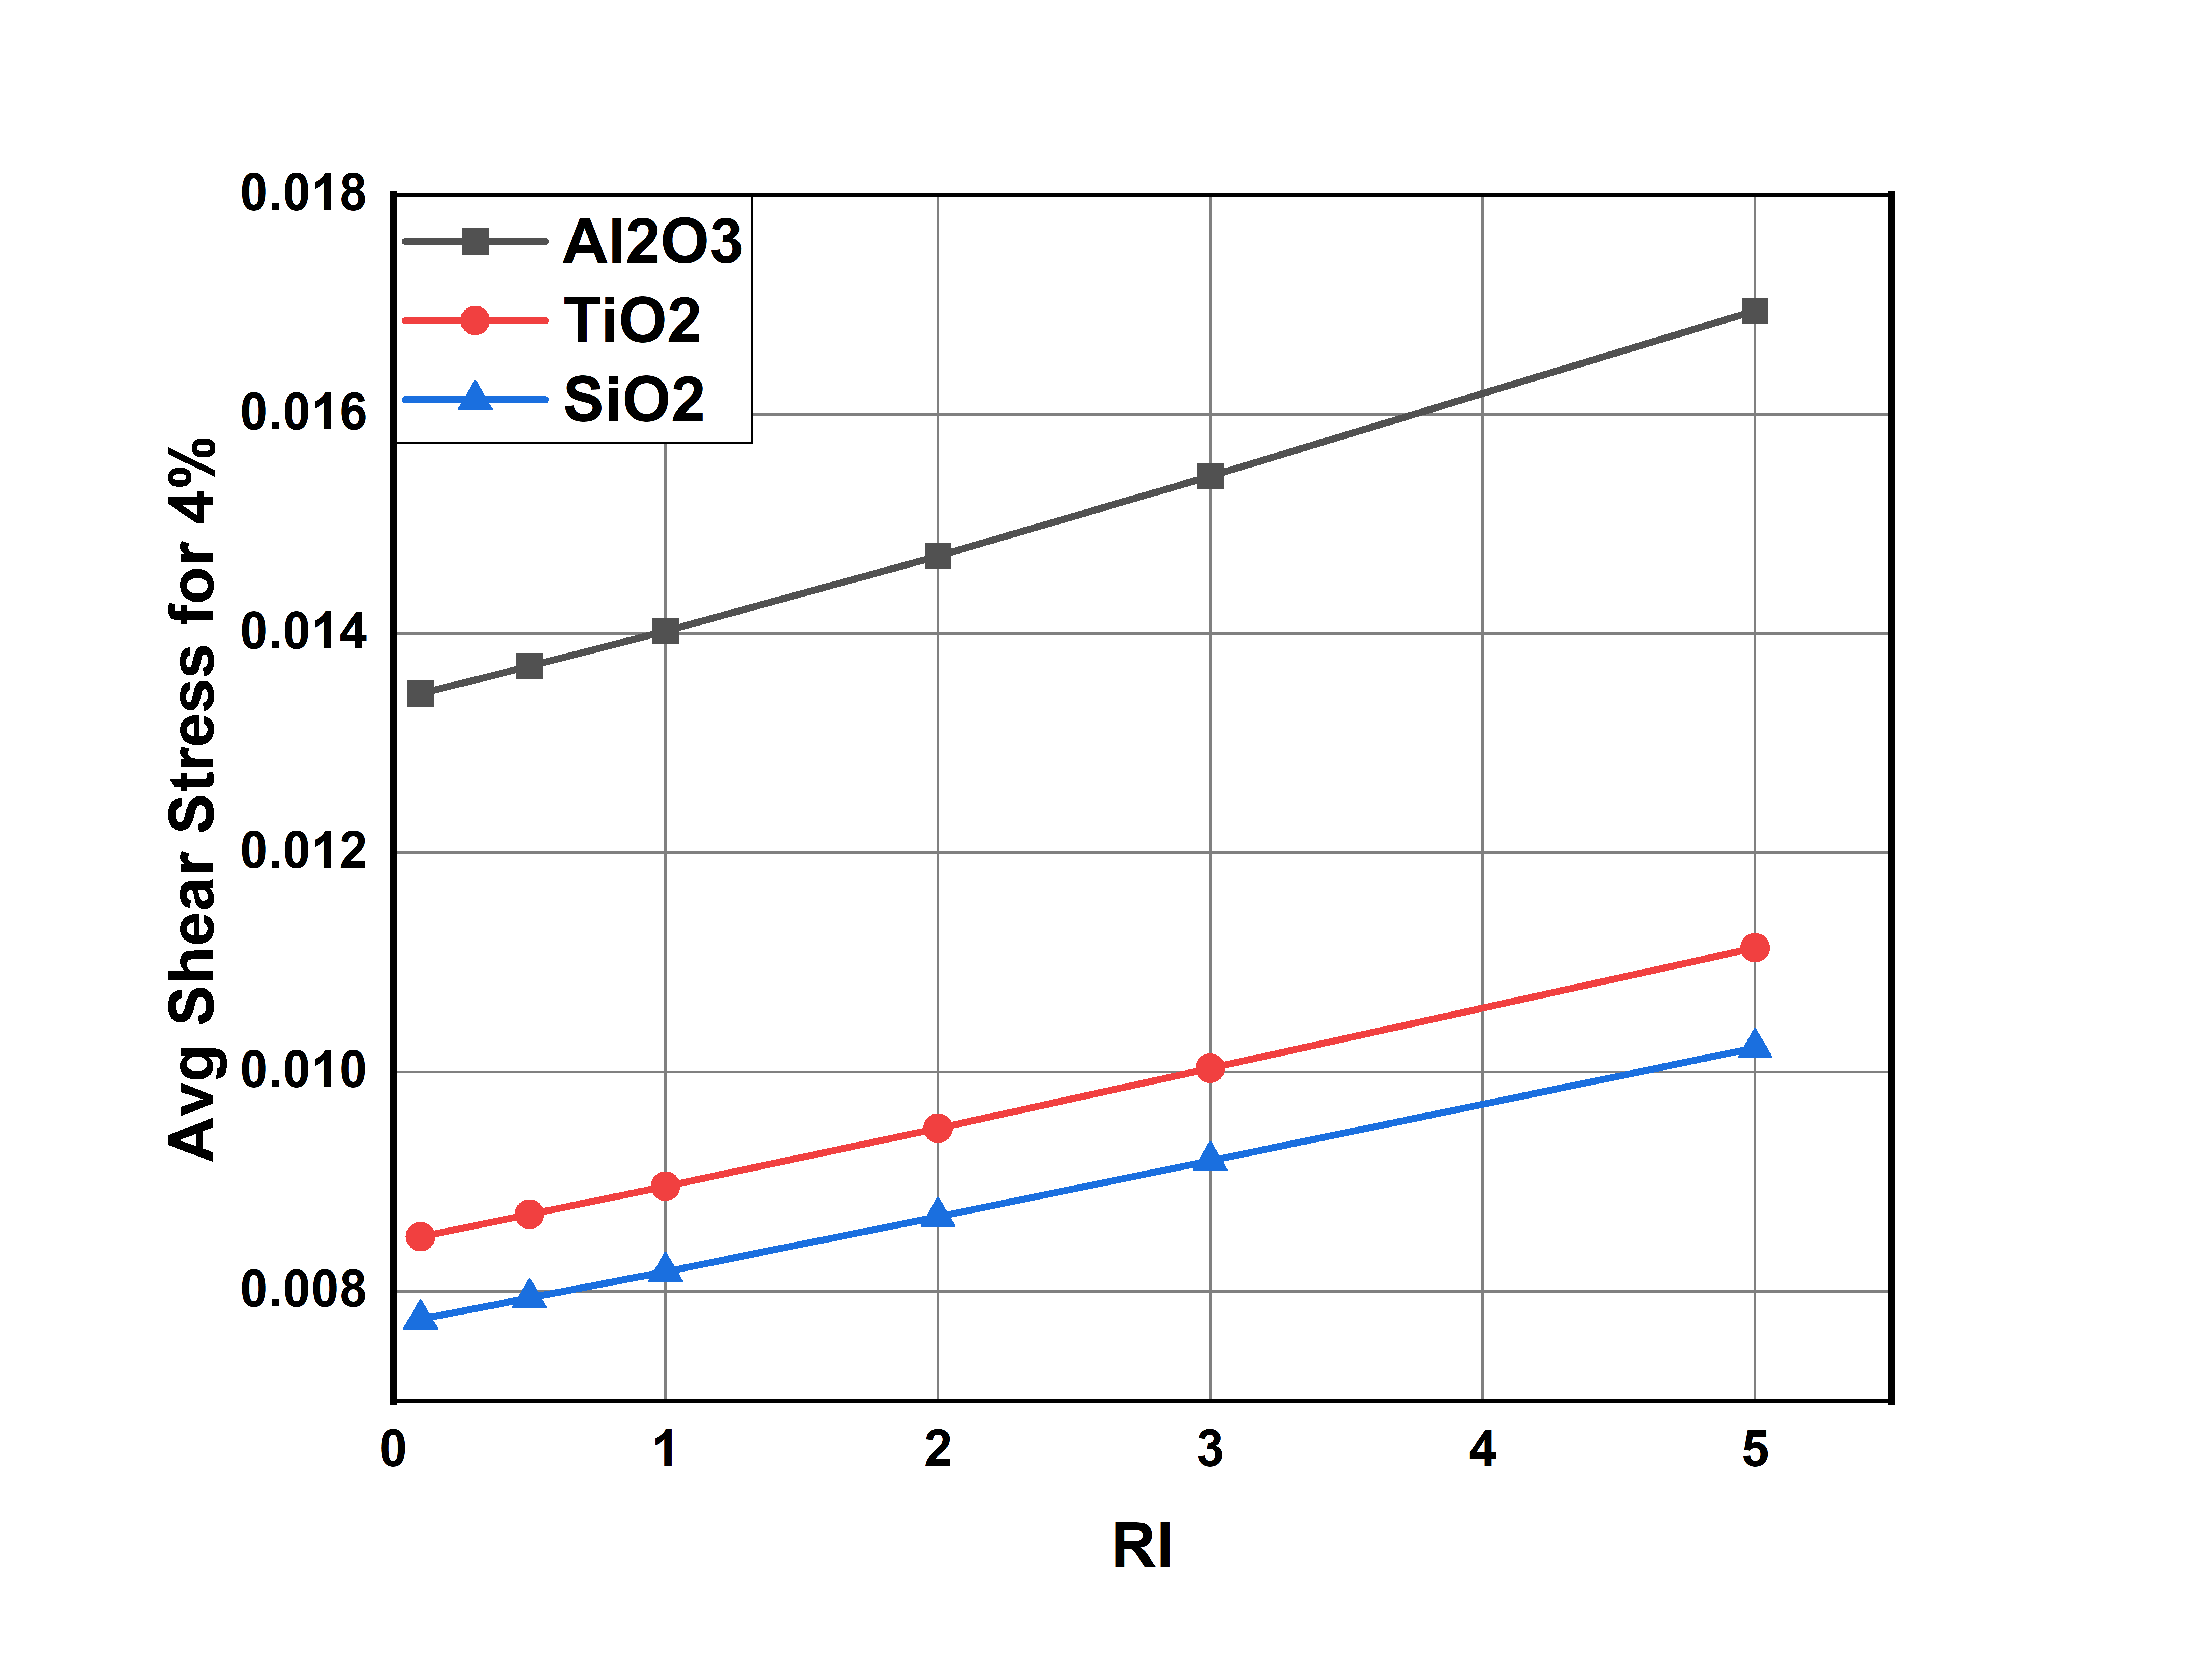
Comparing results between Nanofluids:
Along with heat transfer coefficient Aluminum oxide nanofluid also has higher shear stress around the walls of the duct (0.0169)
As concentration increases gap between silicon oxide and titanium oxide increases and at 4% volume concentration titanium oxide has higher shear stress which is undesirable.(0.0113 vs 0.0102)
Silicon oxide nanofluid is giving us the very less shear stress. 0.0102
Graph-28: Average shear stress for various nanofluids at 4% volume concentration

Slide 55
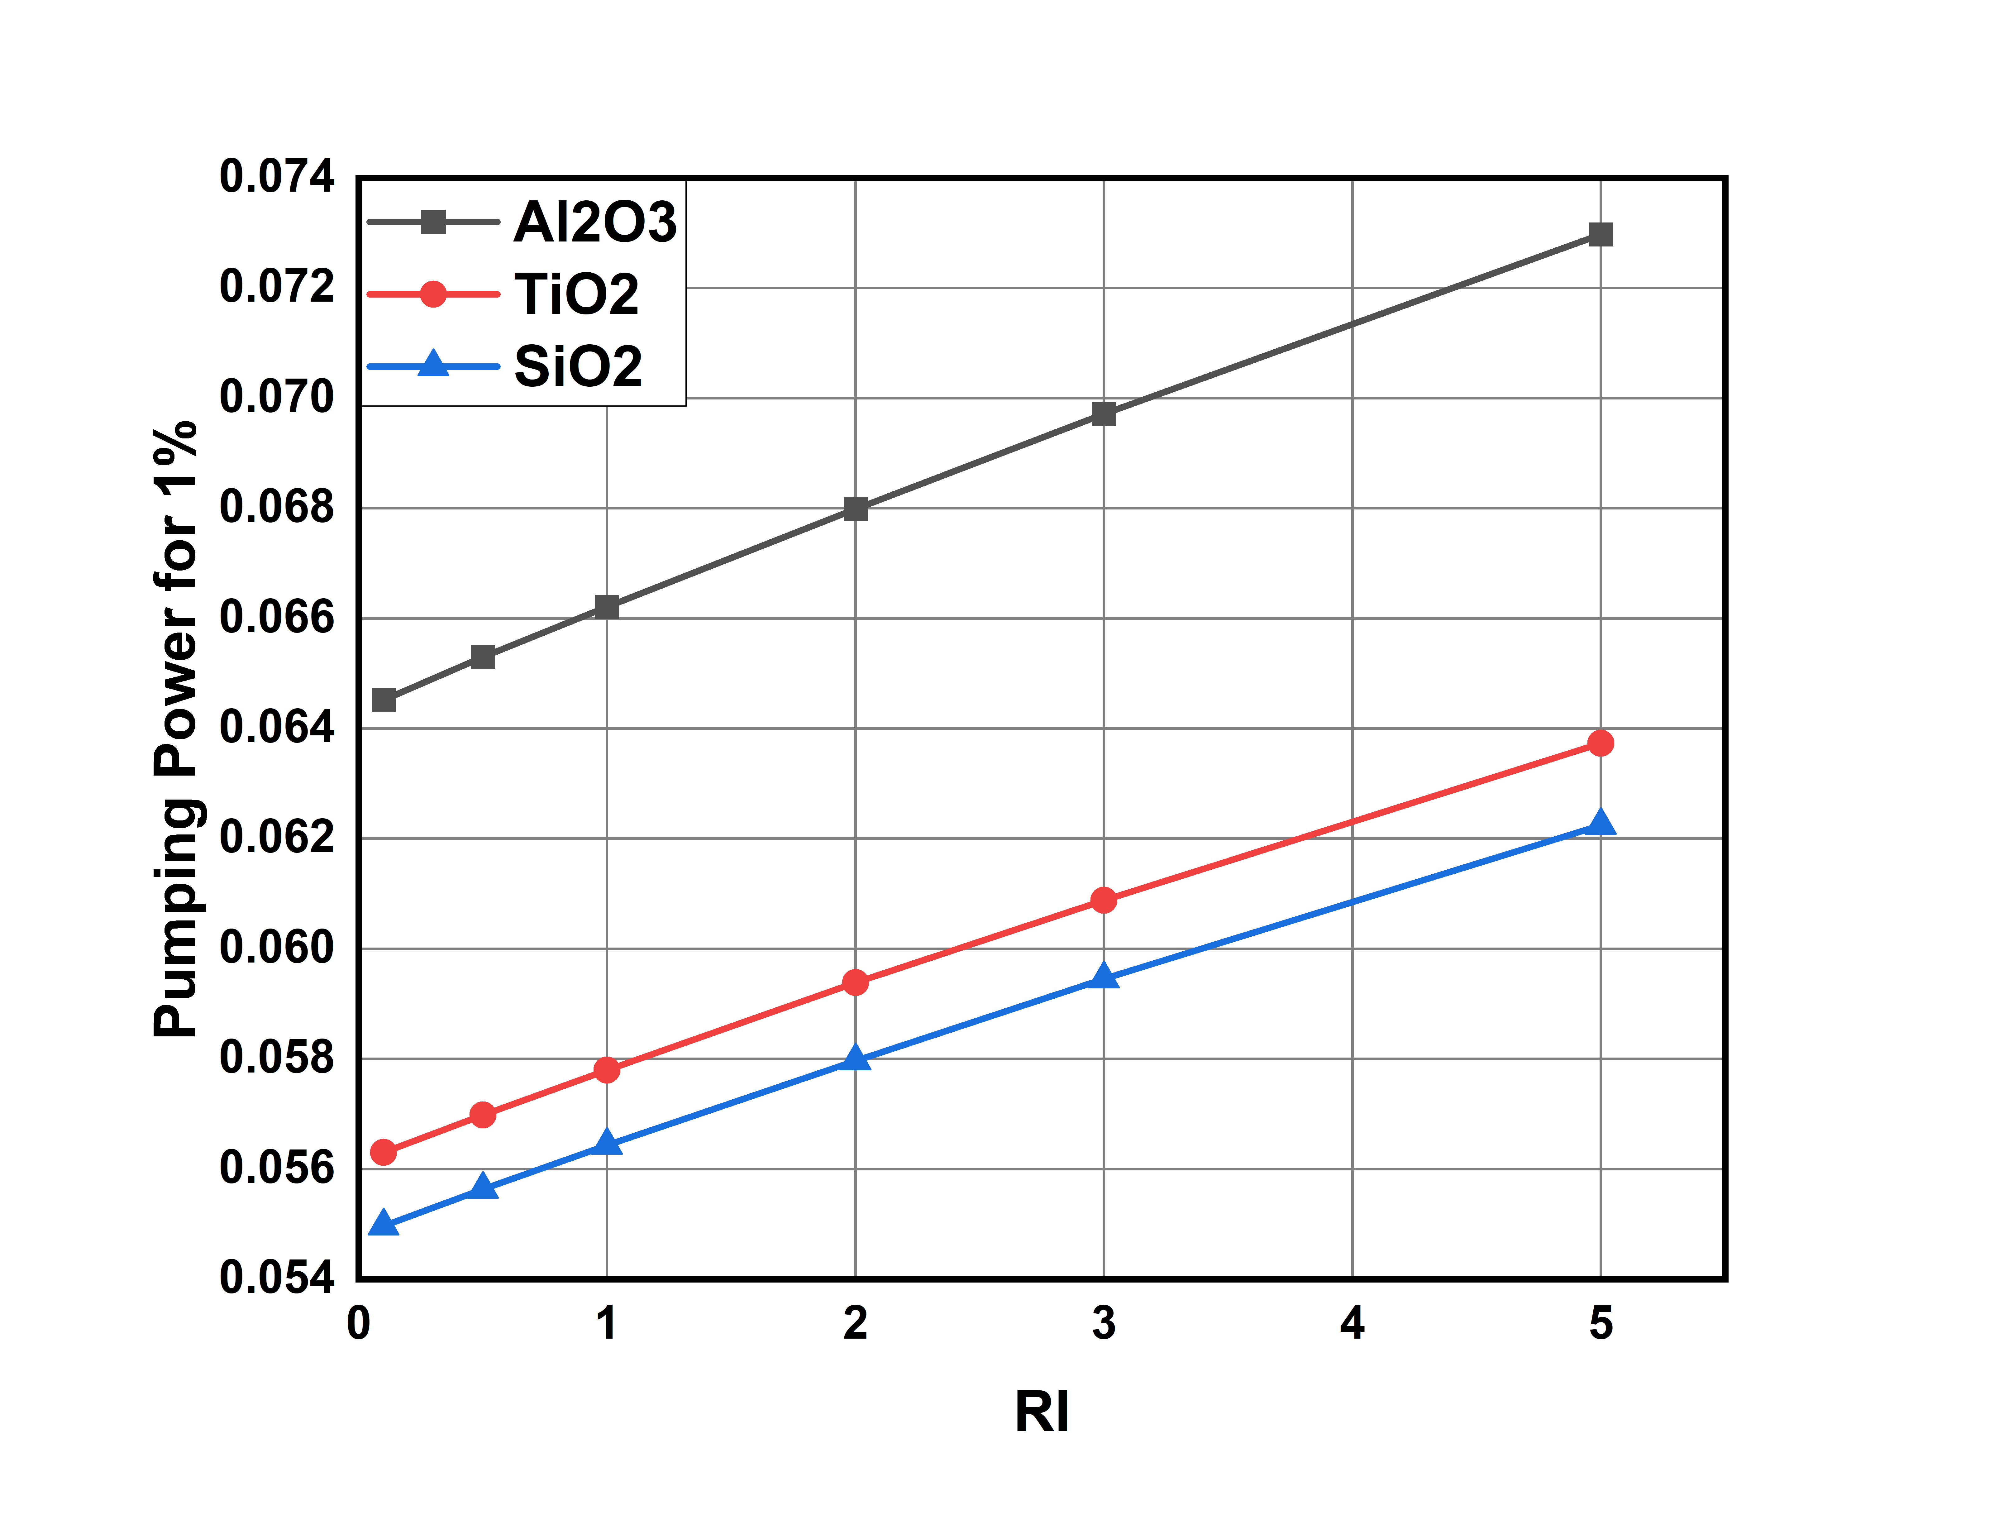
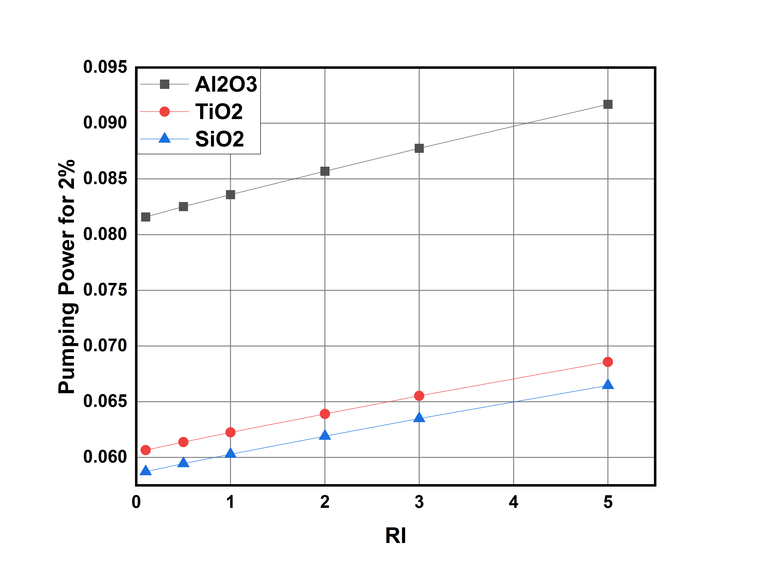
Comparing results between Nanofluids:
Graph-29: Pumping power for various nanofluids at 1% volume concentration
Graph-30: Pumping power for various nanofluids at 2% volume concentration

Slide 56
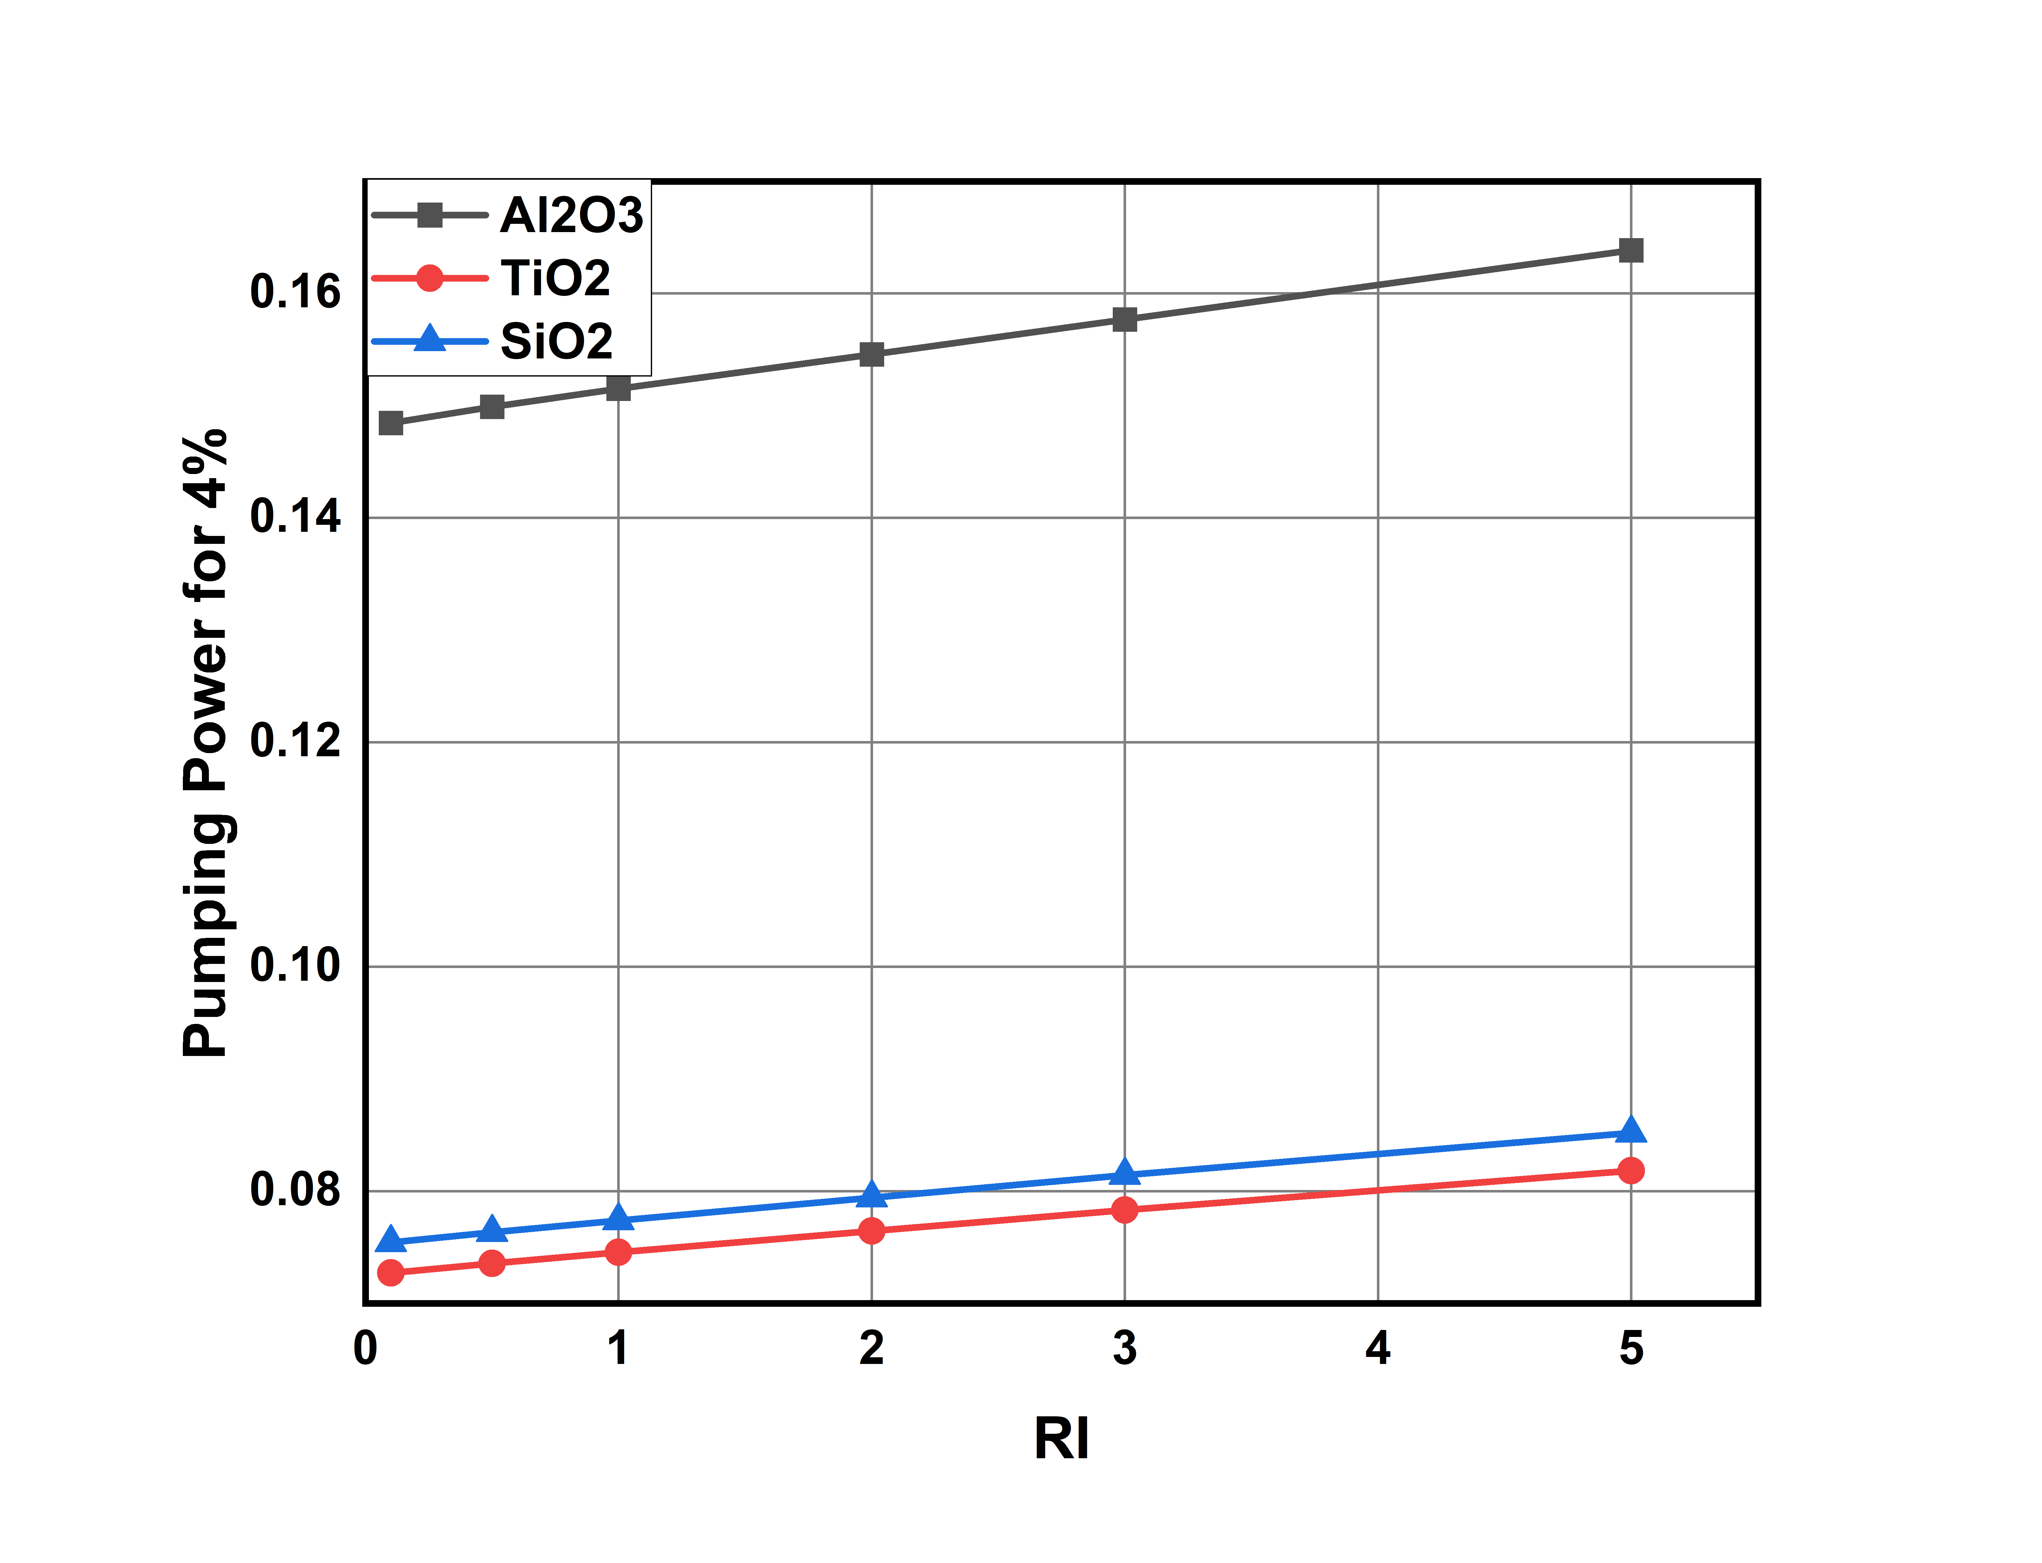
Comparing results between Nanofluids:
Pumping power required for Water based Aluminium oxide nanofluid is (0.1685 at 4 % concentration ) more compared to silicon oxide and titanium oxide nanofluids.
Pumping power required for Titanium oxide nanofluid is more than that required for silicon oxide nanofluid at lower volume concentrations. (0.07543 vs 0.07274)
As concentration increases Silicon oxide having pumping power of than that of Titanium oxide nanofluid (0.0818 vs 0.0852)
Graph-31: Pumping power for various nanofluids at 4% volume concentration

Slide 57
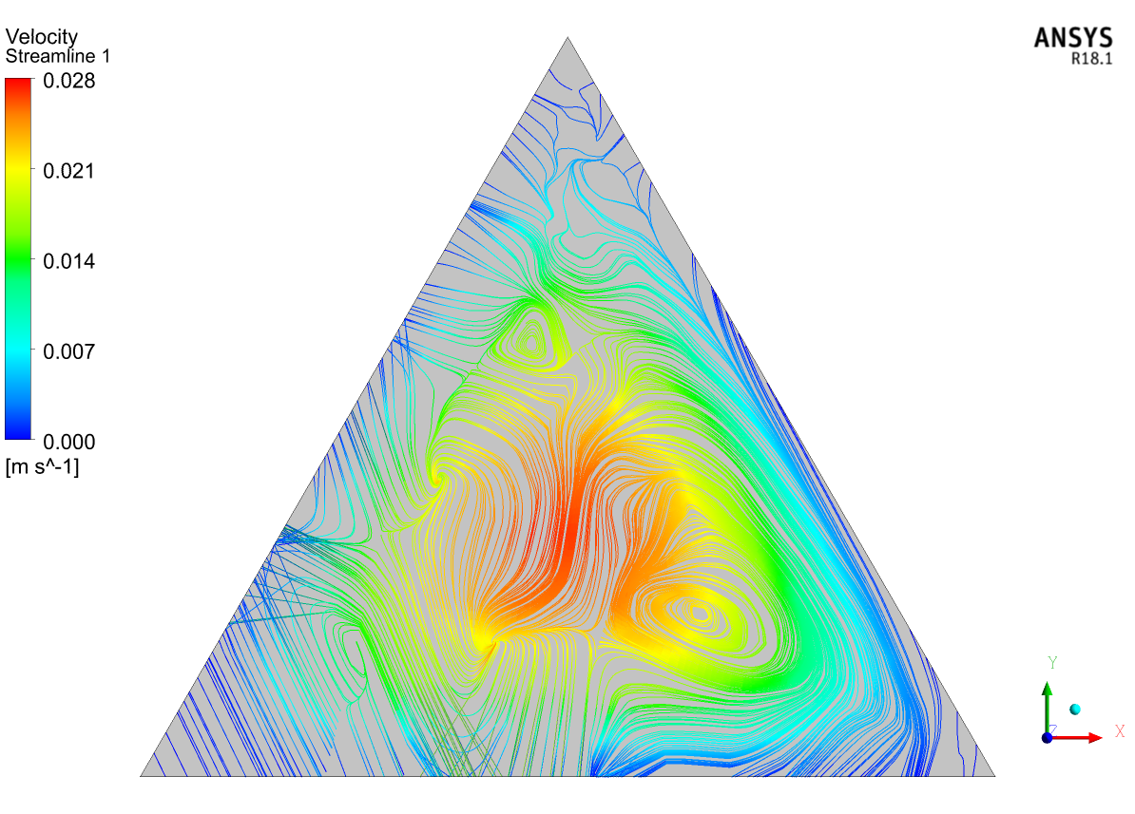
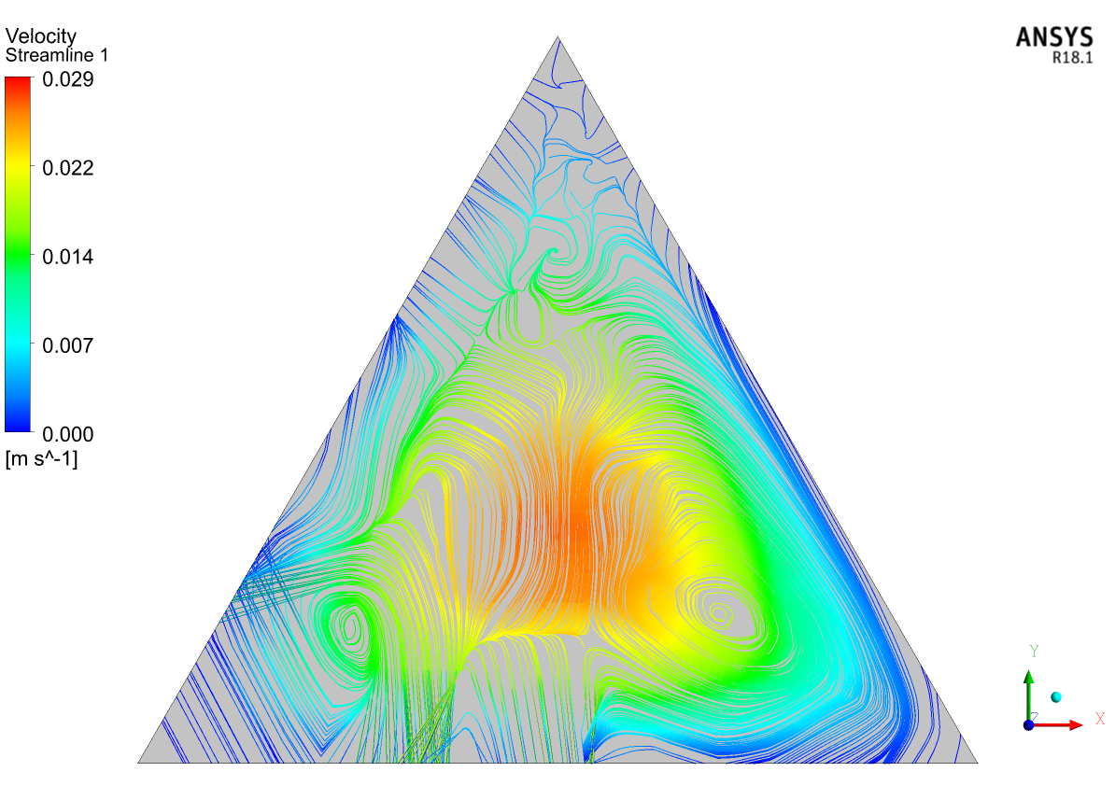
Contours of Aluminium oxide nanofluid:
Figure-2: Velocity Streamline at midpoint(1000mm) at 4% volume concentration and Richardson number=0.1
Figure-3: Velocity Streamline at midpoint(1000mm) at 4% volume concentration and Richardson number=0.5

Slide 58
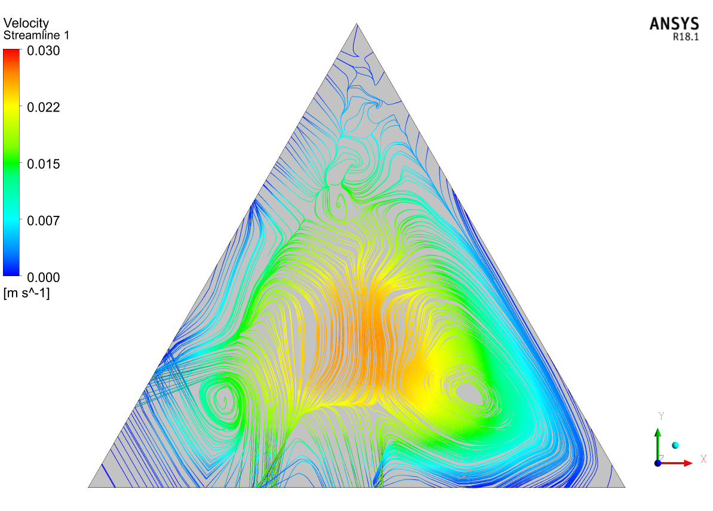
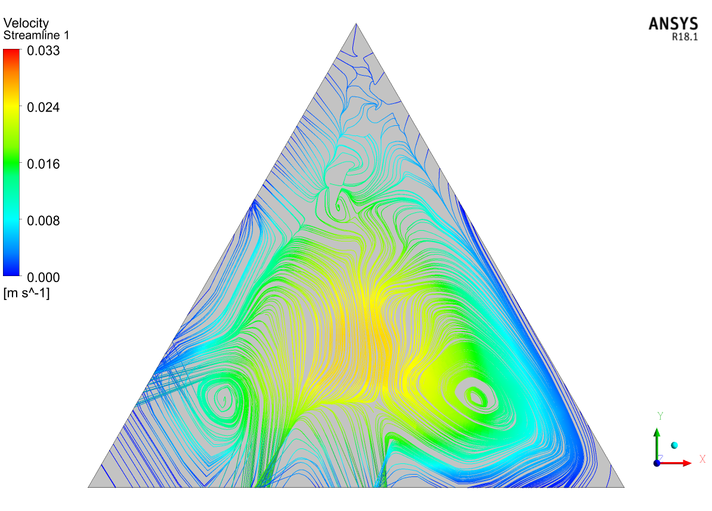
Contours of Aluminium oxide nanofluid:
Figure-4: Velocity Streamline at midpoint(1000mm) at 4% volume concentration and Richardson number=1
Figure-5: Velocity Streamline at midpoint(1000mm) at 4% volume concentration and Richardson number=2

Slide 59
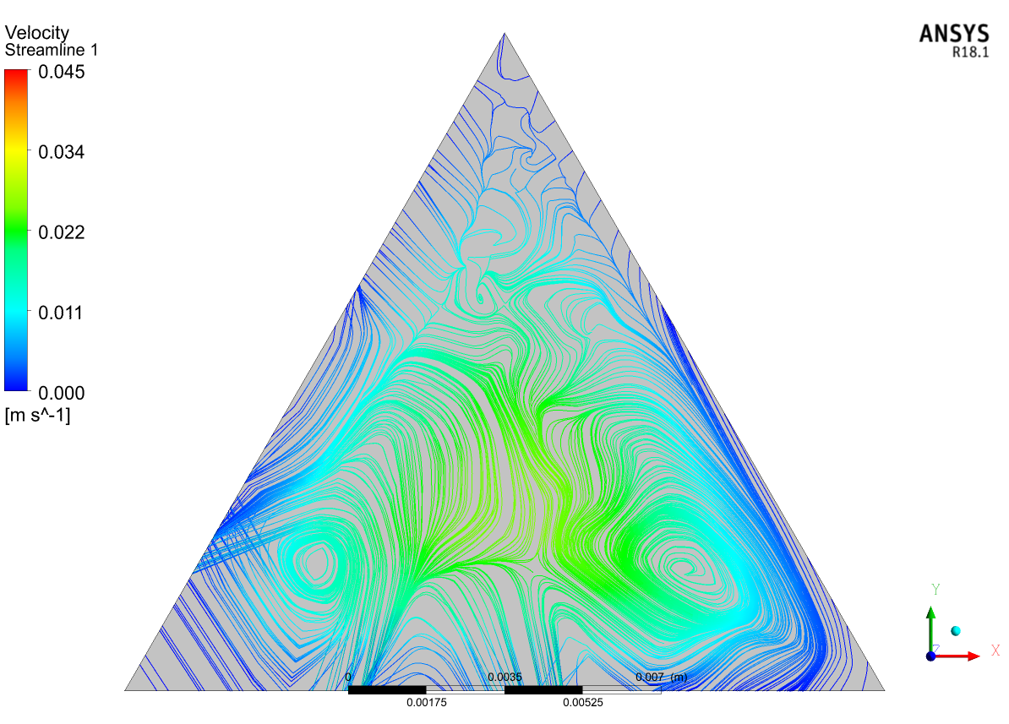
Contours of Aluminium oxide nanofluid:
Figure-6: Velocity Streamline at midpoint(1000mm) at 4% volume concentration and Richardson number=5

Slide 60
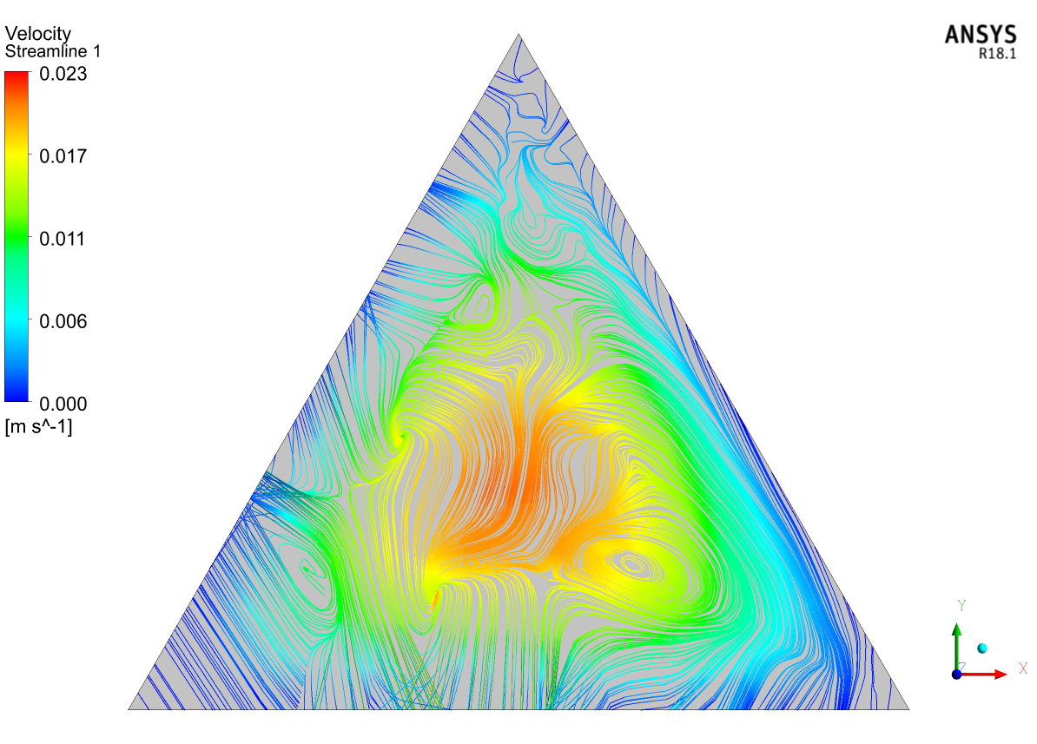
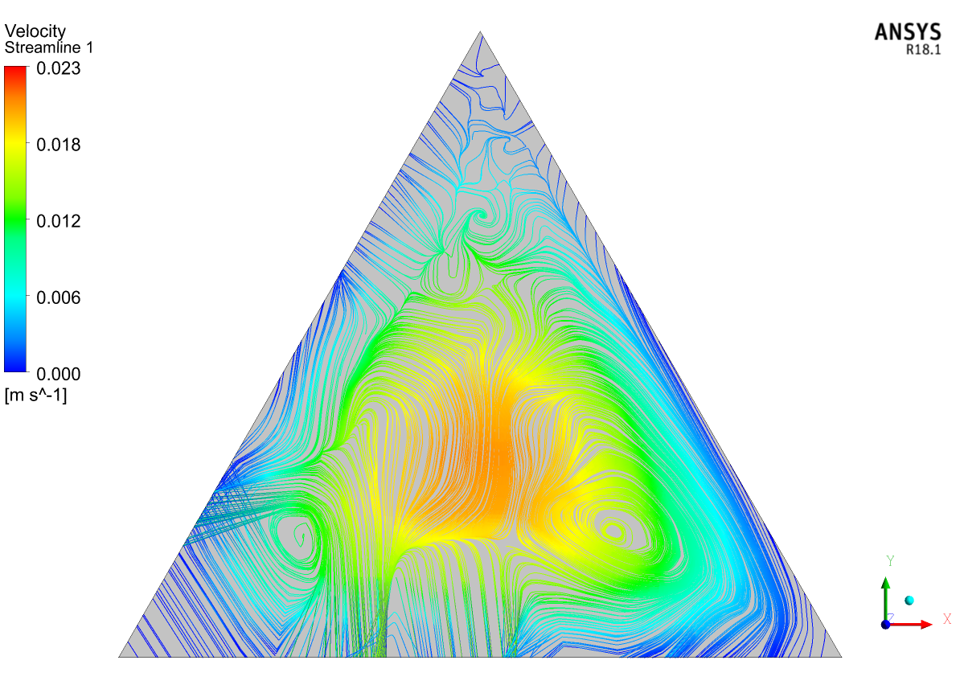
Contours of Titanium oxide nanofluid:
Figure-7: Velocity Streamline at midpoint(1000mm) at 0% volume concentration and Richardson number=0.1
Figure-8: Velocity Streamline at midpoint(1000mm) at 0% volume concentration and Richardson number=0.5

Slide 61
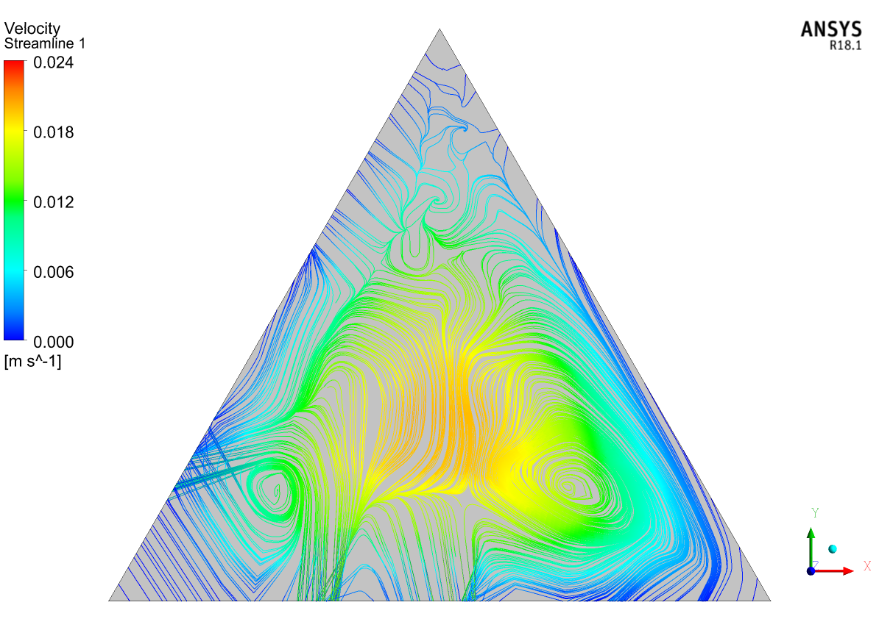
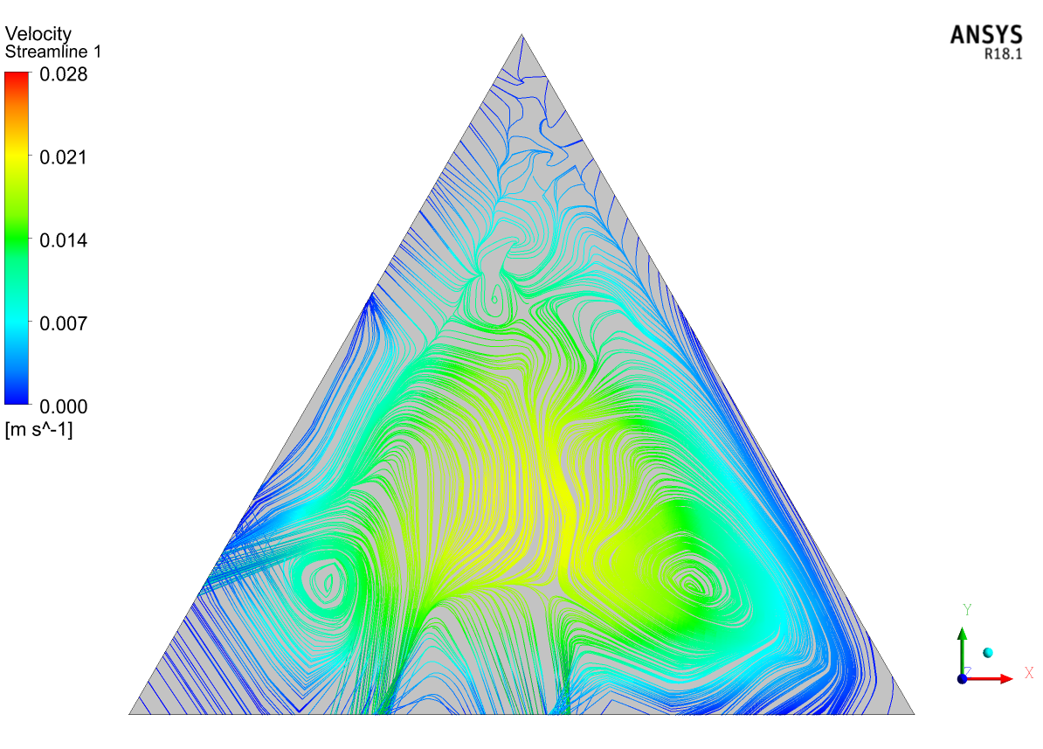
Contours of Titanium oxide nanofluid:
Figure-9: Velocity Streamline at midpoint(1000mm) at 0% volume concentration and Richardson number=1
Figure-10: Velocity Streamline at midpoint(1000mm) at 0% volume concentration and Richardson number=2

Slide 62
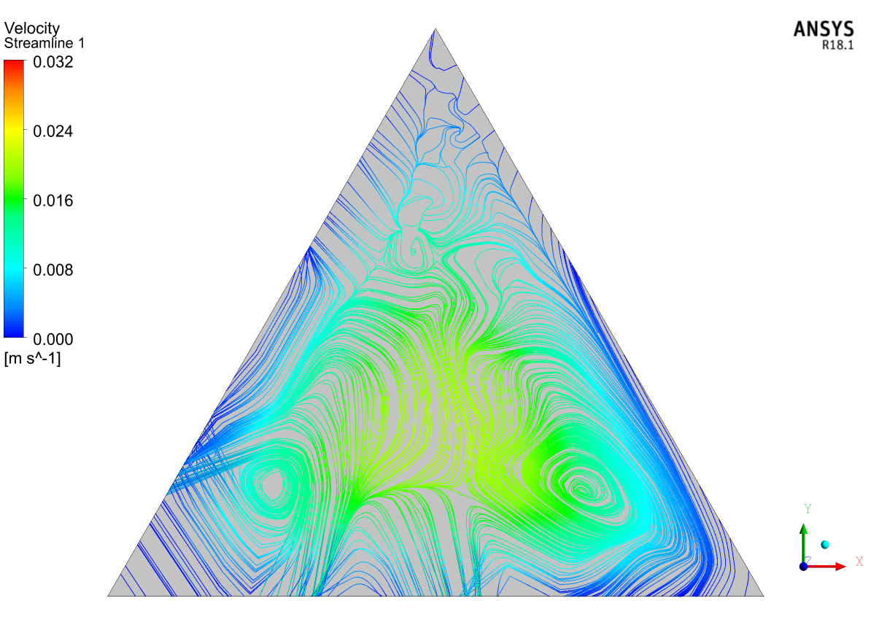
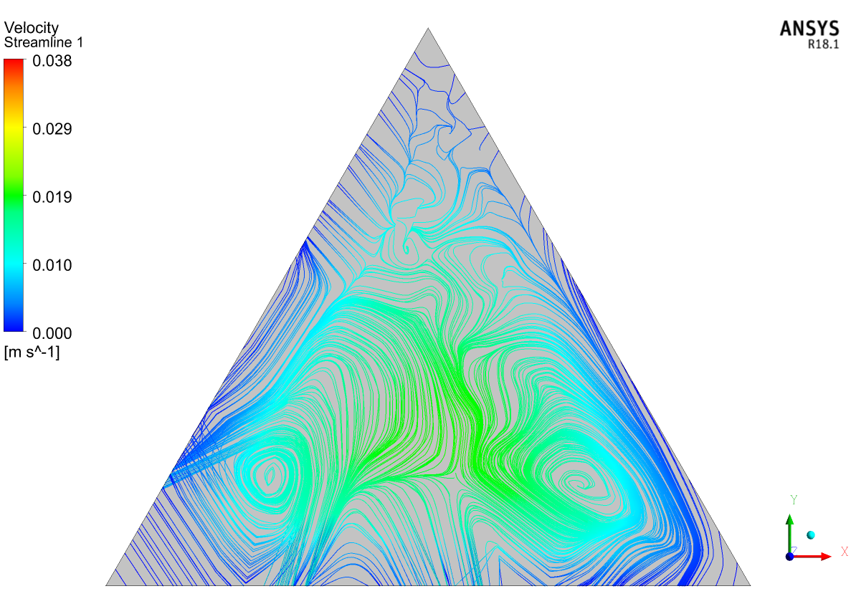
Contours of Titanium oxide nanofluid:
Figure-11: Velocity Streamline at midpoint(1000mm) at 0% volume concentration and Richardson number=3
Figure-12: Velocity Streamline at midpoint(1000mm) at 0% volume concentration and Richardson number=5

Slide 63


Contours of Silicon oxide nanofluid:
Figure-13: Velocity Streamline at midpoint(1000mm) at 0% volume concentration and Richardson number=0.1
Figure-14: Velocity Streamline at midpoint(1000mm) at 0% volume concentration and Richardson number=0.5

Slide 64


Contours of Silicon oxide nanofluid:
Figure-15: Velocity Streamline at midpoint(1000mm) at 0% volume concentration and Richardson number=1
Figure-16: Velocity Streamline at midpoint(1000mm) at 0% volume concentration and Richardson number=2

Slide 65

Contours of Silicon oxide nanofluid:
Figure-17: Velocity Streamline at midpoint(1000mm) at 0% volume concentration and Richardson number=5

Slide 66

Grid Independent Analysis of Rectangular Duct:
We have taken a rectangular duct of 17mm*14.722mm cross-section and performed grid independent analysis by taking mesh sizes from 3.5mm to 0.5mm.
We obtained no of elements ={11420,33348,63000,145640,509490,673968,940086,1216700,1421280,2176608,2728440,3944000} for mesh sizes of {3.5,2.5,2,1.5,1,0.9,0.8,0.75,0.7,0.6,0.55,0.5}
After a mesh size of 0.75mm nusselt number is becoming almost constant.
3.5
2.5
2
1.5
1
0.9
0.8
0.75
0.7
0.6
0.55
0.5

Slide 67

Heat Transfer Coefficient for different Richardson numbers and different volume concentration values:
HTC increases with increase in volume concentration of nano particles.
HTC for different Richardson’s number ranges from 38.2672 to 138.0554
The percentage increase of HTC at 1%,2%,4% with respective to the HTC at 0% is calculated by:
% Change = (HTC at x% - HTC at 0% ) / HTC at 0%
For Richard number 1:
% change for 1% = 12.743 % for 2% =27.416% for 4% =70.348%
For Richard number 2:
% change for 1%= 11.610% for 2% = 24.572% for 4%= 61.316%
For Richard number 4:
% change for 1% = 9.141% for 2% = 19.763% for 4%= 48.533%
As Richardson number is increasing HTC increases and after a certain Richardson number it is becoming constant.
Graph 32: Richardson Number vs Heat Transfer Coefficient values for different volume concentrations.

Slide 68

Nusselt Number for different Richardson numbers and different volume concentration values:
Nusselt number increases with increase in concentration.
Nu value for different Richardson’s number ranges from 0.640146064 to 2.09810638
The percentage increase of Nusselt number at 1%,2%,4% with respective to the Nusselt number at 0% is calculated by
% Change = (Nu at x% - Nu at 0% ) / Nu at 0%
For Richardson number = 1:
% Change at 1% = 8.212 % , 2% = 19.603% , 4% = 54.556%
For Richardson number = 2
% Change at 1% = 7.124% , 2% =16.934% , 4% = 46.361%
For Richardson number = 4:
% Change at 1% =4.754% , 2% =12.419% , 4% = 34.764%
Graph 33: Richardson Number vs Nusselt Number values for different volume concentrations.

Slide 69

Average Shear stresses for different Richardson numbers and different volume concentration values:
As Nusselt number is increasing average shear stress on walls also increasing.
Average shear stress for different richardson’s number ranges from 0.005350876 to 0.01462316
The percentage change in avg shear stress compared with 0% concentration as reference are as follows
% Change = (value at x% - value at 0% ) / value at 0%
For Richard number 1:
% change for 1% = 13.608% for 2% = 31.853% for 4% = 93.2364%
For Richard number 2:
% change for 1%= 13.152% for 2% = 30.748% for 4%: 89.136%
For Richard number 4:
% change for 1% = 13.322% for 2% = 30.301% for 4%: 84.538%
Graph 34: Richardson Number vs Average Shear Stress values for different volume concentrations.

Slide 70

Pumping Power for different Richardson numbers and different volume concentration values:
Here as Heat transfer is increasing power required to pump the fluid into duct also increasing.
Pumping power is increasing linearly with respective to Richardson’s number.
The range of pumping power is 0.02440888 and 0.073286753
The percentage change with 0% concentration as reference are as follow
% Change = (value at x% - value at 0% ) / value at 0%
For Richardson Number = 1:
% change at 1% = 21.905% at 2% = 53.975% at 4% = 179.086%
For Richardson Number = 2:
% change at 1% = 21.877% at 2% = 53.799% at 4% = 177.960%
For Richardson Number = 4:
% change at 1% = 21.352% at 2% = 53.150% at 4% = 174.932%
At higher concentrations and at higher Richardson’s number pumping power required is becoming more.
Graph 35: Richardson Number vs Pumping Power values for different volume concentrations.

Slide 71

Grid independent Analysis of Duct with 80 degrees:

Slide 77
Conclusions
Water based Aluminum oxide nanofluid has higher heat transfer properties, it has greater Nusselt numbers and heat transfer coefficients. Also as Volume concentrations increasing properties are also getting improved with greater heat transfer.
The only disadvantage of using Aluminum oxide-water based nanofluid is, it requires higher pumping power and also greater shear stresses are generated along the walls.
Titanium oxide-water based nanofluid has better heat transfer capacity rather than the Silicon oxide-water based nanofluid.
But silicon oxide-water based nanofluid requires lesser pumping power and having lesser shear stresses at lower concentrations.

Slide 78
Nomenclature
PP: Pumping power (W)
Pr: Prandtl number(ν/a)
q: Heat flux (W/m²)
Re: Reynolds number
Ri: Richardson number
T: Temperature (K)
u, v, w: Velocity component (m/s)
V: Average velocity (m/s)
v: Volume flow rate (m³/s)
x, y, z: Spatial coordinates (m).
A: Cross-section area (m²)
c_{p}: Specific heat (J/kgK)
d: Duct diameter (m)
f: Friction factor
g: Gravitational acceleration (m/s²)
Gr: Grashof number
h: Heat transfer coefficient (W/m²K)
H: Duct height (m)
l: Duct edge length (m)
L: Total duct length (m)
Nu: Nusselt number
P: Pressure (Pa)
Pe: Peclet number

Slide 79
Nomenclature
Greek Symbols:
α: Thermal diffusivity (m²/s)
β: Volumetric expansion coefficient (1/K)
λ: Thermal conductivity (W/m K)
μ: Dynamic viscosity (Pa s)
ρ: Density (kg/m³)
τ: Wall shear stress (kg/m)
ν: Kinematic viscosity (m²/s)
π: Nanoparticle volumetric concentration.
Subscripts:
avg: Average
b_{f}: Base fluid
f: Fluid
h: Hydraulic
m: Mass
n_{f}: Nanofluid
p: Solid particle
w: Wall.

Slide 80
References
[1] Aggarwala, B. D., & Gangal, M. K. (1975). Laminar flow development in triangular ducts. Transactions of the Canadian Society for Mechanical Engineering, 3(4), 231–233. https://doi.org/10.1139/tcsme-1975-0031
[2] Buongiorno, J., Venerus, D. C., Prabhat, N., McKrell, T., Townsend, J., Christianson, R., Tolmachev, Y. V., Keblinski, P., Hu, L.-W., Alvarado, J. L., Bang, I. C., Bishnoi, S. W., Bonetti, M., Botz, F., Cecere, A., Chang, Y., Chen, G., Chen, H., Chung, S. J., … Zhou, S.-Q. (2009). A benchmark study on the thermal conductivity of nanofluids. Journal of Applied Physics, 106(9), 094312. https://doi.org/10.1063/1.3245330
[3] Ferrouillat, S., Bontemps, A., Ribeiro, J.-P., Gruss, J.-A., & Soriano, O. (2011). Hydraulic and heat transfer study of SiO2/water nanofluids in horizontal tubes with imposed wall temperature boundary conditions. International Journal of Heat and Fluid Flow, 32(2), 424–439. https://doi.org/10.1016/j.ijheatfluidflow.2011.01.003

Slide 81
[4] Hanks, R. W., & Cope, R. C. (1970). Laminar-turbulent transitional flow phenomena in isosceles triangular cross-section ducts. AIChE Journal. American Institute of Chemical Engineers, 16(4), 528–535. https://doi.org/10.1002/aic.690160405
[5] Mohammed, H. A., Om, N. I., Shuaib, N. H., Hussein, A. K., & Saidur, R. (2011). The application of nanofluids on three dimensional mixed convection heat transfer in equilateral triangular duct. Heat and Technology, 29(2), 3–12. https://eprints.um.edu.my/6691/
[6] Montgomery, S. R., & Wibulsvas, P. (2019). Laminar flow heat-transfer in ducts of rectangular cross-section. Proceeding of International Heat Transfer Conference 3.
[7] Xuan, Y., & Li, Q. (2000). Heat transfer enhancement of nanofluids. International Journal of Heat and Fluid Flow, 21(1), 58–64. https://doi.org/10.1016/s0142-727x(99)00067-3
[8] Yilmaz, T., & Cihan, E. (1993). General equation for heat transfer for laminar flow in ducts of arbitrary cross-sections. International Journal of Heat and Mass Transfer, 36(13), 3265–3270. https://doi.org/10.1016/0017-9310(93)9000Zhou, S.-Q., & Ni, R. (2008). Measurement of the specific heat capacity of water-based Al2O3 nanofluid. Applied Physics Letters, 92(9), 093123. https://doi.org/10.1063/1.2890431
.

Slide 82
[9] Talukdar P., Shah M., “Analysis of laminar mixed convective heat transfer in horizontal triangular ducts,” Numerical Heat Transfer Part A: Applications, vol. 54, no. 12, pp. 1148–1168, 2008.
[10] Lawal A., “Mixed convection heat transfer to power law fluids in arbitrary cross-sectional ducts,” Journal of Heat Transfer, vol. 111, no. 2, pp. 399–406, 1989.
[11] Schneider G. E., LeDain B. L., “Fully developed laminar heat transfer in triangular passages,” Journal of energy, vol. 5, no. 1, pp. 15–21, 1981.
[12] Hanks R. W., Cope R. C., “Laminar-Turbulent Transitional Flow Phenomena in Isosceles Triangular Cross-section Ducts,” AIChE Journal, vol. 16, no. 4, pp. 528–535, 1970.
[13] Altemani C. A. C., Sparrow E. M., “Turbulent heat transfer and fluid flow in an unsymmetrically heated triangular duct,” Journal of Heat Transfer, vol. 102, no. 4, pp. 590–597, 1980.
[14] Leung C. W., Wong T. T., and Kang H. J., “Forced convection of turbulent flow in triangular ducts with different angles and surface roughnesses,” Heat and Mass Transfer, vol. 34, no. 1, pp. 63–68, 1998. https://www.sciencedirect.com/science/article/abs/pii/S0142727X11000117
[15] Sharabi M., Ambrosini W., He S., and Jackson J. D., “Prediction of turbulent convective heat transfer to a fluid at supercritical pressure in square and triangular channels,” Annals of Nuclear Energy, vol. 35, no. 6, pp. 993–1005, 2008. .

Slide 83
[16] Chaves C. L., Quaresma J. N. N., Macˇdo N., Macědo E. N., Pereira L. M., and Lima J. A., “Forced convection heat transfer to power-law non-Newtonian fluids inside triangular ducts,” Heat Transfer Engineering, vol. 25, no. 7, pp. 23–33, 2004.
[17] Manca O., Nardini S., Ricci D., and Tamburrino S., “Numerical investigation on mixed convection in triangular cross-section ducts with nanofluids,” Advances in Mechanical Engineering, vol. 2012, Article ID 139370, 13 pages, 2012.
[18] Rehme K., “Simple method of predicting friction factors of turbulent flow in non-circular channels,” International Journal of Heat and Mass Transfer, vol. 16, no. 5, pp. 933–950, 1973.
[19] Lai Y. G., “An unstructured grid method for a pressure-based flow and heat transfer solver,” Numerical Heat Transfer, Part B: Fundamentals, vol. 32, no. 3, pp. 267–281, 1997.
[20] Chen S., Chan T. L., Leung C. W., and Yu B., “Numerical prediction of laminar forced convection in triangular ducts with unstructured triangular grid method,” Numerical Heat Transfer Part A: Applications, vol. 38, no. 2, pp. 209–224, 2000.
[21] Shah R. K., London A. L., Laminar Flow Forced Convection in Ducts, Academic Press, New York, NY, USA, 1978.

Slide 84
THANK YOU

